Slide 1
Workplace Inspections
June 2024, version 2

Slide 2
Purpose
Identify hazards to prevent injuries, equipment damage, or property damage through elimination or control
Meet Legal Requirements

Slide 3
Workplace Safety and Health Act
A written health and safety program must include
A schedule for the regular inspection of the workplace and of work processes and procedures at the workplace.
Conducting workplace inspections is a duty of the Health and Safety Committee or Representative.

Slide 4
Workplace Safety and Health Act
The inspection schedule must include
What will be inspected, by whom and how frequently?
Include inspection of work procedures and processes
State what inspection records must be produced to ensure accountability
Provision for correcting defects found during each inspection
State what training those who carry out inspections require
Notes:
As with all aspects of your safety program – inspection activities must be documented and kept on file

Slide 5
Types of Inspections
Regular
Periodic, i.e. Daily, weekly, monthly
Intervals that prevent development of unsafe conditions
Special
When required by malfunction or incident
New Job Process
A variation from the normal process
Notes:
Extinguishing systems
Ventilation
Lighting
Supervisors inspections
Machinery, tools and equipment in accordance with mfg’s recommendations unless specified otherwise
Portable ladders – before each use

Slide 6
Who Conducts Inspections?
Operators/Users/Supervisors
Engineers or Professional Personnel
Workplace Health and Safety Committee Members or Representative
Worker and Employer Representative
Notes:
A major responsibility of the H&S Committee
Maintenance person (e.g. electrician, plumber, extinguishers, etc.) You are the prime contractor and must ensure their safety as well – have a procedure for choosing contractors

Slide 7
Workplace Inspections
The Workplace Safety and Health Committee is responsible to carry out detailed safety and health surveys with the workplace periodically for the purposes of:
Familiarization with the types of task performed and the operation methods at the workplace
Identification of worker concerns
Identification of safety and health hazards, working conditions, and methods to eliminate and control hazards

Slide 8
Regularly Scheduled or Formal Safety Inspections
Conducted by the Workplace Safety and Health Committee or Representative

Slide 9
Inspection Steps
Planning
Inspecting
Recommending and Follow up
Notes:
EXERCISE:
In pairs discuss procedures or steps to conduct an investigation using above points.
Flip Charts
What types of questions will you ask
What procedures are you looking at
What equipment will you check

Slide 10
Pre-Inspection
Previous Inspection Reports
Incident and Injury Reports
Concerns
Health and Safety Committee minutes
Policies and Procedures (including PPE)
Notes:
Why?
Check areas that had previous issues – ensure completion
Identify areas where injuries have occurred and inspect – identify trends, certain areas – equipment – processes
Ensure that you’re aware of policies and procedures – how things should be done, what ppe is required

Slide 11
What is Inspected?
Worksite
Building
Structures
Tools, Equipment & Machinery
Kitchen
Facility management
Laundry
Patient Handling
Work Methods and Practices
Use of personal protective equipment
Safe patient handling procedures
Housekeeping
WHMIS
Violence Prevention Program
Notes:
Ventilation and lighting
Take into account ergonomic factors and concerns such as requirements for reaching and bending and the frequencies of particular motions.
QUESTION
What types of tools and work methods are looked at in your establishment during inspections.
e.g. Fryers and filtering machines
Ladders
Fire extinguishing systems

Slide 12
Tips on Workplace Inspections
Focusing on injury prevention:
Judge whether the items being communicated to you, or that you are observing, are likely to cause an incident/accident.
Dealing with issues that are not genuinely related to workplace safety will reduce the integrity of future inspections.

Slide 13
Inspection How To
Plan inspection and prepare survey or monitoring tools
Inspection Checklist
Specific spot checklist
Maps or floor plan
Work procedures
Notes:
Checklists and maps are useful to keep the inspection in focus and to ensure important aspects are not overlooked.
A form ensure consistency in inspections. Can be added to if other items are identified.
Look at sample handout.

Slide 14
Inspection Methods
Equipment and premises check
Employee interviews
Policies and procedures in place, adhered to, enforced
Notes:
Run equipment, demonstrate knowledge of equipment

Slide 15
Conduct the Inspection
Make and record observations
Ask questions to check understanding of procedures
Identify and Assess Hazards
Take immediate action if necessary

Slide 16
Tips on Workplace Inspections
Asking questions - It is important that:
Questions should be non-threatening & objective.
Do not unnecessarily delay or interrupt critical work activities.
Ensure question regarding hazard identification are followed by solution seeking questions.
Thank the person who takes time to answer questions or provide input during workplace inspections.

Slide 17
Tips on Workplace Inspections
Communicating:
The supervisor and staff in the area may identify hazards that you won't be able to in a standard inspection. They are the experts in their area.
They also know what controls will be most effective.
When a hazard has been identified and measure are being taken to control it ensure that the supervisor informs workers.

Slide 18
Tips on Workplace Inspections
Not attaching blame:
The purpose of a workplace inspection is to find and correct hazards or sources of danger.

Slide 19
Hazards Identified
Immediate action where possible
Put on meeting agenda
Assign responsibility for action and completion date

Slide 20
Hazard Recognition and Control
During inspections

Slide 21
Definition of Hazard
Any existing or potential condition in the workplace which, by itself, or by interacting with another variable, can result in deaths, injuries, property damage, and other losses
Firenze 1978
Notes:
Hazards are not always obvious
Hazard recognition requires training, awareness and experience
A condition does not have to exist at the moment to be classified as a hazard. Potentially hazardous conditions must be considered.
Some hazards and risks may have come to be considered routine or unimportant over a period of time.

Slide 22
Types of Hazards
Health
Safety
Chemical
Biological
Physical
Ergonomics
Slip or Trip
Fire/Explosion
Equipment
Lifting
Violence
Working Along

Slide 23
Hazard Recognition and Control

Slide 24
Spot the hazards?
Can you spot the hazards in the following photos?

Slide 25
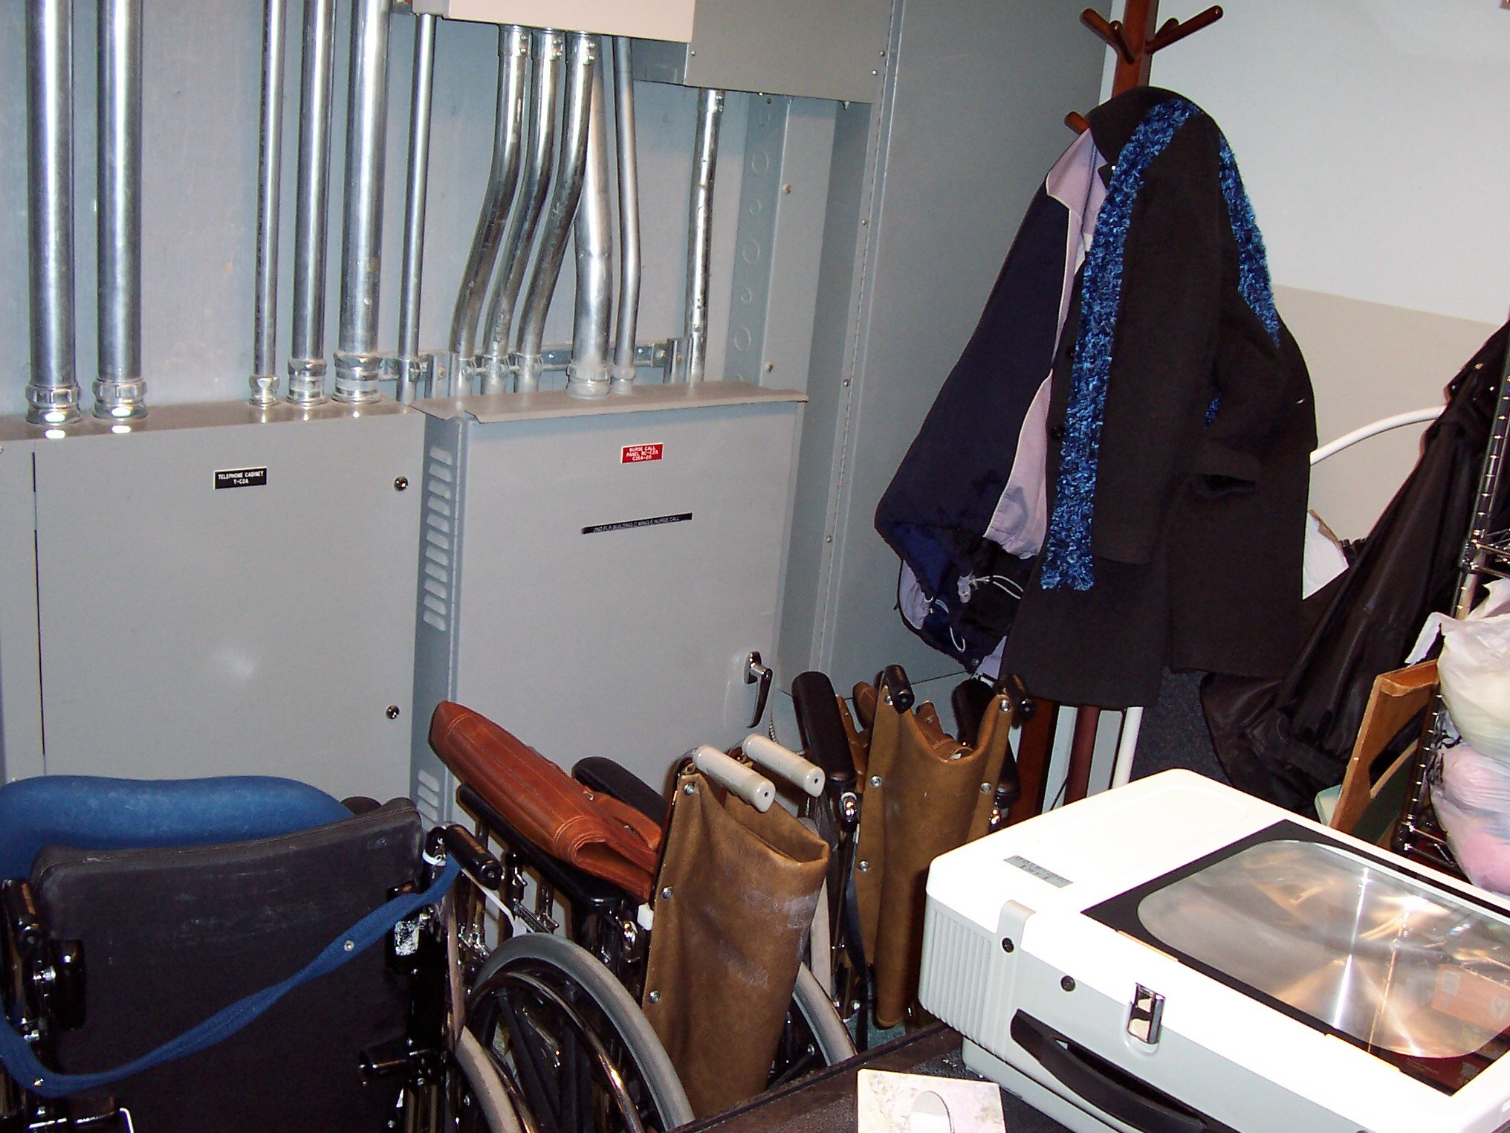
Blocked electrical panel access
Electrical Panels must have a 1 meter minimum clearance at all times

Slide 26
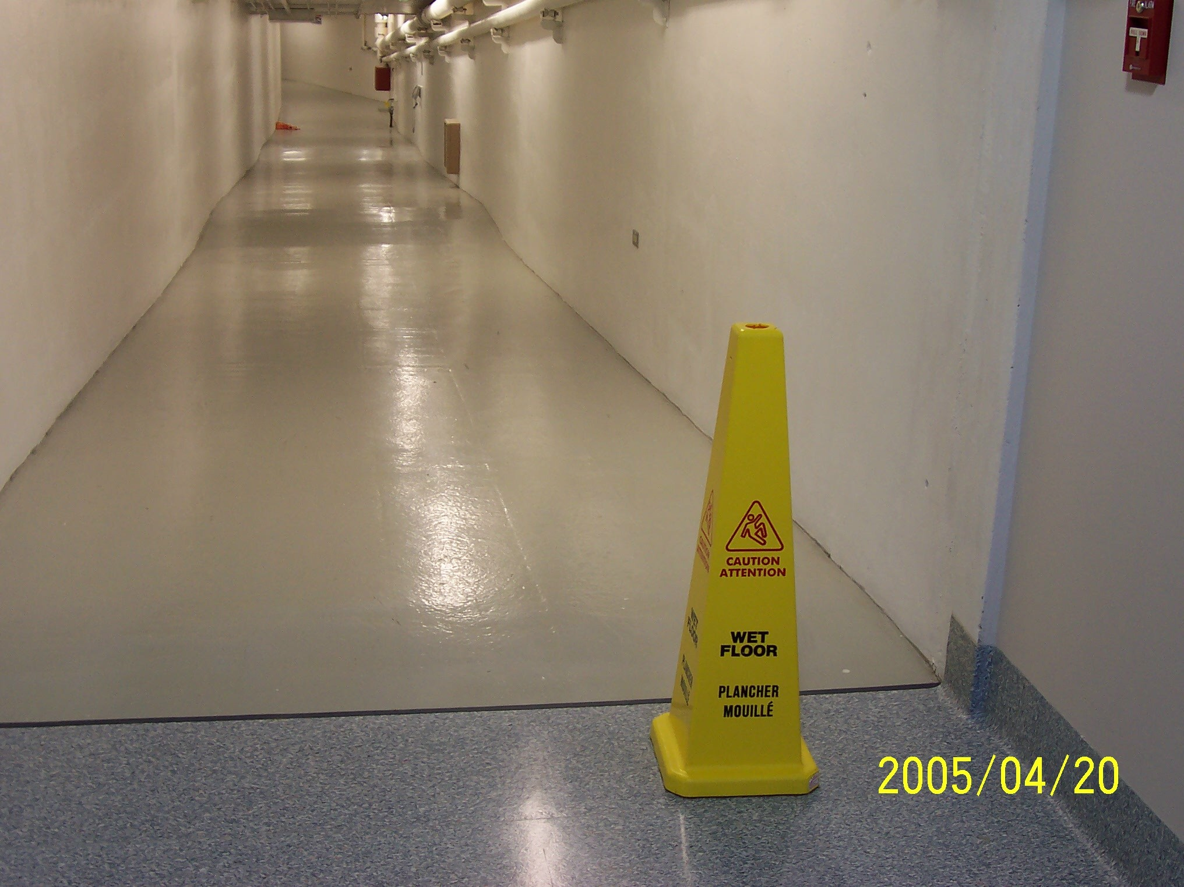
Slippery Floor

Slide 27
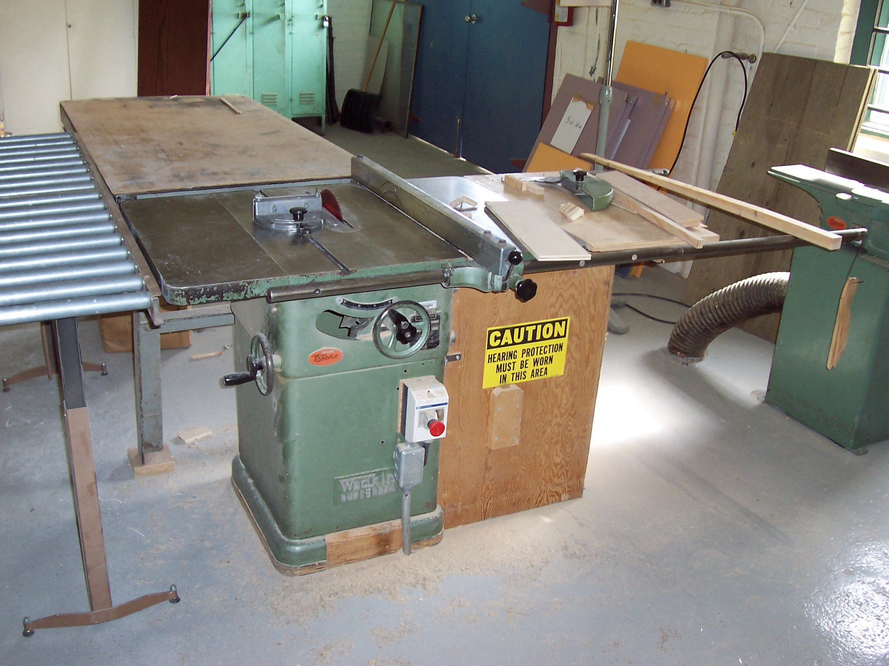
Missing Saw Guard

Slide 28
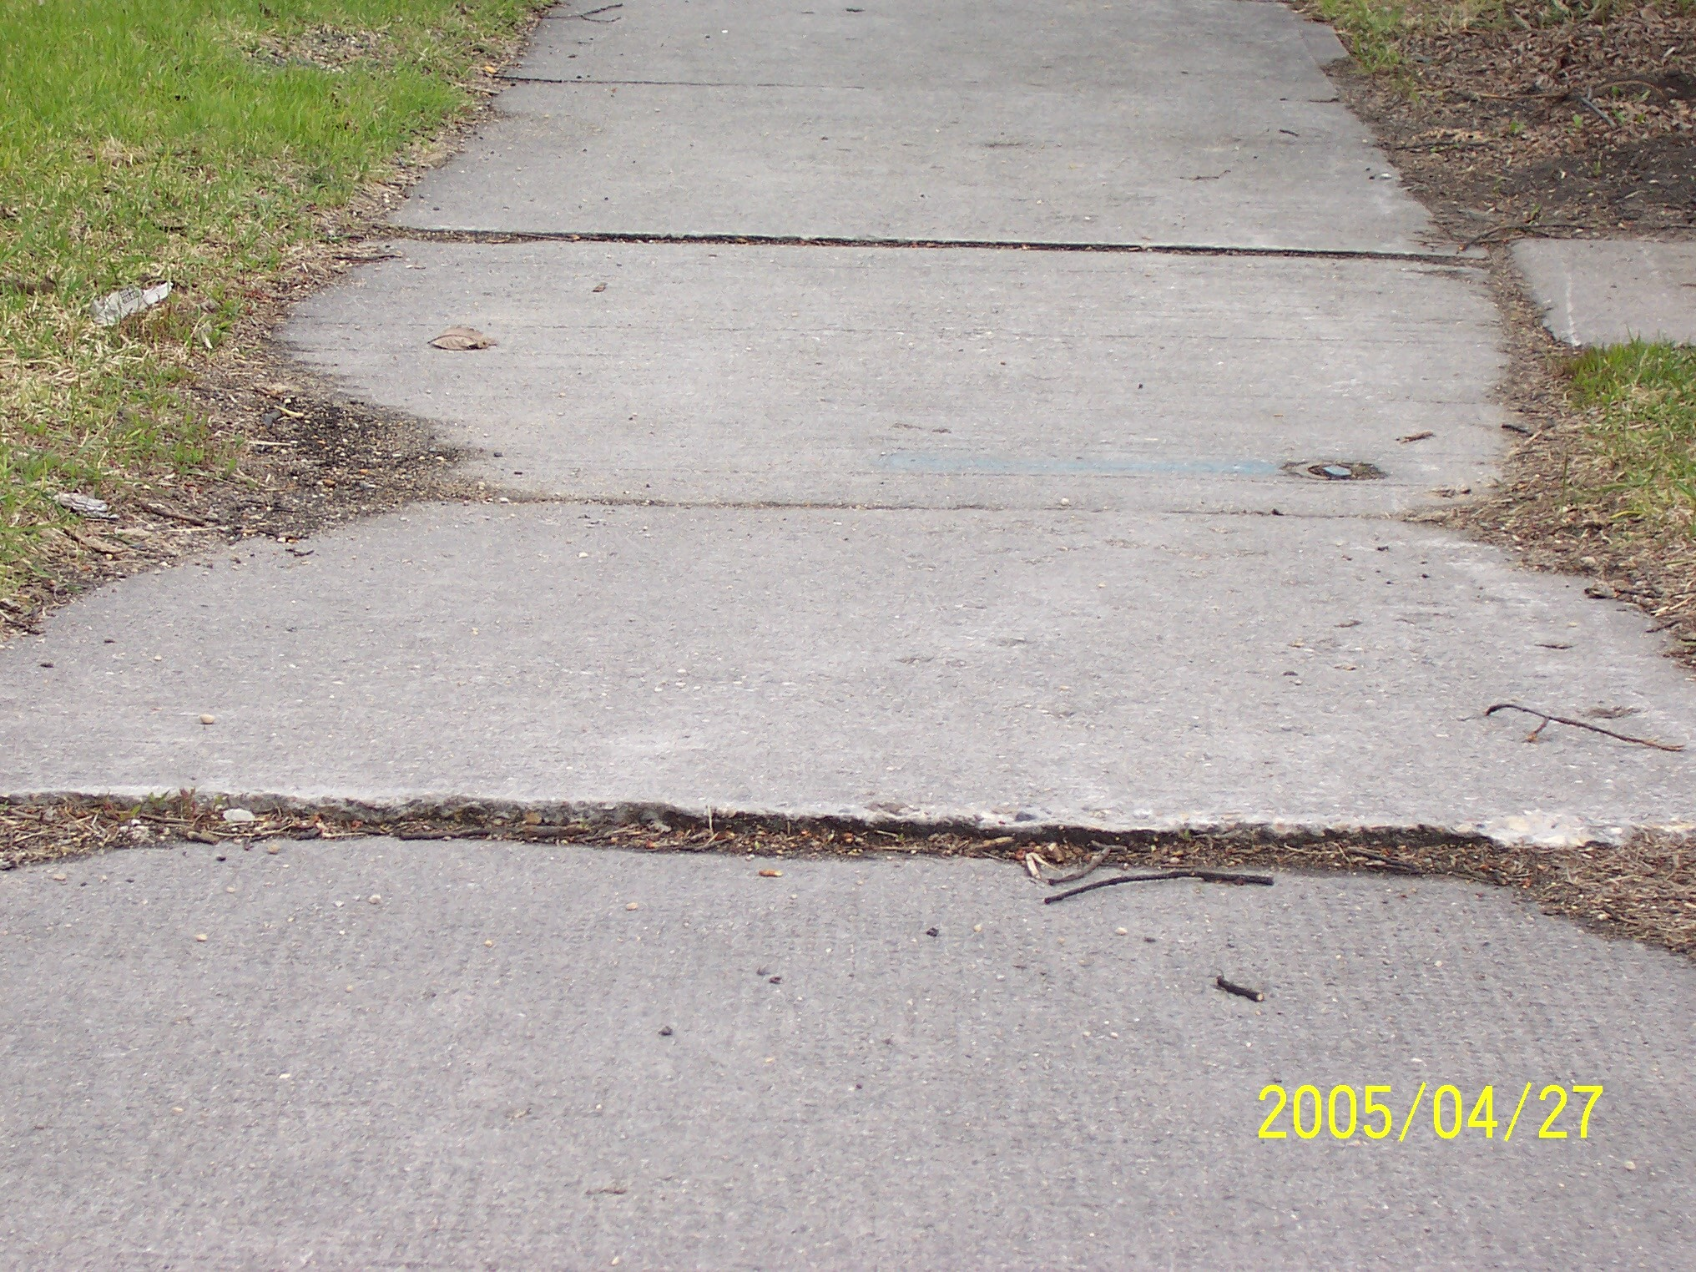
Uneven Sidewalk

Slide 29
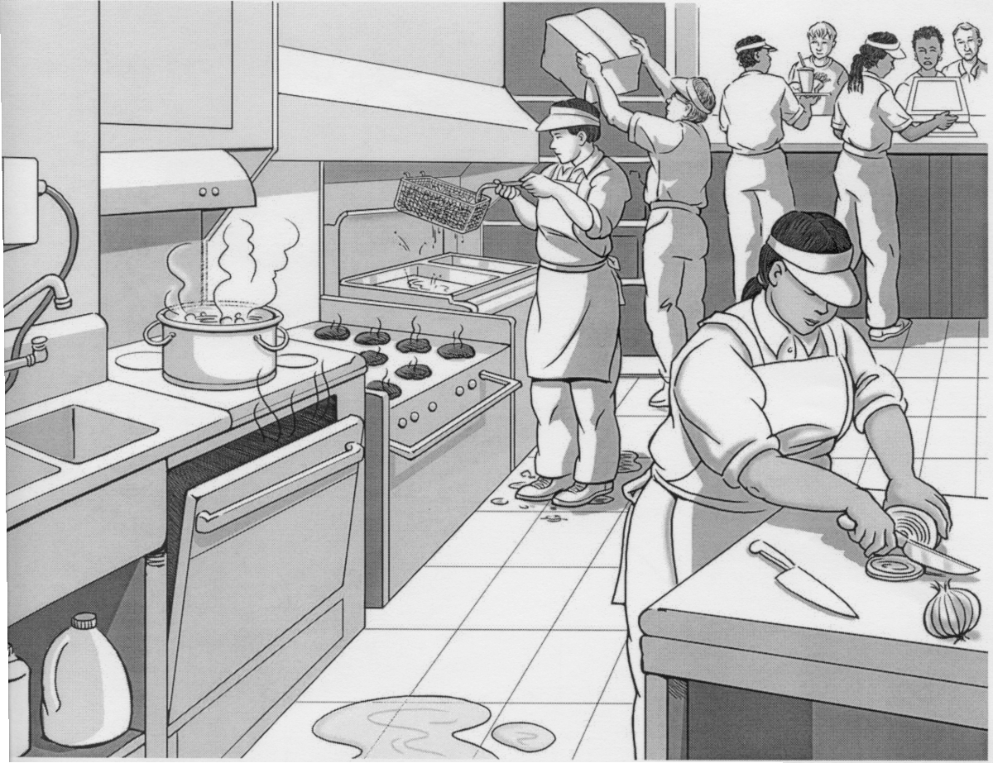
Find the Hazards
Lifting above shoulder
Gloves?
No Gloves
Pot boiling over
Too many burners on
Slippery surface
Cut resistant gloves ?
Labels?? Storage ??
Wet Floor

Slide 30
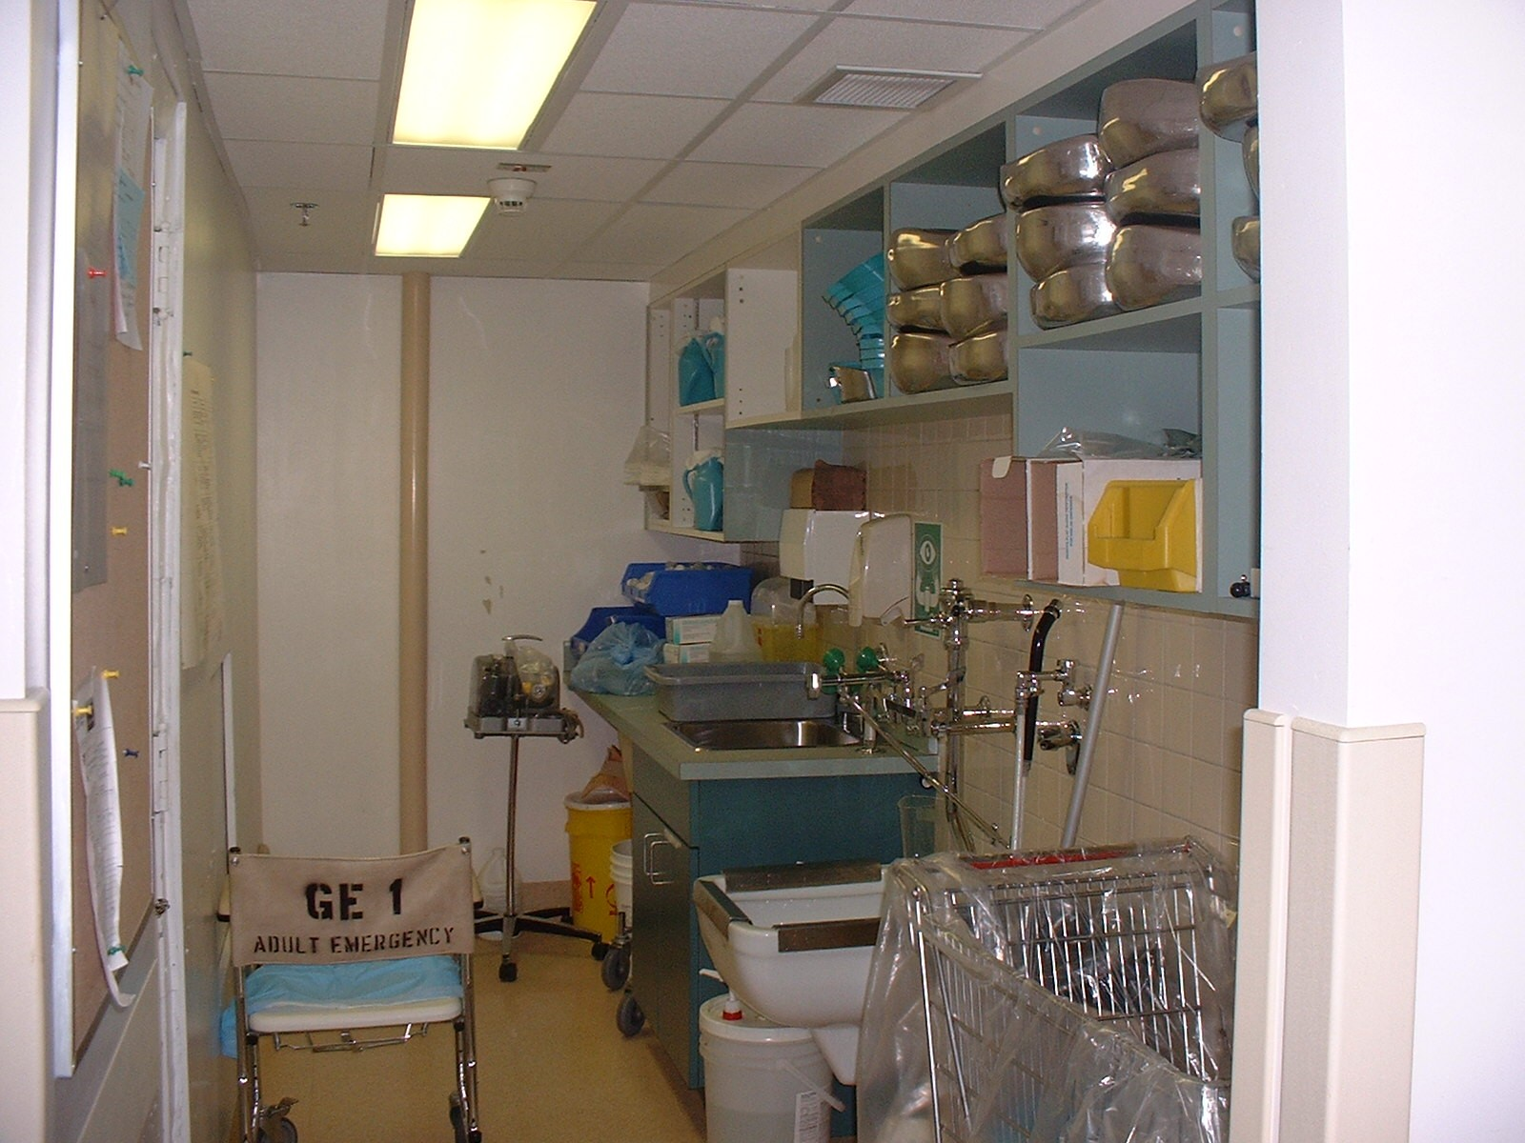
Find the Hazards
Access to material on shelf
Storage above shoulder height
Cluttered room
Cluttered Counter
Eyewash access
Opportunity to mix
clean with soiled
Unlabeled chemicals

Slide 31
Can we think of other hazards?
Fire Safety & Egress
Patient/Resident Aggression/Violence
Infectious Diseases
Needle stick Injuries
Handling of Medications (Cytotoxic Drugs)
Patient Handling
Manual Handling
Allergies (Latex)

Slide 32
Musculoskeletal Injuries

Slide 33
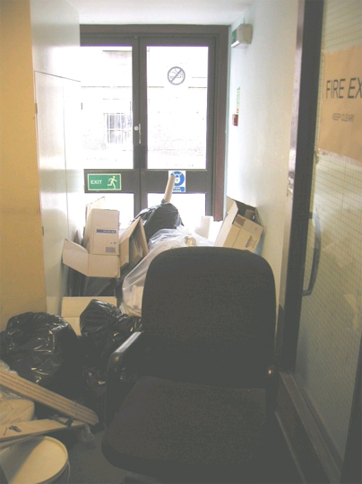
Fire Safety & Egress
Cluttered hallways, rooms
Electrical cords
Evacuations

Slide 34
Patient/Resident Aggression
Violence, Harassment and Aggressive Behaviours
Residents
Families
Visitors
Other employees
Notes:
Low staffing levels, high turnover rates, and stress.
Hazard of exposure to violent, confused or mentally unstable patients.
Dealing with combative, disoriented, uncooperative patients.
Mentally unstable patients, that are possibly dangerous.
Exposure to workplace violence in rooms not prepared for violent patients:
Moveable furniture that could be used as weapons, or to entrap employees.
Possible items on countertops that could be thrown at workers.

Slide 35
Infectious Diseases
Notes:
Tuberculosis
HIV
Hepatitis

Slide 36
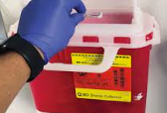
Needlestick Injuries
Notes:
Is this just nursing – what about laundry and housekeeping

Slide 37
Chemical Exposure

Slide 38
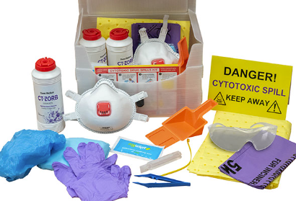
Handling of Cytotoxic Drugs
Notes:
Cytotoxic drugs include any drug that inhibits or prevents the function of cells. Cytotoxic drugs include drugs used to treat cancer and in some cases, to treat certain skin conditions (e.g., psoriasis).
Cytotoxic drugs are toxic compounds and are known to have carcinogenic, mutagenic and/or teratogenic potential. With direct contact they may cause irritation to the skin, eyes, and mucous membranes, and ulceration and necrosis of tissue. The toxicity of cytotoxic drugs dictates that the exposure of health-care personnel to these drugs should be minimized. At the same time, the requirement for maintenance of aseptic conditions must be satisfied.
Worker exposure occurs by inhalation of drug dust or aerosol, absorption through the skin, and ingestion through contact with
contaminated food, drink, or cigarettes. The aerosol is generated during the preparation or the administration of the drug, (e.g., while breaking open ampules, withdrawing needles from drug vials, transferring drugs with syringes, or expelling air from a drug-filled syringe). Such aerosol can result in exposing not only the worker immediately involved, but also exposing other people in the surrounding areas. Workers may also be exposed to cytotoxic drugs when they handle contaminated equipment and supplies.
During administration, clearing air from a syringe or infusion line and leakage at tubing, syringe, or stopcock connections should be avoided to prevent opportunities for accidental skin contact and aerosol generation. Dispose of syringes and unclipped needles into a leakproof and puncture-resistant container.
The disposal of cytotoxic drugs and trace contaminated materials (e.g., gloves, gowns, needles, syringes, vials) presents a possible source of exposure to pharmacists, nurses and physicians as well as to ancillary personnel, especially the housekeeping staff. Excreta from patients receiving cytotoxic drug therapy may contain high concentrations of the drug. All personnel should be aware of this source of potential exposure and should take appropriate precautions as established by your hospital or clinic to avoid accidental contact.

Slide 39
Patient Handling

Slide 40
Manual Handling

Slide 41
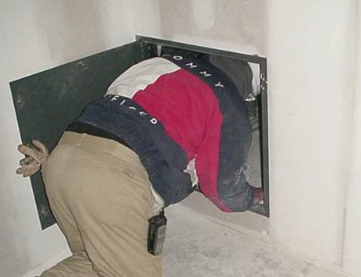
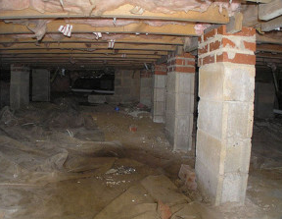
Confined Space

Slide 42
Fall Protection

Slide 43
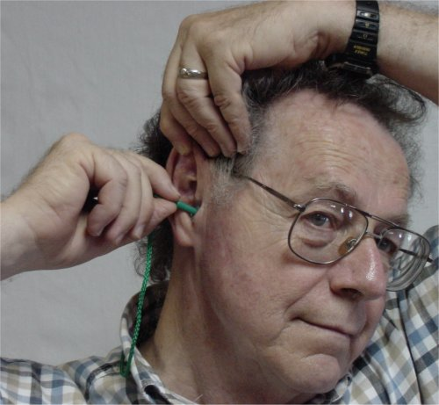
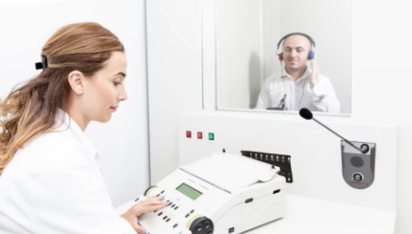
Hearing Conservation

Slide 44
Ergonomics

Slide 45
Machine Guarding

Slide 46
Latex Allergies
Notes:
Along with the increasing usage of latex gloves, there have been a rising number of reports of allergic reactions to latex, including some severe, immediate reactions. The more immediate reactions range from hives, runny nose and asthma to full intolerance of the gloves (e.g., a serious lowering of blood pressure and potentially anaphylactic shock).
Latex is a natural product, collected and concentrated from certain trees. The concentrated rubber latex is treated with additives in manufacturing latex gloves. The gloves are soaked in water to remove proteins present in latex, but some proteins remain in the final product. The proteins and additives can cause the skin reactions. They can also be adsorbed through the powders used in gloves. The proteins are thought to be responsible for the more severe, immediate reactions to the gloves. Persons allergic to additives in latex gloves can react to these chemicals in other natural rubber and non-rubber products, such as plastics, pesticides, oils, adhesives, bandages, tape and organic dyes.
Emergency and first aid equipment
Blood pressure cuffs
Stethoscopes
Oral and nasal airways
Endotracheal tubes
Tourniquets
Intravenous tubing
Syringes
Electrode pads
Adhesive tape
Ace bandages
Personal protective equipment
Gloves
Surgical masks
Goggles
Respirators
Rubber aprons
Office supplies
Rubber bands
Erasers
Hospital and other medical supplies
Anesthesia masks
Catheters
Wound drains
Injection ports
Rubber tops of multidose vials
Dental dams
Dental bite blocks
IV tubing

Slide 47
Tips on Workplace Inspections
Dealing with high-risk hazards:
These situations should be reported and dealt with immediately by the supervisor of the area before someone gets hurt.
Items identified with less risk can be addressed after the workplace inspection is completed.
Example - slip and fall hazards in moderate to high traffic areas are a good example of a high-risk hazard.

Slide 48
Tips on Workplace Inspections
Carefully inspecting high-risk areas:
When inspecting an area that has been identified as a high incident/accident risk it is important that:
The environment, machinery, and other equipment, and the work processes are observed carefully.
Observe the way the work is done, the work process and the physical environment.

Slide 49
Workplace Inspections
Ensuring that all areas are covered:
Include those that are not occupied by employees on a full-time basis. These areas may not be inspected as frequently.
Storage areas are a good example and often a common location of initial sources of fire.

Slide 50
Assess the Risk Potential
Consider
The seriousness or the potential harm
The probability of occurrence
How often and how long workers are exposed to the hazard
How well current control and systems are working

Slide 51
Risk Model
We can use a simple Risk Model to help determine the importance of a concern

Slide 52
Determining Risk
Risk models use three determinates:
Probability – how often could the hazard occur? (A function of how much and how often)
Severity - How much harm could the hazard pose?
Criticality – how badly can the hazard disrupt normal events?

Slide 53
Determining Probability
Determine the hazard to be one of the following:
Frequent – may occur in one year
Occasional – may occur over next 2 yrs.
Uncommon– may occur in 2 – 5 years
Remote – may occur in 5 – 30 years

Slide 54
Determining Severity
Determine severity to be one of the following:
Catastrophic – may cause death , major damage, large financial loss.
Major – may cause serious injury / illness, damage or financial loss
Moderate – may cause minimal injury / illness, damage or financial loss
Minor – will not cause injury / illness, damage or financial loss

Slide 55
Assigning a Risk Score
Probability | Severity of Effect
 |  | Catastrophic | Major | Moderate | Minor
 | Frequent | 16 | 12 | 8 | 4
 | Occasional | 12 | 9 | 6 | 3
 | Uncommon | 8 | 6 | 4 | 2
 | Remote | 4 | 3 | 2 | 1

Slide 56
Assigning a Risk Score
Probability | Severity of Effect
 |  | Catastrophic | Major | Moderate | Minor
 | Frequent | 16 | 12 | 8 | 4
 | Occasional | 12 | 9 | 6 | 3
 | Uncommon | 8 | 6 | 4 | 2
 | Remote | 4 | 3 | 2 | 1

Slide 57
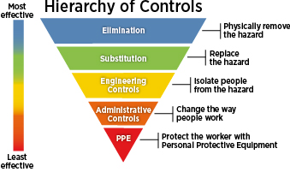
Control the Hazard
Remove the hazard at its source (eliminate hazard)
Control the hazard along its path to the workers
Control the hazard at the level of the worker

Slide 58
Eliminate the Hazard
Remove the hazard at its source
Choose a different process
Modify an existing process
Substitute with less hazardous substance.
Improve environment (ventilation)
Modify or change equipment or tools
Notes:
Redesign – containers to make them easier to hold and lift
Lighting, ventilation
Ergonomic design
Automation – e.g. food processors for chopping – may present different hazards which will need to be controlled.

Slide 59
Contain the Hazard
Control the hazard along the path to the worker
Machine Guarding
Worker Booths
Enclosures
Barriers
Dilution
Notes:
The further a control keeps a hazard away from workers, the more effective it is.

Slide 60
Controlling a Hazard at the Level of the Worker
Does not remove the risk posed by a hazard.
Reduce the risk of injury and lessens the potential of the seriousness of the injury.
The least effective method of hazard control.
Lessen exposure:
Use Work schedules which reduce the length of time exposed to hazard
Use of Personal Protective Equipment
Notes:
PPE does not eliminate the hazard therefore not as effective.
Can cause other hazards. Awkward or bulky PPE may prevent a worker from working safely.
It is the job of the employer, managers and supervisors to require workers to use PPE. Workers must be trained to use, store and care for their equipment properly.
Supervisors have the duty under the Act to ensure that PPE is used
Workers have the duty under the Act to use PPE
e.g. Training, supervision, safe work procedures, PPE
Workers must understand the limitations of their PPE
PPE should be treated as a condition of employment.

Slide 61
Short Term / Long Term Solutions
Sometimes it is not feasible to immediately remove a hazard.
Resources
Reasonable and practicable
In these cases a short term solution may be suggested with the goal of a long term solution instituted when possible.
Notes:
For example: noise exposure
Offer PPE’s – short term
Engineering controls – long term

Slide 62
Hints on Developing Solutions
Points in developing solutions
Focus on causes before solutions
Brainstorm range of possibilities
Look for short-term and long-term solutions – trying to find the best possible
Tips on Brainstorming
Set a time limit
Welcome all ideas & build on them
Record ideas and evaluate them
How to work towards agreement
Criticize ideas not individuals
Treat concerns seriously (show respect)
Try to understand differences & summarize various positions
Listen, clarify the facts
Find out what is agreed on

Slide 63
Corrective Action
State problem or problems
Suggest method and action
Ensure assignment of people to be responsible
Specify Target Date
Follow Up

Slide 64
Making Written Recommendations
Define the problem
Background Information
Solutions that relate directly to the problem
Reach a consensus among the committee
Forward to person who has authority to take action
Reference the time frame for response (30 days in detail and in writing)
Notes:
Include
Subject
date made
recommended time frame
Options
reasoning behind
Costs
Capital funding
Non Capital funding
Safety and Security Funding
Equipment Committee
Departmental Budget
Program Budget
time frame for response.

Slide 65
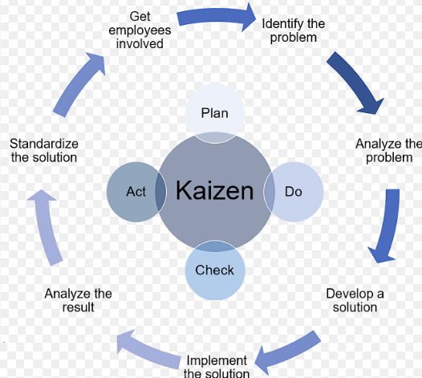

Slide 66
Contact OESH for further information.

