Slide 1
Manager’s toolkit for Success
WRHA Francophone Health

Slide 2
Welcome/Bienvenue
Leading employees in designated bilingual positions as well as supporting the delivery of services in both official languages are essential aspects of our organizational success.

Slide 3
Agenda and Overview
Mission, Vision, Values
Services provided by FrancophonHealth
Active Offer
Bilingual Positions
Job Postings
Language Testing
Conditions of Employment
Language Training
Tutoring
Compliance
Translations
Designated Bilingual Employee Expectations
My Right Care
WRHA Francophone Health Website

Slide 4
MISSION, VISION, VALUES
MANDATE
The mandate of Francophone Health is to assist the Winnipeg Health Region in promoting and providing health services in French in accordance with its FLS policies, the Government of Manitoba FLS Policy, and regulations established under the legislation governing the Regional Health Authorities of Manitoba.
VISION
The Winnipeg Health Region envisions a health care system in which designated bilingual or francophone facilities, programs, services and agencies ensure an active offer and effective delivery of services to Francophones in French.
MISSION
Providing leadership and support to enhance the effective delivery of health care services to Winnipeg’s francophone population.
VALUES
Dignity – as a reflection of the self-worth of every person
Care – as an unwavering expectation of every person
Respect – as a measure of the importance of every person
Equity – promote conditions in which every person can achieve their full health potential (or best health possible)
Accountability – as being held responsible for the decisions we make

Slide 5
Services provided by Francophone Health
Language Testing/Evaluations
Translation of public facing documents
Language Training and Workshop opportunities for WRHA employees
Rosetta Stone, tutoring and discussion groups to enhance employee French speaking skills
Support for Hiring Managers for Designated Bilingual Positions
Francophone Health Web Page with online learning links, dictionaries, lexicons etc.
Awareness, presentations and resources to internal/external stakeholders on the importance of services in both official languages and WRHA as an employer of choice.
Representation on various internal/external committees to ensure a Francophone lens.

Slide 6
Active Offer

Slide 7
Active Offer
What is an Active Offer?
An Active Offer is an open invitation to the public to use one of the two official languages. The public is confident from the very first point of contact that Health Services in French are available.
Services in French are clearly evident, readily available, visible and easily accessible at all times (whether they are delivered orally, in writing, or electronically) and of comparable quality to those offered in English, without the individual having to ask for them. It's a constant offer, based on a person-centered approach.

Slide 8
Why is an Active Offer important?
The objective of an Active Offer is to help overcome the language barriers faced by Francophones living in a minority context. It raises awareness that French Language Services are available. The francophone patient or client will:
Be able to express their symptoms more clearly, and to better understand the information that is presented to them.
Obtain a more accurate diagnoses
Benefit from reduced consultation time, number of tests and diagnostic errors
Be able to give informed consent to treatment
Better understand instructions and follow them more effectively
Feel more comfortable with their interaction with a health professional and their health care journey.
Health outcomes improve when we communicate with patients in their official language of choice and has a tangible impact not only on their health outcome but also their safety.
One of the most dangerous misconceptions is that if a patient speaks a little English, they can get by. Even francophones who can normally communicate in English may lose their ability during situations of stress or pain, or when they are under the influence of medication or are afflicted with symptoms of dementia.

Slide 9
Bilingual Positions
Significance of hiring employees into bilingual positions
It ensures effective communication with the patients, clients, residents. It promotes inclusivity, diversity and enhances our healthcare services.
Benefits of having staff proficient in both official languages
Patient care: The patients, clients, residents feel more comfortable and understood when they can communicate in their preferred language and there are more positive health outcomes.

Slide 10
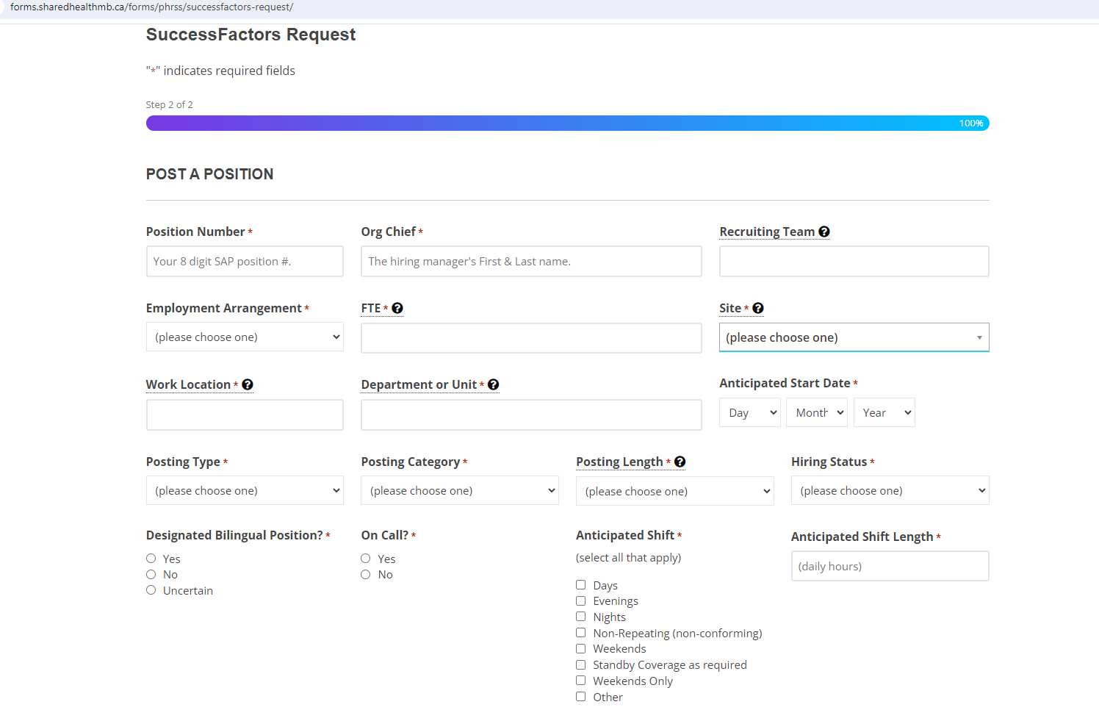
Job Postings
Forms.sharedhealthmb.ca/forms/phrss/successfactors-request/

Slide 11
Language Testing
A separate linguistic profile exists for each position outlining whether speaking, listening, reading and/or writing are required and at which level of proficiency.
If only oral testing is required, it can be done over the phone and takes approximately 10 - 15 minutes
Reading Comprehension test have a time allotment of – 30 minutes
Writing Test have a time allotment of – 60 minutes

Slide 12
Condition of employment
Removing time limit for condition of employment
Improvement Plan/Follow-up Testing
Language Training recommendations
Performance conversation component

Slide 13
Language Training
Language training is offered 3 times a year sponsored by Santé en français.
September to December
January to March
April to June
Classes are instructor led and offered through the St. Boniface University.
Classes are mostly virtual with some levels held in person
Employees pay $50 towards the cost of the course and Santé en français pays the remainder of the fees. The $50 fee may be refunded to the employee from your Employee Professional Development fund. A receipt will only be issued if the employee has attended the minimum required hours.
Employees must be employed in a designated bilingual position, or by a designated bilingual facility, program, service or agency.
Employees must have direct contact with patients, residents, clients or the public.
Employees must be committed to actively participate in a minimum of 24 of the 33 hours required per session
Parallel program funded by Francophone Health for employees in non-designated facilities.

Slide 14
Tutoring
Tutoring is available through St. Boniface University and arranged by Francophone Health.
Employees will be authorized by Francophone Health for a certain number of tutoring hours.
Employees schedule their own tutoring sessions with the tutor. Sessions will take place virtually at a mutually agreed upon time.
Tutoring sessions last 1 hour. The tutor will let the employee speak freely and correct them to the degree the employee chooses.

Slide 15
Compliance
Active Offer (performance conversations and mystery shops)
Via telephone including voice mail and in-person
Documentation – anything public facing
Signage – in public areas

Slide 16
Translation
Translations of regional information, as well as documents produced by designated facilities and programs, intended for the general public or clients / patients / residents and their families, as well as job postings and advertisements, are processed by WRHA Francophone Health.
Francophone Health do not translate your documents. Your requests are sent to an accredited translator.
An accredited translator has studied translation for several years. They can provide context specific translations, incorporating standardized vocabulary from the lexicon created by WRHA Francophone Health and understood by our clients. Their translations are concise and the context, content and grammar are correct.
NO – to computer aided translation tools!

Slide 17
Translation
To have a document translated, fill in the translation request form and send it to FLS@wrha.mb.ca
Documents must be in a final format and vetted to all those who need to modify or verify your document prior to sending it to Francophone Health to process.
Turnaround times are indicated on the form, and it is dependent on the word count of your document.
If your document is a Rush you must indicate it on the form. Documents accepted on a Rush format are time sensitive job postings and public health emergencies.
When sending in requests, the request form and documents to be translated must be in Word format. The odd exception can be made, but they will be dealt with on a case-by-case basis. A request form must accompany each document to be translated.
Once your document has been translated and sent back to Francophone Health, your document is reviewed for errors or omissions before it is sent back to you.
It is up to the client to complete the formatting of the documents.
Once documents have been formatted, you must send your document back to Francophone Health for a final review.

Slide 18
Designated Bilingual Employee Expectations
Wearing of bilingual identifier
Active Offer greeting with public and clients
Serving francophone clients in their language of choice
Bilingual voicemail
Bilingual E-mail signature
Bilingual Business Cards
Responses to emails in the chosen language of the recipient
Translation of documents intended for the public
Ensuring they maintain the level of French that is required for their position
If assistance with translation is needed for voicemail, e-mail signature or business card, please contact FLS@wrha.mb.ca.

Slide 19
Resource Kit for Managers
Translation Request Form
Testing Request Form
Recruitment Results Form
Maximize your French document
Maximize your English document

Slide 20
My Right Care
https://wrha.mb.ca/
Comment accéder aux services de santé en français à Winnipeg (wrha.mb.ca)

Slide 21
Websites
Francophone Health Website
https://professionals.wrha.mb.ca/francophone-health/
Linguistic Insecurities Website
Difference en français - Shared Health - Health Providers (sharedhealthmb.ca)

Slide 22
Next Steps
Provision of the appropriate tools to employees so that they succeed in their position.
Participation of Managers and Staff in Francophone Health workshops and initiatives.
Nomination of staff members who go the extra mile for the annual Health in French Excellence Award.

Slide 23
Questions or Comments?

Slide 24
Thank you
Thank you for your time and commitment. Your support will have a positive impact on care received by Francophones and their health outcomes.

