Slide 1
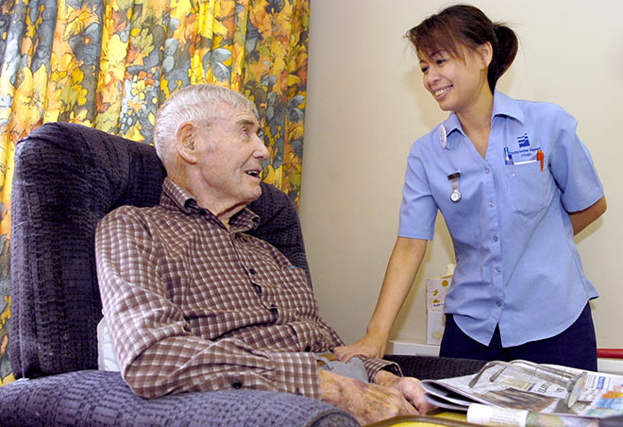
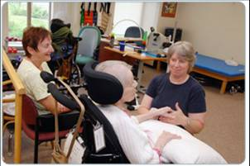
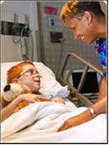
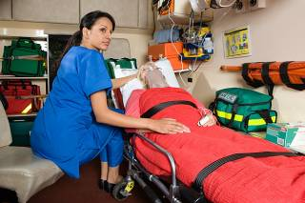
Point of Care Risk Assessment INTRODUCTION
Please note: the term “patient” refers to patients, residents and clients depending on the healthcare delivery setting.

Slide 2
Point of Care Risk Assessment Objectives
The Point of Care Risk Assessment (PCRA) empowers the Health Care Worker to decide what additional steps need to be taken to protect themselves, the patients they care for, and others in the environment. The PCRA is a tool for you to work safely.
Safe work allows you to provide care while preventing harm, and reducing risk, creating a healthy and safe environment for everyone!

Slide 3
Point of Care Risk Assessment INTRODUCTION
At the end of this learning module you will have the opportunity to test your knowledge by answering five multiple choice questions on PCRA.
Refer to the WRHA Infection Prevention and Control Manual for more information

Slide 4
Point of Care Risk Assessment WHAT IS PCRA?
A Point of Care Risk Assessment (PCRA) is:^{[4]}
Healthcare Worker (HCW)
Patient Environment
1. A Healthcare worker’s assessment of infection transmission risk:
during a specific interaction
with a specific patient
in a specific environment
under available conditions
2. The resulting choice of appropriate actions and/or personal protective equipment (PPE) to minimize risk to yourself, your patients and others in the environment.
INFECTION RISK

Slide 5
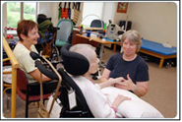
Point of Care Risk Assessment Who performs a Point of Care Assessment?
EVERYONE!
Anyone who interacts with patients or the patient environment needs to know about PCRA. This includes clinical and non-clinical staff in acute care, long term care and community settings.

Slide 6
Point of Care Risk Assessment When do you perform a Point of Care Risk Assessment?
Before every interaction with a patient or the patient environment. YOU will choose the appropriate actions/PPE to minimize the risk to you, your patient and others in the environment based on your assessment of infection transmission risk.

Slide 7
Point of Care Risk Assessment Performing a Point of Care Risk Assessment
To perform a PCRA consider infection transmission risk for the specific:
Interaction
Environment
Patient
Health Care Worker
To determine the appropriate actions/PPE to minimize the risk for yourself, your patient and others in the environment.

Slide 8
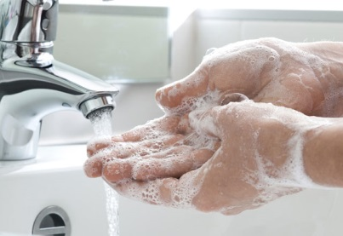
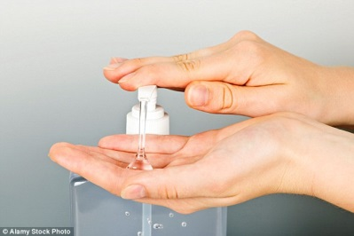
Point of Care Risk Assessment Interaction Scenarios
Scenarios of what to consider in your Assessment include:
1. THE INTERACTION
Will you have contact with the patient or their environment?
If so, perform hand hygiene before and after contact

Slide 9
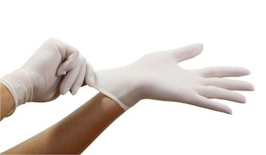
Point of Care Risk Assessment Interaction Scenarios
1.1. Interaction - Patient:
1.1.1. Establishing an intravenous
Is there a risk of contact with blood?
If so, perform hand hygiene and put on gloves before contact; take off gloves and perform hand hygiene after contact

Slide 10
Point of Care Risk Assessment Interaction Scenarios
1.1.2. Adjusting a patient’s face mask or oxygen tubing
Is there a risk of contact with secretions? If so:
perform hand hygiene and put on gloves before contact
take off gloves and perform hand hygiene after contact

Slide 11
Point of Care Risk Assessment Interaction Scenarios
1.1.3. Applying a bandage or dressing
Is there a risk of contact with non-intact skin?
If so, perform hand hygiene and put on gloves before contact; take off gloves and perform hand hygiene after contact

Slide 12
Point of Care Risk Assessment Interaction Scenarios
1.1.4. Transferring a patient
Will you have contact with the patient or their environment?
If so, perform hand hygiene before and after contact

Slide 13
Point of Care Risk Assessment Interaction Scenarios
1.2 Interaction – Patient Environment
1.2.1 Changing bed linens
Will you have contact with the patient environment?
If so, perform hand hygiene before and after contact

Slide 14
Point of Care Risk Assessment Interaction Scenarios
1.2.2 Disinfecting floors, patient rooms, treatment areas or client homes
Will you have contact with the patient environment?
If so, perform hand hygiene before and after contact

Slide 15
Point of Care Risk Assessment Interaction Scenarios
1.2.3 Touching computers or electronics in patient care areas
Will you have contact with the patient environment?
If so, perform hand hygiene before and after contact

Slide 16
Point of Care Risk Assessment Interaction Scenarios
1.2.4 Touching wheelchairs
Will you have contact with the patient environment?
If so, perform hand hygiene before and after contact

Slide 17
Point of Care Risk Assessment Interaction Scenarios
1.3 Interaction – Visibly Soiled Items/Surfaces
Will you have contact with visibly soiled or likely soiled items or surfaces?
If so:
Perform hand hygiene
If soiling of clothing is anticipated, put on a gown
Put on gloves before contact
Take off gown and gloves after contact
Perform hand hygiene

Slide 18
Point of Care Risk Assessment Interaction Scenarios
1.4 Interaction – Non-intact Skin
Is there a possibility of contact with non-intact skin, mucous membranes, body fluids or excretions?
If so:
Perform hand hygiene
If soiling of clothing is anticipated, put on a gown
Put on gloves before contact
Take off gown and gloves after contact
Perform hand hygiene

Slide 19
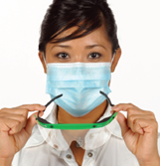
Point of Care Risk Assessment Interaction Scenarios
1.5 Interaction – Bodily Fluids
Are splashes or sprays of body fluids or excretions anticipated?
If so, before contact:
Perform hand hygiene
If soiling of clothing is anticipated, put on a gown
Put on a mask, eye protection and gloves
After contact:
Take off gloves and gown, perform hand hygiene
Take off eye protection then mask, perform hand hygiene

Slide 20
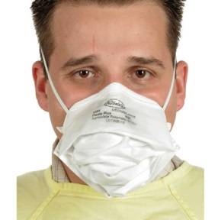
Point of Care Risk Assessment Interaction Scenarios
1.6. Interaction - Aerosols
Are aerosols likely to be generated? If so:
before contact:
Perform hand hygiene and put on a mask, or N95 respirator if indicated, and eye protection
after contact:
Take off eye protection and mask or N95 respirator
Perform hand hygiene

Slide 21
Point of Care Risk Assessment Patient Impact Scenarios
2. THE PATIENT - Factors affecting the extent of patient impact on their environment
2.1 Is the patient on Additional Precautions? If so:
Follow the infection control measures already identified for interactions with this patient
But remember: other control measures may be needed in addition to those already identified so don’t stop with someone else’s assessment!
If not:
Implement Additional Precautions as appropriate

Slide 22
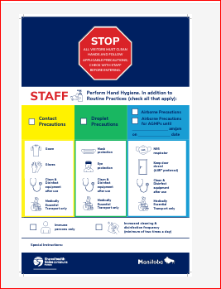
Point of Care Risk Assessment Patient Impact Scenarios

Slide 23
Point of Care Risk Assessment Patient Impact Scenarios

Slide 24
Point of Care Risk Assessment Patient Impact Scenarios

Slide 25
Point of Care Risk Assessment Patient Impact Scenarios

Slide 26
Point of Care Risk Assessment Patient Impact Scenarios
Continue to consider factors that must always be considered such as:
2.2. Patient - Coughing
Is the patient coughing? If so:
Anyone within 2 metres of the patient may be at risk of splashes or sprays
Offer the patient a procedure or surgical mask when not isolated in their room/bedspace

Slide 27
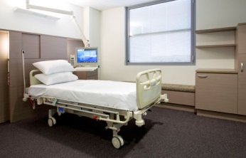
Point of Care Risk Assessment Patient Impact Scenarios
2.3. Patient – Diarrhea/uncontained stool/wound drainage
Does the patient have diarrhea or uncontained stool or wound drainage?
If so, there is a risk of spreading germs to the environment
Give the patient priority for a single room
Implement Contact Precautions if needed

Slide 28
Point of Care Risk Assessment Patient Impact Scenarios
2.4. Patient – Active Infection
Does the patient have an active infection?
If so, there is a risk of spreading germs
Treat active infection
Consider implementing appropriate Additional Precautions

Slide 29
Point of Care Risk Assessment Patient Impact Scenarios
2.5. Patient – Symptomatic
Is the patient symptomatic for specific suspected or confirmed diseases?
If so, there is a risk of spreading germs
Restrict movement within the specific patient care area/facility as appropriate
Consider implementing appropriate Additional Precautions

Slide 30
Point of Care Risk Assessment Patient Impact Scenarios
2.6. Patient – Immune Status
What is the patient’s immune status?
Consider potential exposure to infections such as measles, mumps, rubella, varicella in the priority for single rooms or for roommate selection
Refer to the WRHA Infection Prevention and Control Manual for specific disease information

Slide 31
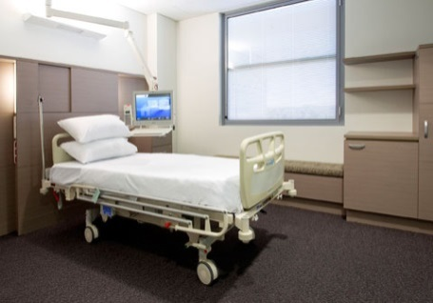
Point of Care Risk Assessment Patient Impact Scenarios
2.7. Patient – Hand Hygiene
Is the patient willing and able to perform hand hygiene?
Consider the priority for single rooms or for roommate selection

Slide 32
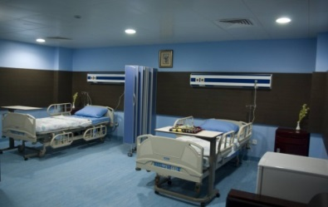
Point of Care Risk Assessment Environmental Scenarios
THE ENVIRONMENT
3.1. Is the patient in a shared room / treatment space?
If so:
Consider the space within the patient curtains as the patient’s environment
Perform a Point of Care Risk Assessment before every interaction within the patient curtains

Slide 33
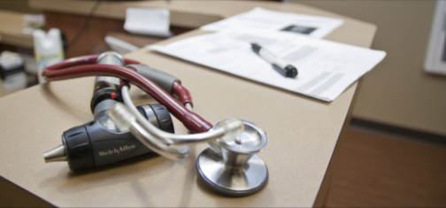
Point of Care Risk Assessment Environmental Scenarios
3.2. Environment – Non-critical Equipment
Is there is a risk of spreading germs from the environment?
Clean non-critical patient care equipment and the patient environment

Slide 34
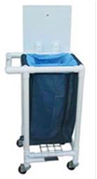
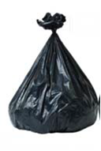
Point of Care Risk Assessment Environmental Scenarios
3.3. Linen and waste
Is there a risk of contact with body fluids?
Handle linen and waste according to facility/program policy and procedures

Slide 35
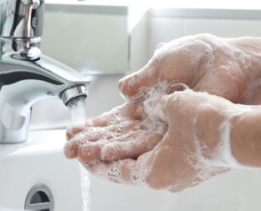
Point of Care Risk Assessment Environmental Scenarios
3.4. Handling specimens
Is there a risk of contact with body fluids?
If so:
Perform hand hygiene and put on gloves before contact
Take off gloves and perform hand hygiene and after contact

Slide 36
Point of Care Risk Assessment Environmental Scenarios
3.5. Leaving the patient environment?
If so, there is a risk of spreading germs to other areas
Perform hand hygiene before leaving the patient environment

Slide 37
Point of Care Risk Assessment Available Conditions Scenarios
4. HEALTH CARE WORKERS – SKILL SET
4.1. Consider the skill set of the HCW
Does the HCW have the knowledge and ability to perform the task without increasing the risk of infection transmission?
HCW to seek education and resources as required.
Assign the most experienced HCW when appropriate.

Slide 38
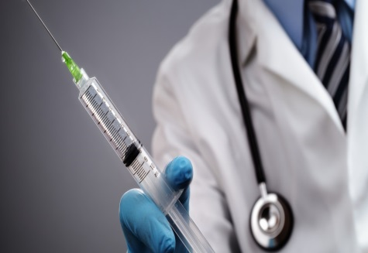
Point of Care Risk Assessment Available Conditions Scenarios
4.2. Health Care Workers - Immune Status
Is there a risk of exposure to specific infections (e.g. measles, mumps, rubella, varicella)?
If so, assign an immune HCW when possible.

Slide 39
Point of Care Risk Assessment Resource & References
Point of Care Risk Assessment in Routine Practices of the WRHA Acute Care IP&C Manual
The Canadian Centre for Occupational Health and Safety (CCOHS) Vision. Available at: http://www.ccohs.ca/ccohs.html.
ROUTINE PRACTICES AND ADDITIONAL PRECAUTIONS ASSESSMENT AND EDUCATIONAL TOOLS9 | PART I — ROUTINE PRACTICES TOOL SET. (2013). Public Health Agency of Canada. Available at: http://www.ipac-canada.org/pdf/2013_PHAC-RPAP_Tools_eng.pdf.
Routine Practices and Additional Precautions: Preventing the Transmission of Infection in Health Care. (2012 April). Manitoba Health. Available at: http://www.gov.mb.ca/health/publichealth/cdc/docs/ipc/rpap.pdf.

Slide 40
Point of Care Risk Assessment QUIZ
1. A Point of Care Risk Assessment (PCRA) is:
The Infection Control Professional’s assessment of infection transmission risk
The healthcare worker’s assessment of infection transmission risk
The manager or supervisor’s assessment of infection transmission risk
None of the above
2. If aerosols are anticipated, before contact:
Perform hand hygiene; put on eye protection and gloves
Perform hand hygiene; put on the appropriate mask or respirator and eye protection
Perform hand hygiene; put on eye protection and put on gown if soiling of clothing is likely, put on gloves
Perform hand hygiene; put on the appropriate mask or respirator

Slide 41
Point of Care Risk Assessment QUIZ
3. If contact with non-intact skin, mucous membranes, body fluids, excretions or visibly
soiled items is anticipated, before contact:
Perform hand hygiene; put on gloves, a gown, eye protection and a procedure or surgical mask
Put on gloves and put on a gown if soiling of clothing is likely
Perform hand hygiene; put on a gown if soiling of clothing is likely; put on gloves
Perform hand hygiene; put on a gown if soiling of clothing is likely and put on gloves and eye protection
4. If contact with a patient or their environment is anticipated, before contact:
Put on PPE as indicated
Perform hand hygiene and put on PPE as indicated
None of the above

Slide 42
Point of Care Risk Assessment QUIZ
5. If splashes or sprays of body fluids or excretions are anticipated, before contact:
Perform hand hygiene; put on a mask and eye protection
Perform hand hygiene; put on gloves and eye protection
Perform hand hygiene; put on a gown, mask, eye protection and gloves
None of the above
6. During a Point of Care Risk Assessment (PCRA), consider if contact with the following is
anticipated:
The patient or their environment
Non-intact skin, mucous membranes, body fluids, excretions or visibly soiled items
Splashes or sprays of body fluids or excretions
All of the above

Slide 43
Point of Care Risk Assessment QUIZ
7. A Point of Care Risk Assessment (PCRA) is the healthcare worker’s assessment of
infection transmission risk:
During a specific interaction with a specific patient
In a specific environment
Under available conditions
All of the above
8. When caring for a person with a fever, cough and runny nose, healthcare workers wear:
A procedure or surgical mask
Gloves and a yellow isolation gown
Eye protection
All of the above

Slide 44
Point of Care Risk Assessment QUIZ
9. To touch a walker, healthcare workers, before contact:
Perform hand hygiene
Perform hand hygiene and put on gloves
Perform hand hygiene and put on gloves and a gown
10. To care for a person at risk for tuberculosis with cough, fever, unexplained weight loss, a healthcare worker wears:
Eye protection
An N95 respirator
Gloves and a yellow isolation gown
All of the above

Slide 45
Point of Care Risk Assessment QUIZ
11. To care for a person with fever and rash suspected to be Chicken Pox, a susceptible
healthcare worker wears:
a) A procedure or surgical mask
b) An N95 respirator
c) Gloves and a yellow isolation gown
d) A and C
e) B and C
12. To care for a person suspected of having Meningitis, a susceptible healthcare worker
wears:
A procedure or surgical mask and eye protection
An N95 respirator and eye protection
A procedure or surgical mask, eye protection, gloves and a yellow isolation gown
An N95 respirator, eye protection, gloves and a yellow isolation gown

Slide 46
Point of Care Risk Assessment
1. A Point of Care Risk Assessment (PCRA) is:
b) The healthcare worker’s assessment of infection transmission risk
2. If aerosols are anticipated, before contact:
Perform hand hygiene; put on the appropriate mask or respirator and eye protection
3. If contact with non-intact skin, mucous membranes, body fluids, excretions or visibly
soiled items is anticipated, before contact:
c) Perform hand hygiene; put on a gown if soiling of clothing is likely; put on gloves
4. If contact with a patient or their environment is anticipated, before contact:
b) Perform hand hygiene and put on PPE as indicated

Slide 47
Point of Care Risk Assessment
5. If splashes or sprays of body fluids or excretions are anticipated, before contact:
c) Perform hand hygiene; put on a gown, mask, eye protection and gloves
6. During a Point of Care Risk Assessment (PCRA), consider if contact with the following is
anticipated:
d) All of the above
7. A Point of Care Risk Assessment (PCRA) is the healthcare worker’s assessment of
infection transmission risk:
d) All of the above
8. When caring for a person with a fever, cough and runny nose, healthcare workers wear:
d) All of the above

Slide 48
Point of Care Risk Assessment
9. To touch a walker, healthcare workers, before contact:
Perform hand hygiene
10. To care for a person at risk for tuberculosis with cough, fever, unexplained weight loss, a healthcare worker wears:
An N95 respirator
11. To care for a person with fever and rash suspected to be Chicken Pox, a susceptible healthcare worker wears:
e) B and C
12. To care for a person suspected of having Meningitis, a susceptible healthcare worker wears:
A procedure or surgical mask and eye protection

