Slide 1
Welcome to the Routine Practices Learning Module
Infection Prevention & Control

Slide 2
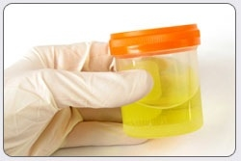
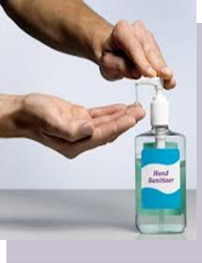
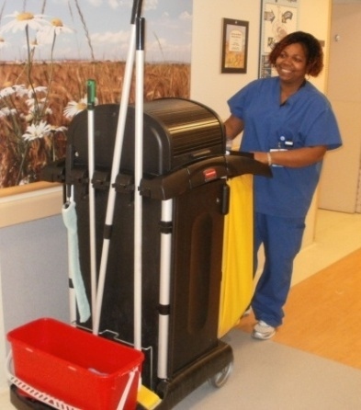
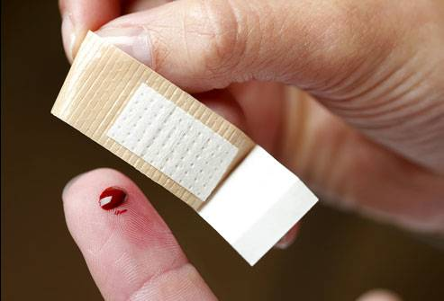
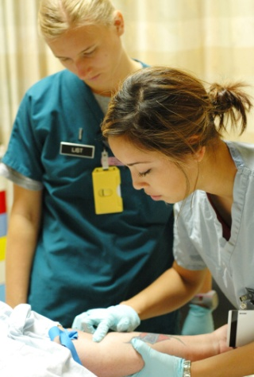
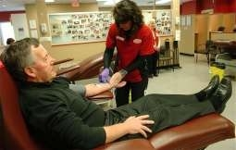
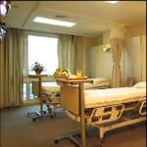
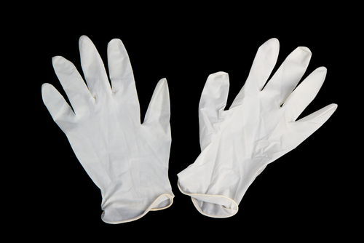
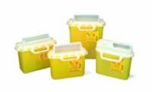
Routine Practices WRHA Infection Prevention & Control

Slide 3
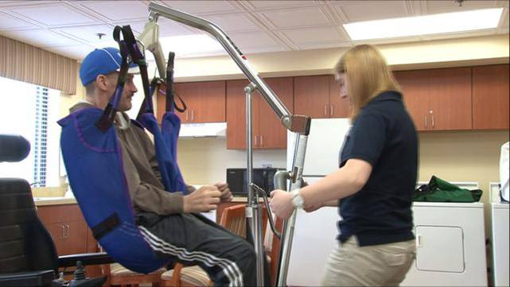
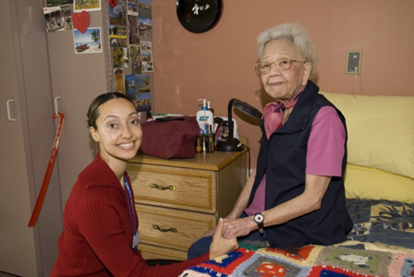
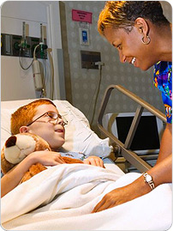
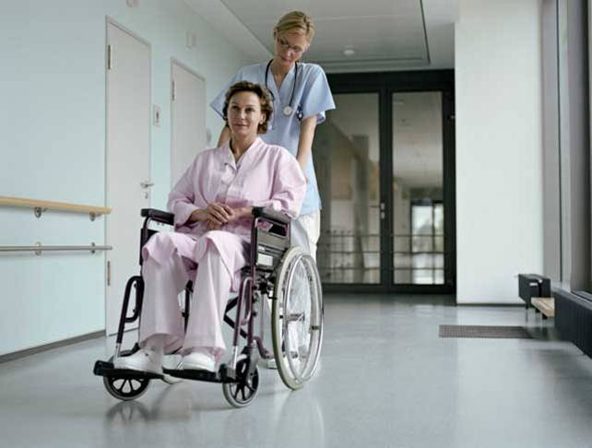
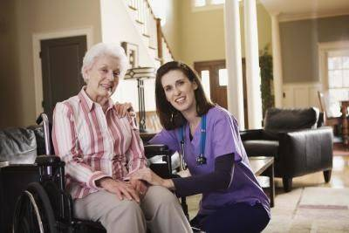
This Routine Practices PowerPoint presentation is intended to provide staff working in acute care, long term care and community settings with basic Infection Prevention & Control (IP&C) information. ALL STAFF need to know Routine Practices regardless of work setting
* The word “patient” will be used to indicate patient, resident, or client.

Slide 4
Routine Practices
The following Educational Modules must be completed to meet your educational requirements for these elements of Routine Practices:
Hand Hygiene
Personal Protective Equipment
Point of Care Risk Assessment (PCRA)
Management of the Health Care Environment
AND
Source Control
Whether you are a presenter or using this PowerPoint for self study the speaker notes must be reviewed
This PowerPoint should take about 20 minutes to review

Slide 5
Routine Practices What are they? ROUTINE PRACTICES include:
Point of Care Risk Assessment (PCRA)
Hand Hygiene
Source Control
Patient accommodations/ placement/flow
Aseptic Technique
Personal Protective Equipment (PPE)
Specimen Collection
Sharps safety and prevention of bloodborne transmission
Management of patient environment
Visitor management and education

Slide 6
Routine Practices What Are They?
Routine Practices are basic infection prevention and control measures expected for the care of all patients at all times in any healthcare setting
Consistently following Routine Practices reduces the risk of transmission of germs
Notes:
Routine Practices recognize germs are always present and can be transmitted from one person to another either directly or indirectly

Slide 7
Routine Practices Why use them?
About 220,000 Canadians (or one patient in nine) admitted to hospital every year get a healthcare associated infection (HAI) as a consequence of their hospital stay
8,000 patients die annually from these infections (about the same number of annual deaths as those from breast cancer and motor vehicle accidents)
Notes:
HAIs are not the fourth leading cause of death in Canadians after cancer, heart disease and stroke

Slide 8
The Chain of Infection
GERM (infectious agent)
HOW GERMS GET AROUND
(means of transmission)
HOW GERMS GET IN
(portals of entry)
NEXT SICK PERSON (susceptible host)
WHERE GERMS LIVE (reservoir)
HOW GERMS GET OUT (portal of exit)
Notes:
Infectious agents spread from a reservoir out of a portal of exit through various means of transmission
They gain access through a portal of entry to a susceptible host where colonization or infections can occur

Slide 9
Definitions
Infectious agent: A germ able to cause infection e.g., bacteria, fungi, virus, parasite
Reservoir: The place where infectious agents live or grow e.g., a person, animal and/or object
Portal of Exit: The way the infectious agent leaves the reservoir e.g., sneezing, wound discharge, bowel
Means of Transmission: The way the infectious agent is spread from one place to another e.g., direct contact, indirect contact, droplet, airborne, common vehicle and vector borne
Portal of Entry: The way the infectious agent gets into a person or animal e.g., the nose, mouth, breaks in the skin, breathing
Susceptible Host: Anyone who is not immune to the infectious agent

Slide 10
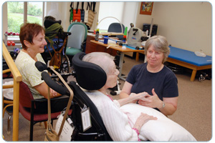
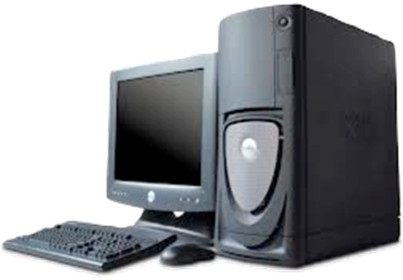
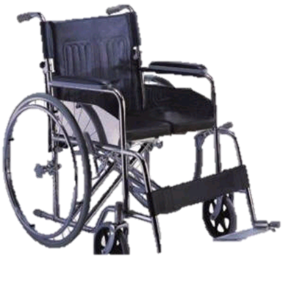
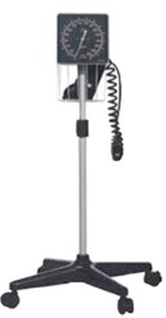
Means of Transmission (How Infections Travel)
DIRECT CONTACT
The most common means of transmission
Occurs when germs are spread by direct physical contact from an infected or colonized person
INDIRECT CONTACT
Occurs when germs are spread by an object or intermediate person

Slide 11
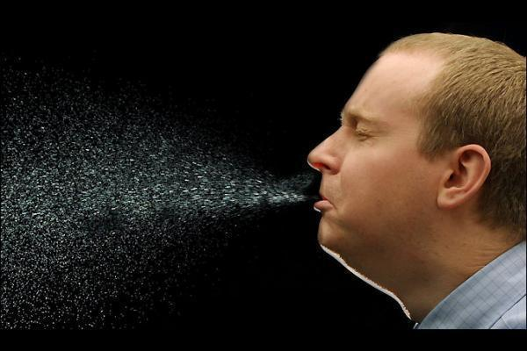
Means of Transmission (How Infections Travel)
DROPLERT TRANSMISSION
Occurs when droplets from an infected person travel a short distance (2 metres/6 feet) through the air and enter a susceptible host
AIRBORNE TRANSMISSION
Occurs when germs are spread by dust or air particles and breathed in by a susceptible host
Notes:
Droplets do not remain suspended in the air, however, environmental surfaces or object may become contaminated by droplets. Coughing and sneezing produce droplets
Airborne transmission: these germs can remain in the air and moved by air currents

Slide 12
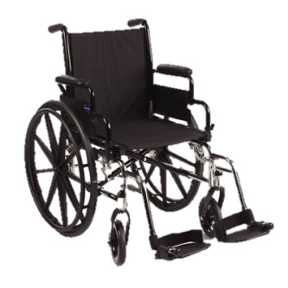
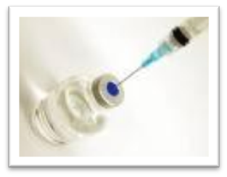
Means of Transmission (How Infections Travel)
COMMON VEHICLE TRANSMISSION
Occurs when a single contaminated source spread germs to multiple susceptible hosts
Examples of common vehicles include contaminated food, medication, water or equipment

Slide 13
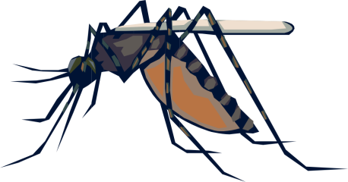
Means of Transmission (How Infections Travel)
VECTOR BORNE TRANSMISSION
Occurs when an insect or animal carries the germs to a susceptible host
Common vectors include mosquitoes, which, for example can carry West Nile virus

Slide 14
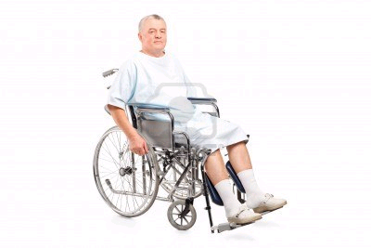
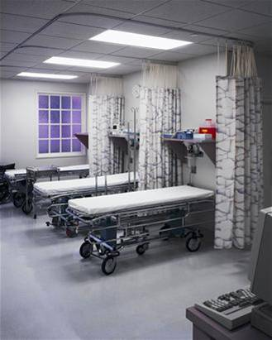
Point of Care Risk Assessment (PCRA)
The PCRA is an evaluation of risk factors related to the contact between:
Healthcare worker (HCW)
Patient
Their environment
A PCRA must be done with:
EVERY TASK!
EVERY PATIENT!
EVERY WHERE!
Notes:
Perform a PCRA before each patient interaction
A PCRA assesses the potential for exposure to germs

Slide 15
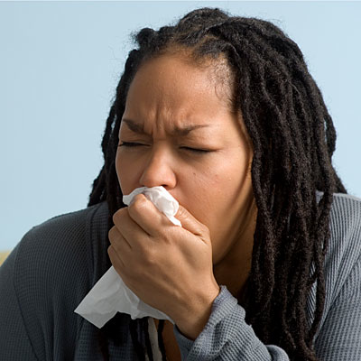
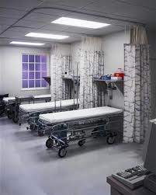
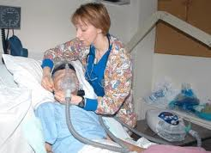
Point of Care Risk Assessment (PCRA)
PCRA is performed when a HCW evaluates a patient and situation
PCRA
EVERY TASK!
EVERY PATIENT!
EVERY WHERE!
Notes:
PCRA includes but is not limited to:
Exposure to blood and body fluids
Need for Additional Precautions
Need for a single/shared accommodation
Strategies to reduce aerosol generation during medical procedures

Slide 16
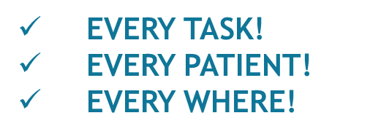
Point of Care Risk Assessment (PCRA)
To perform a PCRA consider the following:
Type of contact with the patient
PCRA
Notes:
CONSIDER:
Type of task/procedure to be performed
Risk of splashes or sprays
Presence of diarrhea or incontinence
Can patient perform hand hygiene
Is patient in a shared room/treatment area

Slide 17
Point of Care Risk Assessment (PCRA)
After completing the PCRA, the HCW will use the following control measures:
Hand hygiene
PPE
Cleaning of non-critical patient equipment
Strategies to reduce aerosol generation during medical procedure
Appropriate patient placement
PCRA
EVERY TASK!
EVERY PATIENT!
EVERY WHERE!

Slide 18
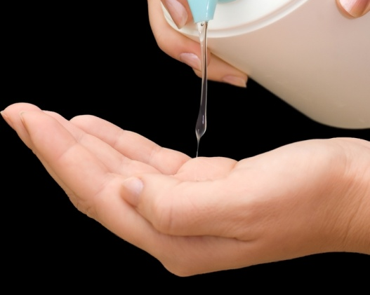
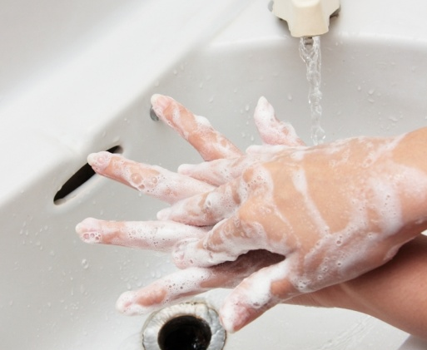
HAND HYGIENE
The educational module on Hand Hygiene must be completed to meet your educational requirements for this element of Routine Practices
Hand hygiene is the most important way to prevent the spread of germs. It reduces the number of microorganisms on the hands.
Hand hygiene involves cleaning of hands with either soap and water or alcohol-based hand rub
Notes:
The evidence supporting the effectiveness of hand hygiene is overwhelming

Slide 19
HAND HYGIENE
15 seconds: it’s all the time that’s needed to destroy almost all potentially harmful germs
While most healthcare providers believe they are already practicing appropriate hand hygiene, our WRHA hand hygiene rates show, on average, compliance is 40 – 70%

Slide 20
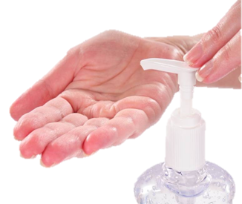
Hand Rubs vs. Soap & Water
Alcohol-based hand rub is the recommended method of hand hygiene in any healthcare setting when hands are not visibly soiled
Alcohol-based hand rub SHOULD NOT be used when hands are visibly soiled
Notes:
Wash hands with soap and water when hands are visibly soiled

Slide 21
Alcohol Based Hand Rub Safety
Alcohol based hand rub (AHHR) is at least 60% ethyl alcohol, or ethanol (equal to 120 proof). To compare, a bottle of vodka is 80 proof
Ingesting small of ABHR can produce the same side effects as consuming large amounts of alcohol
Headache, dizziness, drowsiness, incoordination, nausea, slowed reaction time, slurred speech, giddiness, and unconsciousness
Consumption of ABHR can also result in:
Brain, liver, and kidney damage (from long-term use)
Toxic ethanol levels

Slide 22
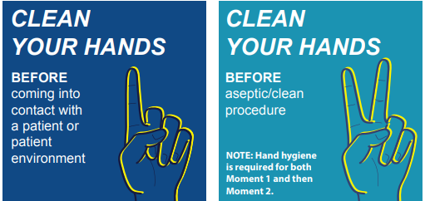
4 Moments of Hand Hygiene
Notes:
Step 1 examples:
Before entering patient care environments
Before entering the patient treatment or exam room or home
Before touching patient
Before touching any objects or furniture in the patient environment, e.g bed, wheelchair, adjusting IV
Step 2 examples:
Immediately before any aseptic/clean procedure
Performing invasive procedures
Handling dressings or touching open wounds
Preparing and administering medications
Preparing, handling, serving or eating foods
Feeding a patient
Shifts and breaks

Slide 23
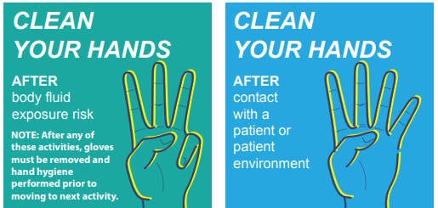
4 Moments of Hand Hygiene
Notes:
Step 3 examples:
Contact with blood and body fluids, non-intact skin and/or mucous membranes
Contact with contaminated item
Procedures on the same patient where soiling of hands is likely
Oral care, wound care, patient toileting
Removal of gloves
Personal use of toilet or wiping of nose/face
Feeding patient
Before and after shifts and breaks
Step 4 examples:
When leaving the patient or their environment
After touching a patient
After touching any object or furniture in patient’s environment

Slide 24
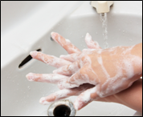
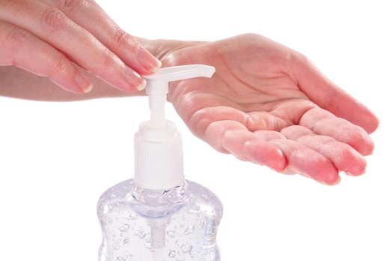
4 Moments of Hand Hygiene
Point of Care (POC)
Refers to the place where 3 elements meet
Patient
HCW
Care potentially involving contact is taking place
Hand hygiene product needs to be accessible as close as possible to patient

Slide 25
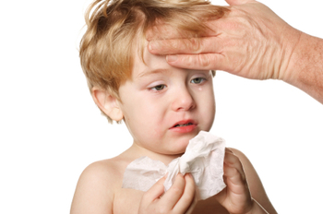
Source Control
Source Controls are measures used to contain germs from an infectious person
Early Diagnosis and Treatment
Notes:
Ensure patients with signs of infections are seen quickly and that all infections are considered

Slide 26
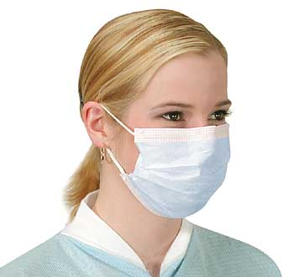
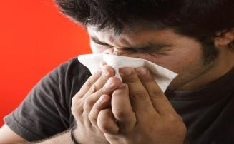
Source Control
Respiratory Hygiene
Is the combination of measures used to minimize the spread of respiratory germs
Notes:
How to practice respiratory hygiene:
Cover mouth and nose against a sleeve/shoulder during coughing or sneezing
Use tissue to cover mouth and nose during coughing and sneezing
Discard used tissues into the wastebasket
Turn head away from others when coughing and sneezing
Wear a procedure or surgical mask to protect others when coughing or sneezing
Perform hand hygiene after coughing and/or sneezing

Slide 27
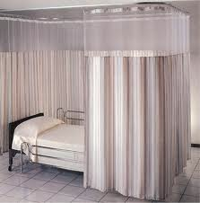
Source Control
Triage
Emergency Rooms/Acute Assessment Settings
Post Signs
Use physical barriers
Patient Placement
Notes:
Post signs to direct individuals with signs of infection to specific areas
Physical barriers between individuals with signs of infection
Place individuals who may soil the environment into a single room right away, e.g. vomiting, diarrhea

Slide 28
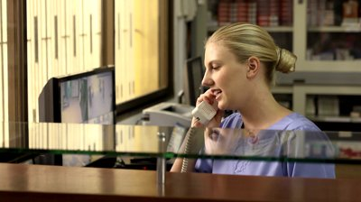
Source Control
Triage
Ambulatory Settings/Clinic Settings
Post signs in entrances
Identify individuals with signs of infection when scheduling appointments
Patients with signs and symptoms of and infection needing routine clinic visits should be identified when scheduling appointments. Request they reschedule appointment after the infection has gone away.
Notes:
Post signs in entrances reminding individuals with signs of infection to perform hand hygiene and respiratory hygiene
For individuals that cannot defer their appointment, remind them to follow hand hygiene and/or respiratory hygiene
Direct individuals who cannot defer their clinic visits into a private room or schedule them at a time when other individuals are not present

Slide 29
Source Control
Spatial Separation
Spatial separation and spacing of 2 meters spatial distance is necessary
In a healthcare facility, a single room with toilet and sink is recommended
2m
Notes:
Spatial separation and spacing is necessary to decrease exposure to germs from individuals in clinical and waiting areas and between a coughing/sneezing individual and a susceptible individual to prevent transmission of respiratory germs
If 2 meters/6 feet cannot be achieved:
The infectious individual must be at least 1 meter/3 feet apart
The individual must wear a mask

Slide 30
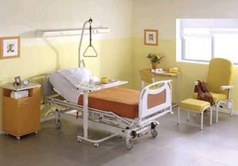
Source Control
Patient Accommodation, Placement and Flow
Accommodation of patients in single rooms is preferred
Determine patients who get priority placement in single rooms
Notes:
Single rooms with private toilet, designated patient handwashing sink and designated staff handwashing sink reduces chances for cross transmission
Priorities for placement in single rooms is determined by
Requirement of additional precautions
Identified as high risk for transmission of germs e.g. incontinent of stool
Identified as being high risk for infections e.g. immuno-suppressed, open wounds

Slide 31
Source Control
Patient Accommodation, Placement and Flow
When rooms must be shared, consider:
Roommates/visitors and their activities
Avoid placing infected patient together with a patient at high risk of infection
Create a boundary, e.g. draw curtains
Do not share sinks or toilets

Slide 32
Source Control
Patient Accommodation, Placement and Flow
Patient Flow:
Patient flow is transfer within and outside of facility/area and their activity
Considers the potential for exposure to and transmission of germs as a result of their activity and transport due to contact with other patients, their items and environmental surfaces
Notes:
Determine if transport/activity is needed
Determine accommodation is acceptable
If they are on Additional Precautions, determine if they can leave the room
Communication is important between areas, e.g. transporting, receiving
Source Control measures are important e.g. Patient perform hand hygiene, skin lesions are covered, wears a mask

Slide 33
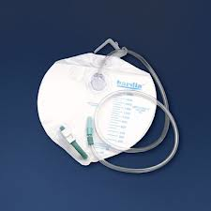
Aseptic Technique
Practices used to make patients, medical supplies and surfaces free from germs
Required to prevent germs from entering patients sterile areas, e.g. IV site, urinary catheter site

Slide 34
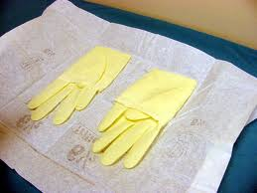
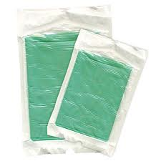
Aseptic Technique
Components of aseptic technique
Using an aseptic on patient’s skin
Performing hand hygiene
Sterile gloves
Gowns
Masks when required
Sterile drapes
Maintaining a sterile field
Refer to the WRHA IP&C Manual for more details

Slide 35
Aseptic Technique
Injection Safety:
Never administer medications from the same syringe to more than one patient even if the needle is changed
Do not enter a vial with a previously used syringe or needle
Assign multi-use vials to a single patient whenever possible
Never use medications packaged as single use vials for more than one patient
Do not use Iv bags or bottles as a source for more than one patient
Notes:
Syringe or needle is contaminated after it has entered or connected to a patient’s IV infusion bag or administration set

Slide 36
Personal Protective Equipment (PPE)
The educational module on PPE must be completed to meet your educational requirements for this element of Routine Practices
PPE provides a physical barrier between the sources of infection and protects to user from exposure to germs
PPE should be used appropriately

Slide 37
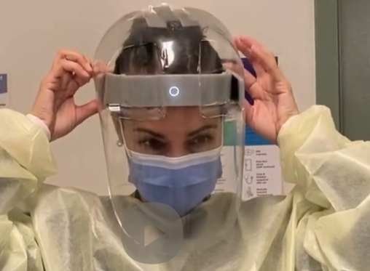
Personal Protective Equipment (PPE)
Personal Protective Equipment (PPE) includes:
Gowns
Gloves
Facial protection
Masks (N95 respirators or as indicated for Additional Precautions)
Eye protection
Notes:
Appropriate use of PPE includes:
Performing a PCRA to determine the need for PPE
Correct technique for putting on and taking off PPE
Correct technique when wearing PPE
Discard into designated receptacles immediately after use, followed by hand hygiene

Slide 38
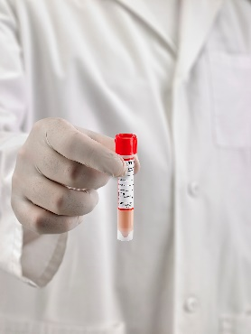
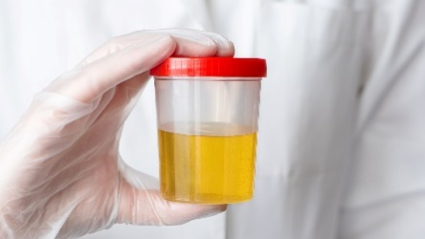
Specimen Collection
ALL clinical specimens are considered potentially infectious and should be handled carefully
They must be packaged to prevent spillage, breakage or damage

Slide 39
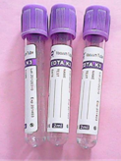
Specimen Collection
Collection process:
Assemble supplies
Perform Hand Hygiene
Apply PPE if required or if splashing is anticipated
The specimen must:
Be labelled
Transported correctly
Have their requisitions filled out according to laboratory policies and procedures
After collection remove PPE and perform Hand Hygiene

Slide 40
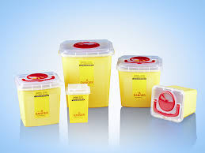
Sharps Safety and Prevention of Bloodborne Transmission
Users of sharps require education and training on how to safely handle sharps and prevent injury to themselves
Follow Routine Practices when splashes with blood and/or body fluids are anticipated
Notes:
Use safety engineered devices
Do not recap used needles
Handle used needles and other sharps with care
Dispose of used needles and sharps into designated puncture-resistant containers

Slide 41
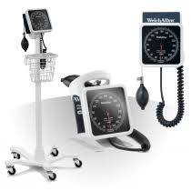
Management of the Patient Care Environment
Includes:
Cleaning of the Environment
Cleaning and Disinfection of Non-Critical Patient Equipment
Handling of Linen
Handling of Waste
Handling of Dishes
Handling of Deceased Bodies

Slide 42
Cleaning of the Environment
Do not eat or drink in areas where patient care is provided
Whenever possible, dedicate non-critical equipment to a single patient
Use organizational approved cleaners and disinfectants
Assign responsibility and accountability for routine cleaning of patient equipment
Ensure environmental cleaning follows a set procedure and frequency
Assigned cleaning tasks should be monitored
Notes:
Ensure surfaces can be cleaned
Increase frequency of cleaning of surfaces that are touched or used more often
In hospital and LTC facilities, ensure rooms/spaces are terminally cleaned following discharge or discontinuation of Additional Precautions

Slide 43
Cleaning and Disinfection of Non-Critical Patient Environment
Contamination of equipment has been implicated in infection transmission
Clean and disinfect items that have been in direct contact with a patient before used on another patient
Clean and disinfect equipment dedicated to a patient according to a regular schedule

Slide 44
Cleaning and Disinfection of Non-Critical Patient Environment
Store sterile/clean supplies in a designated and separate clean dry protected by dust
Discard personal care items (e.g. tissues, lotions) and disposable equipment left in the room following transfer, terminal cleaning, or discharge

Slide 45
Cleaning and Disinfection of Non-Critical Patient Environment
Computer keyboards and computer device technology become contaminated when used during patient car
Ensure computer keyboards in patient rooms are cleaned during discharge or terminal cleaning

Slide 46
Handling of Linen
Risk from contaminated linen is negligible
Handle soiled linen in the same way for all patients
Change bed linen regularly and when soiled
Handle soiled linen with a minimum of shaking
Bag linen at the site of collection
Store and transport clean and soiled linen
separately
Perform hand hygiene after handling soiled linen
Notes:
Roll or fold heavily soiled linen to contain the heaviest soil in the centre of the bundle
Do not remove large amounts of soil, feces or blood clots from linen by spraying with water
Use a gloved hand and toilet tissue then place contents in bedpan/toilet
If used, laundry chutes should be properly designed, maintained and used in a manner to prevent contamination

Slide 47
Handling of Waste
Risk from most healthcare waste is negligible
Waste receptacles should be conveniently located and preferably, hands-free
Contain and dispose of biomedical waste according to WRHA policies and procedures

Slide 48
Handling of Dishes
Disposable dishes and utensils are not required other than when dishwashing equipment is nonfunctioning
No special precautions
Follow Routine Practices

Slide 49
Handling of Deceased Bodies
There are no special requirements
Follow Routine Practices

Slide 50
Visitor Management and Education
Visitors can transmit infections
HCWs are responsible to teach patients and visitors basic principles including Hand Hygiene, Respiratory Hygiene and PPE
Visitors with symptoms of infection (cough, fever, diarrhea) should not visit unless their visit is essential
Notes:
If they must visit, they should be taught and supervised regarding the precautions to be taken

Slide 51
Awareness of Infection Prevention & Control (IP&C) Issues
Community, Hospital or Long Term Care
Refer to WRHA IP&C Manual
Other Routine Practices learning tools and resources are available at: https://professionals.wrha.mb.ca/infection-prevention-control/routine-practices/
Notes:
Contact your manager who will consult with the Community ICP and/or OESH (Occupational and Environment Safety and Health) professional/designate

Slide 52
Communication with IP&C program
When to contact IP&C:
IP&C education is needed
Outbreak or cluster infection is suspected
IP&C safety concerns of patients are to be reported
You have questions about IP&C

Slide 53
Communication with Occupational and Environmental Safety & Health (OESH)
When to contact OESH:
Report exposure to an infectious disease
At work, at home or illness with an infectious disease
Discuss fitness to work
Report of any personal concerns
Skin conditions, allergies, injuries
Discuss use and proper fit of PPE
Reporting of Injury/Near Miss

Slide 54
QUESTIONS??

Slide 55
Routine Practices Quiz Pick an answer, the correct answer will be unlined after the click
Infectious agents, reservoirs and means of transmission are links in the Chain of Infection.
True
False
Which one of the following is an example of direct contact?
Drinking contaminated water
Coughing or sneezing
A bite from a disease carrying insect?
Shaking hands with an infected or colonized person
Respiratory hygiene, hand hygiene and Personal Protective (PPE) equipment are all included in Routine Practices.
True
False

Slide 56
Routine Practices Quiz
Personal care supplies, for example: lotions, creams and razors, may be safely shared between patients.
a) True
b) False
Persons responsible for cleaning soiled equipment should wear PPE suited to the task.
True
False

Slide 57
Resources
Routine Practices document are available at: https://professionals.wrha.mb.ca/infection-prevention-control/routine-practices/
The Routine Practices document contains all the references used to create this PowerPoint

