Slide 1
Dementia Care: Moving Forward
December 2023 Webinar
WRHA Continuing Care
Dementia Care Working Group
Notes:
Good afternoon everyone. Thank you for taking the time to join us today to talk about some of the upcoming changes with our dementia care education and resources.
Please note we are recording the presentation portion of the webinar, and the recording will be accessible on the long term care resources webpage.
The TARGET AUDIENCE for today is any team member who would be a resource who staff who reach out to when needing some assistance related to behavioral situations that arise. As well it is intended for anyone who will be rolling out or supporting the changes being discussed today. This primarily may be EDUCATORS, DOCS, MANAGERS, and SWs but certainly not limited to those roles.

Slide 2
Purpose of Webinar
Provide a brief history and overview of dementia care education to date
Discuss recent changes and introduce new dementia care resources
Acronym change from P.I.E.C.E.S.™ to C.A.U.S.E.
Behaviour Assessment (formerly the P.I.E.C.E.S.™ 3 Question Template)
Quick Reference Guide (formerly the “yellow laminate”)
Responsive Behaviour Pathways
Discuss implementation of the new dementia care resources
Notes:
Dementia care education has been offered for staff working within personal care homes for the past 15 years. We will provide a brief overview of what has been done to date and current status. The majority of our time will be spent walking through some changes taking place and introduce the new resources. We will also discuss some suggestions / strategies for implementation and transition.

Slide 3
Dementia in Long-Term Care
LTC Resident Profile (2015-2016)
87% of residents had a form of cognitive impairment (dementia, stroke, trauma)
69% of residents had dementia
Characteristics | % among residents with dementia
Severe cognitive impairment (Cognitive Performance Scale [CPS] ≥4) | 40%
Any responsive behaviours (Aggressive Behaviour Scale [ABS] ≥1) | 50%
Signs of depression (Depression Rating Scale [DRS] ≥3) | 31%
Dependence in ADLs (Activities of Daily Living Hierarchy Scale ≥3) | 82%
Wandered at least once in the last 7 days | 21%
CIHI: Dementia in long-term care
Notes:
Many of us, from personal experience, know we care for a number of residents who live with some type of cognitive impairment. Although this CIHI data is on the older side, you can see that based on the 2015-16 data, 87% of individuals living in long term care had some type of cognitive impairment. Of those individuals, 69% of people had a diagnosis of dementia.
Of interest are the outcome scales for residents living with dementia. We see the dependence level for ADLs is quite high at 82%. When we you take into consideration the percentage of individuals with severe cognitive impairment and responsive behaviours, it highlights the importance and need for staff to build their knowledge and competence.
Profile of Residents in Residential and Hospital-Based Continuing Care, 2018–2019 | CIHI
In Manitoba, 77% of residents living in residential setting had a neurological diagnosis. Sixty percent of these residents have a diagnosis of dementia.

Slide 4
Why is Dementia Care Education important?
Residents & Families
Person-centred care and quality of life
Resources
Build confidence, competence, and resiliency
Increased job satisfaction and staff retention
Reduce workplace injury to staff
Reduce risk related to resident-to-resident safety events
Reduce risks related to responsive behaviours
Limited availability of specialized supports (e.g. SNU or SNBU beds, constant care)
Staff
Notes:
As we reflect on why dementia education is important, it is also good for us to remind ourselves that education is just a starting point. Providing education or reviewing resources does not create change. We know that gaining confidence, and building skills and expertise takes time and requires practice.
What is shown on the slide is certainly not a comprehensive list, but highlights some key areas where education aims to positively impact residents, families, and staff.
As staff gain better understanding of dementia and how individuals are impacted by the disease, this allows for staff to seek, explore, and understand the meaning behind a person’s behaviour. As we get to know a resident and use the education and resources we look for strategies and interventions that support person-centred care and seek to reduce responsive behaviours and aim to reduce risk of harm for both residents and staff.
From a staff perspective, education is a good starting point to building one’s confidence and gain competence which hopefully allows staff members to feel as though they are able to manage care when difficult or high risk situations arise.
Lastly, yes some of our residents do require a specialized environment, but as we know there are limited resources and so residents remain on our care while they are waiting to move. However, many of our residents do not require a special environment. Regardless of the circumstance, staff working in a PCH will care for residents with dementia, so it is a necessary to develop our skills.

Slide 5
2008 Introduced 5-day P.I.E.C.E.S.™ for professional staff
2019
Revamp of professional staff education moving from 4 days to 2 days.
Introduction of Sponsor Role and evaluation.
2015
Manitoba Health provided opportunity for changes to be made
2015-2018
In effort to build capacity, used a phased approach to provide education for PCHs.
Dementia Care Education Highlights
Creation of:
Senior leadership day
Family education
Resource Person
Refresher Day
Support Staff day
Notes:
Background
2008 – In collaboration with the Alzheimer’s Society of Manitoba, PIECES training for professional staff started. Manitoba Health provided replacement funding for front line nurses, and initially it was 5 days of training and then was reduced to 4 days.
At the start, there was no specific education targeted toward support staff, so over time presentations on various topics were created and made available for educators at the PCH to use.
2015, there was opportunity for every SDO (RHAs at the time) to change what they were doing in collaboration with Alzheimer’s Society of MB. It was decided that the PIECES framework would continue as the foundation, but there was also recognition of challenges of integrating the knowledge into every day practice. Staff turnover also created challenges in maintaining consistency and building expertise.
As a means to try and support putting the knowledge into practice and to build capacity, there was a targeted approach to provide education and to broaden the reach of participants.
Creation of:
Senior leadership day
Family education
Resource Person
Refresher Day (for those who previously took PIECES education)
Development of Support Staff day (able to use replacement funding not previously available for these members of your team)
Rolled out in phased approach to PCHs over the course of a 3 years in effort to build capacity.
In 2019, we took some of the learnings from the previous 3 years and revamped the professional staff education. (move to next slide)

Slide 6
Key changes made in 2019
Professional staff session reduced to 2 days
Increased attendance / greater opportunity for replacement of nurses
Revised to support integrating knowledge into practice
Used a more hands-on and interactive approach with focus on practical aspects of working with people living with dementia
Content included communication approaches/techniques, teamwork, and a person-centred care focus
Introduced the Sponsor requirement as part of the registration for Dementia Care Education for professional staff
Notes:
One of the biggest changes was the length of the education - it reduced from 4 days to 2 days. We still had the same amounts of funds to used for replacement funding, so reducing the number of days of education allowed for a greater number of nurses to attend over the course of the year. We also heard that replacing nurses for 2 days was easier than 4 days which also increased the opportunity for nurses to be able to attend.
These were great benefits, but ultimately the changes were made as an effort to facilitate and support integrating knowledge into practice. The education format incorporated a more interactive approach with a greater focus on communication, along with approaches and techniques that staff could used in every day situations.
The revised program also introduced the sponsorship role. It was hoped that the participants would have a more meaningful engagement in what they had learned . The sponsor is someone who can support the participant in their learnings and how they might incorporate it at the bedside. Recognizes this was a new aspect of the education program and it did require some dedicated time for the sponsor , it was only implemented for nurses attending the 2 day session until some evaluation could take place.
Some highlights of the sponsor role include meeting with the participant prior to them attending the education to talk about what the participant hopes to learn, and then follow up within 2 weeks after the education to talk about what they did learn and discuss what might be incorporated into their practice. There is another follow up in 6-8 weeks either via observation or another discussion.

Slide 7
During the Pandemic
In-person education paused
Providing Dementia Care During a Pandemic
Tip sheets
Security guard training
Offered 1-day virtual session 2021-2023
Included both professional and support staff
Missing the hands on practice
No sponsor involvement
Notes:
The revised program was met with very positive feedback and there was a formal evaluation plan to occur over time, but then 2020 came along and plans changed…
As we know, all in-person education was paused early on in the pandemic. As dementia care education resumed it moved to a modified format that was offered virtually, and became a 1 day session that included both professional and support staff. These sessions were well attended and met a need in the interim until large in person sessions were able to be attended. The limitation with the virtual session was the loss of the hand on practice, as well as some of the information that would have provided more in-depth explanations and practice related to the assessments and tools. The sponsor involvement was put on hold during this time as well.

Slide 8
What prompted the current changes?
P.I.E.C.E.S.™ Canada revised their program & contract no longer exists
As a result, any trademarked acronyms, assessment tools and resources are no longer available for use
A provincial working group updated the resources and education content to reflect the move away from the P.I.E.C.E.S.™ framework and replacing it with the new Behavioural Assessment using the C.A.U.S.E. acronym
Notes:
As time went on, the intent was to resume the program from 2019 and to restart the evaluation process. However, PIECES Canada made significant revisions to their program and the province no longer has a contract with PIECES Canada. This means we no longer will use the Trademark Acronym PIECES™ and some of the copywrite tools such as the 3 Question Template and yellow laminate.
In light of these changes, a provincial working group updated the resources and education content to reflect the move away from the P.I.E.C.E.S.™ framework and replacing it with the new Behavioural Assessment using the C.A.U.S.E. acronym.

Slide 9
Activities Starting in Fall 2023
Return of in-person sessions for:
1-day Support Staff
2-day Professional Staff
Introduce and transition from P.I.E.C.E.S.™ to new acronym C.A.U.S.E.
Incorporate new and revised dementia care resources
Reintroduction of the sponsor role and evaluation
Promote engagement of residents and families
Notes:
After a great deal of work done by the working group, it is exciting to say in-person sessions resumed as of last month. At these sessions participants were introduced to CAUSE and the new resources.
As well, we are restarting the sponsor role, and promoting the engagement of resident and families which will be talked about a little later on.
For now, I am going to hand over the presentation to Sheila who will walk through the new and revised resources.

Slide 10
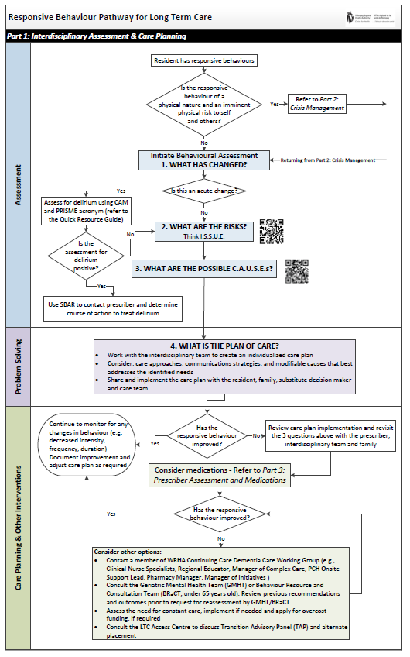
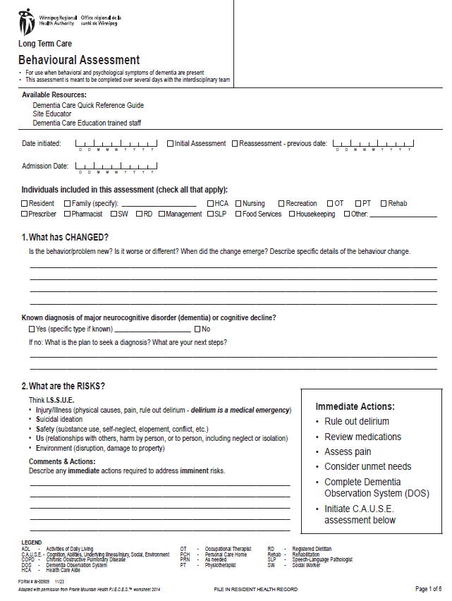
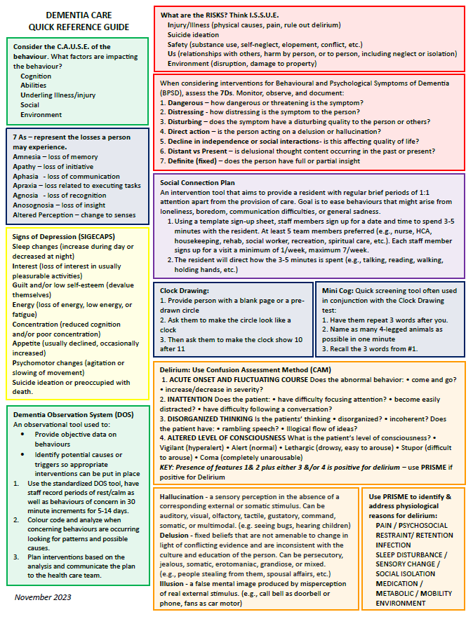
New Dementia Care Resources
Responsive Behaviour Pathway
Behaviour Assessment
Quick Reference Guide
Notes:
Ask participants to have these resources available.
The key items of the new resources include on the left – the 3-part Responsive Behaviour Pathway for LTC, the Behavioural Assessment form in the middle, and the double sided colour enhanced Dementia Care Quick Reference Guide.
All of these items are meant to be used together to work through a Behavioural Assessment.

Slide 11
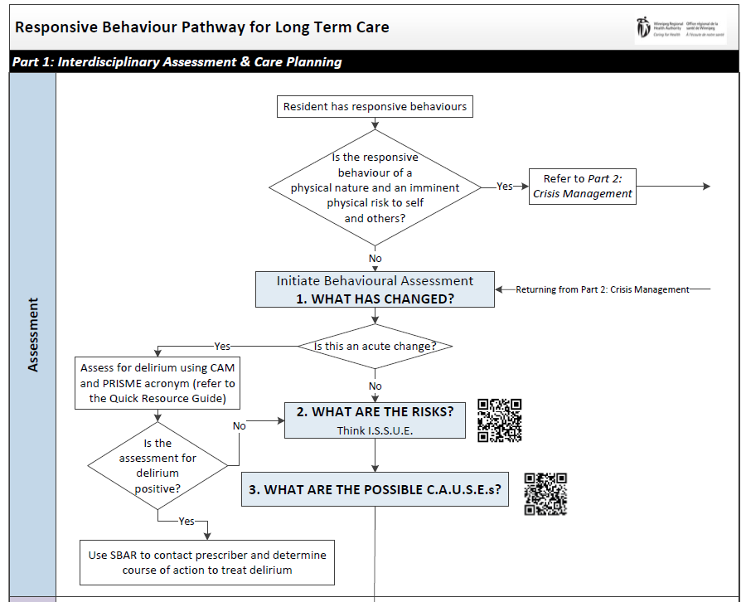
Notes:
The new process follows along on the same framework as the former PIECES™ 3 Question template as demonstrated on Part 1 – Responsive Behaviour Pathway. Beginning with asking the questions: What has changed? What are the risks? What are the possible causes?
QR codes link to short videos associated with the I.S.S.U.E. and C.A.U.S.E. acronym created to support better understanding of their use.

Slide 12
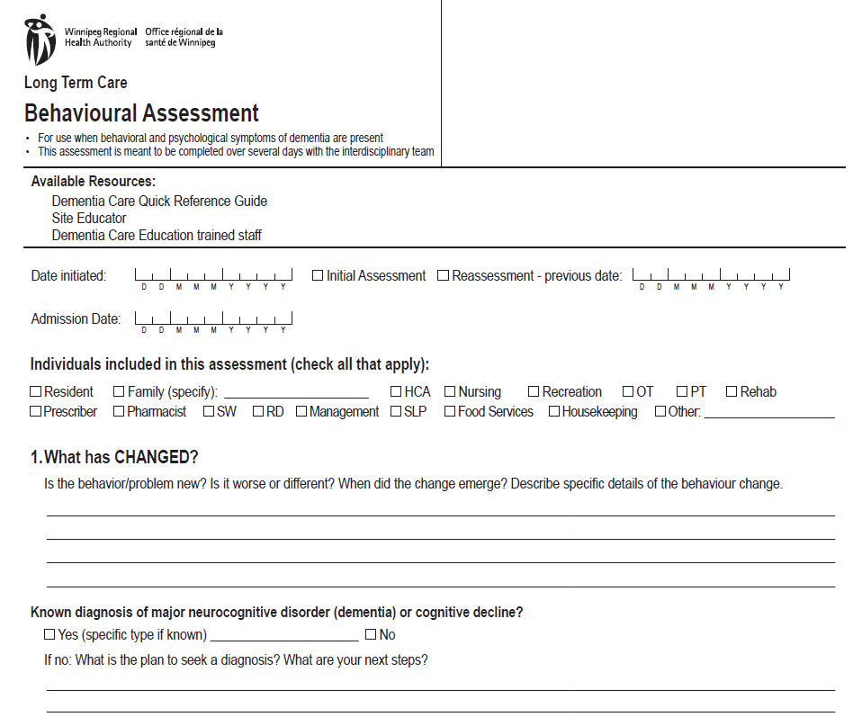
1. What
has CHANGED?
Notes:
This is the part of the pathway where you would initiate the Behavioural Assessment form. It begins with the question: What has changed? Looking at the behaviour and describing.
In the known diagnosis of major neurocognitive disorder – dementia or cognitive decline: this in an area that can identify if a specific diagnosis has already been made which may be helpful in considering the presentation of particular behaviours that may be associated with a specific type of dementia as well as help guide interventions and treatment options for the same reasons. If a prescriber is doing further investigations to determine a specific diagnosis this can be indicated here to alert all team members. This is not an area where nursing is determining or necessarily asking for investigations.

Slide 13
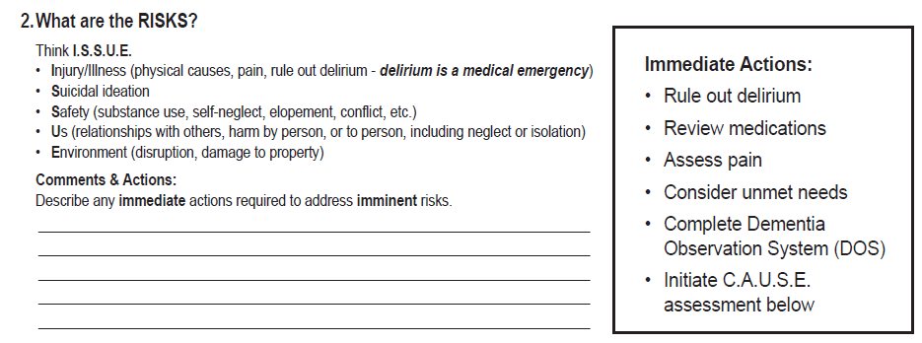
What are the RISKS?
Notes:
Then it asks – What are the risks? using the acronym I.S.S.U.E.
When working through an assessment using the Behavioural Assessment Process form, suggested tools and resources are captured on the Quick Reference Guide to offer more detailed information. Transition

Slide 14
Notes:
I: Injury/Illness – DELIRIUM IS A MEDICAL EMERGENCY, physical causes, pain
S: Suicide Ideation
S: Safety – substance use, self neglect, elopement, conflict
U: Us/relationships with others, harm by person, harm to person, including neglect and isolation
E: Environment – disruption, damage to property
This infographic was created to help PCHs with the transition to the Behavioural Assessment and outlines the ISSUE acronym that replaces the previous RISK one on the old form.
Stands for Injury/illness (risks associated with increased pain, delirium), risk for suicide, risks associated with Safety that might include substance use, self-neglect, elopement, or conflict, “Us” looks to risks related to relationships including harm by person or to person, including neglect of isolation, and finally risks to the environment such as disruptions or damage to property.
QR codes linking to a short video that assists with a better understanding on this new aconym

Slide 15
Notes:
The PIECES™ acronym has been changed to CAUSE – basically looking for the same potential ‘causes’ for behaviour just using a different pneumonic device. This infographic along with other support resources will assist PCHs in the transition away from PIECES™
QR codes linking to a short video that assists with a better understanding on this new acronym

Slide 16
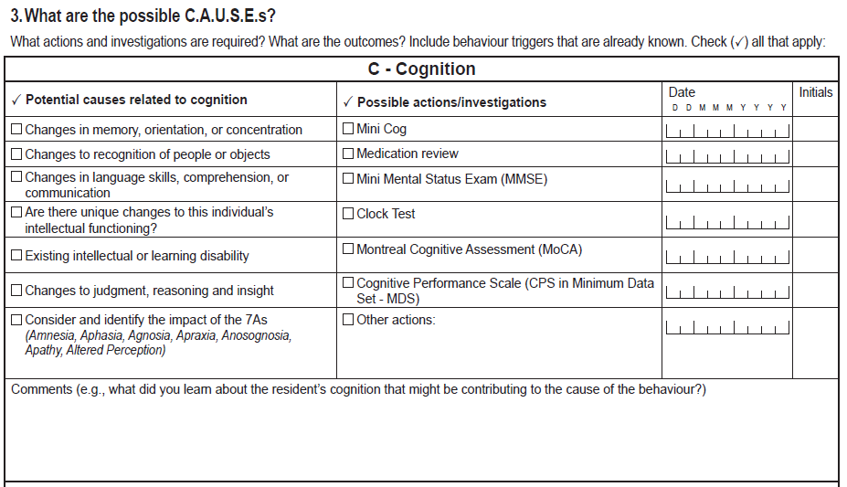
What are the possible C.A.U.S.E.s?
Notes:
On the 2nd page of the Behavioural Assessment form it asks the 3rd question: What are the possible causes? Uses the C.A.U.S.E. acronym is the focus for pages 2, 3, 4, and 5:
C: Cognition
A: Abilities
U: Underlying Illness or Injury
S: Social/Emotional
E: Environmental
*Note the right and left columns are not related. The right side goes through the potential causes related to Cognition such as any noted changes in memory, orientation or recognition of people, etc. and the right side looks at some screening tools, etc. that might be helpful.
Transition: Many of the categories looking at potential causes remind staff to consider if any of the 7 A’s of dementia may be contributing to the behaviour. These are also outlined on the QRG
Transition: Some examples of possible actions or investigations to help determine if that category of cause is contributing can be found on the right side, such as conducting a Mini Cog assessment or a Clock Drawing assessment – also briefly outlined on the QRG

Slide 17
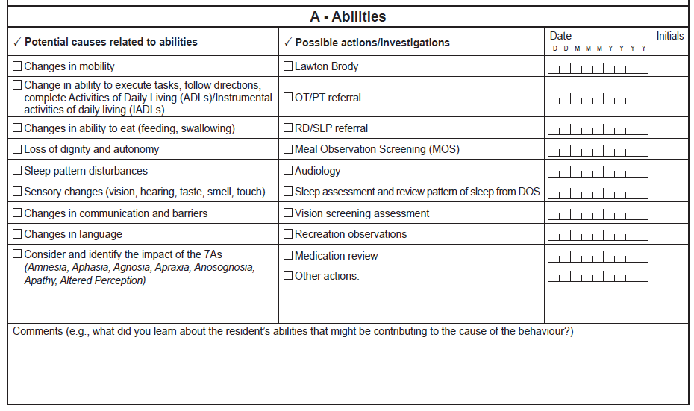
What are the possible C.A.U.S.E.s?
Notes:
As we move through the acronym we look to see if there is something related to Abilities that may be causing the behaviour. Looking to see if any items in the left column apply to our resident and may be contributing to the behaviour. E.g. changes in mobility, ability to perform ADLs, sleep pattern disturbances, ability to communicate, etc. In the right column are some possible action or investigations that may assist in further determining if something related to abilities may be contributing to the behaviour.
Transition – we are again reminded to consider if any of the 7 A’s of Dementia are contributing to the behaviour.

Slide 18
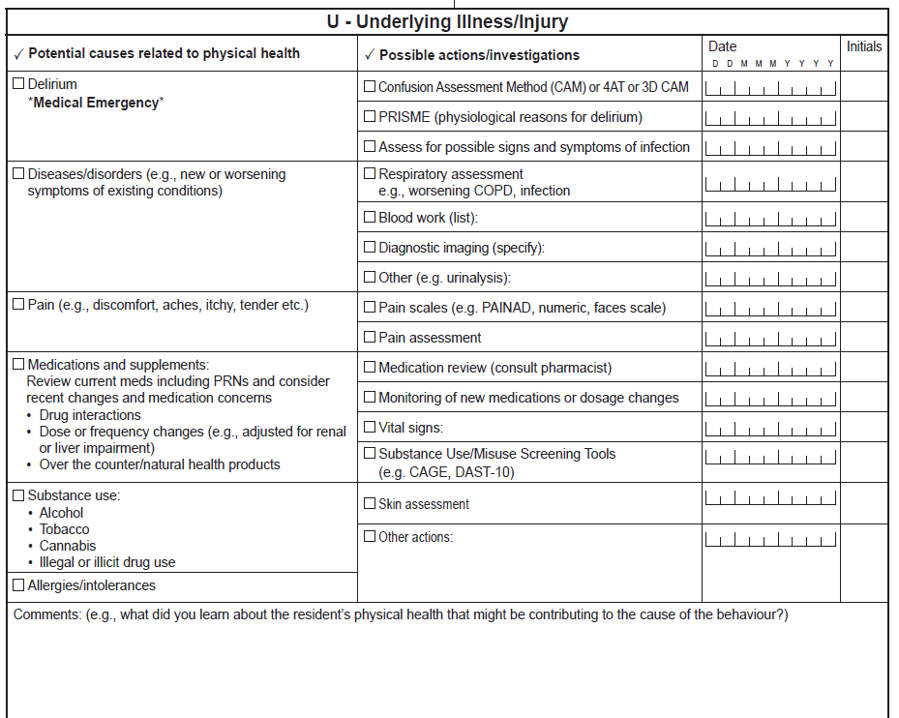
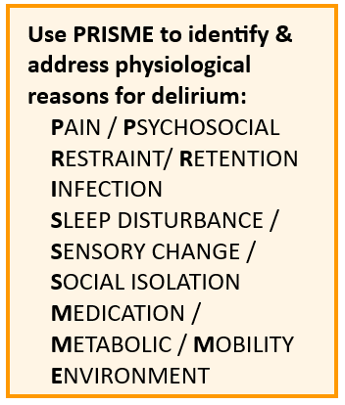
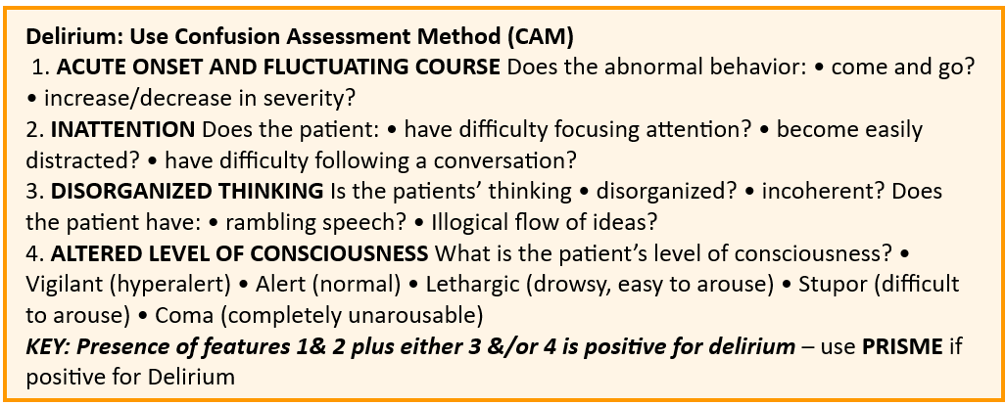
What are the possible C.A.U.S.E.s?
Notes:
Continuing to move through the acronym we look to Underlying Illness or Injury as a potential cause. Assessing if any physical causes such as pain or changes in medication could be contributing to the behaviour. Possible actions or investigations to assist in determining if there is an underlying illness or injury contributing to the behaviour are found on the right column
Transition – focused attention on Delirium and using the CAM or Confusion Assessment Method as a screening tool – more information referenced on the QRG
Transition - and the PRISME acronym to assist in identifying the potential cause of the delirium. – again referenced on the QRG

Slide 19
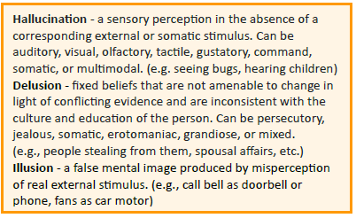
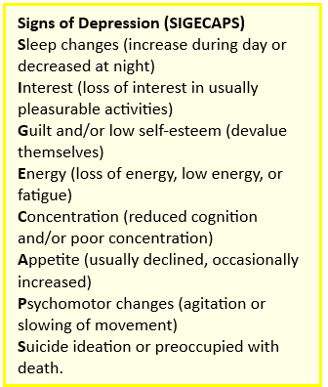
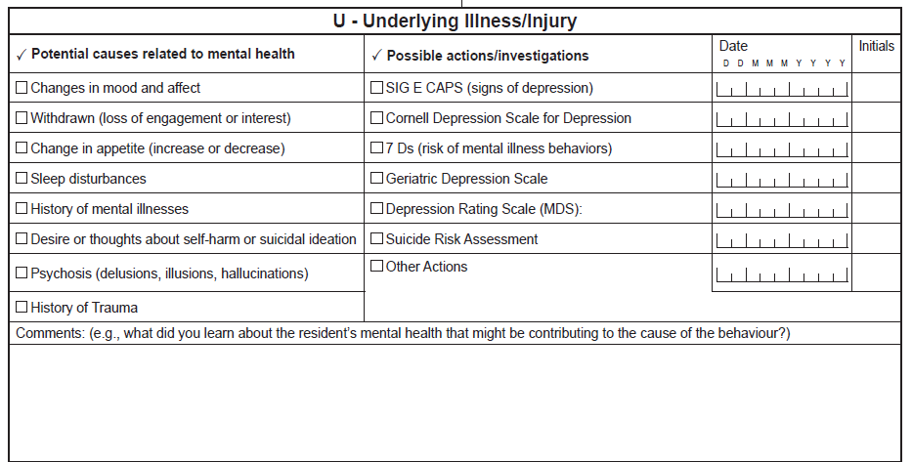
What are the possible C.A.U.S.E.s?
Notes:
Still under looking at Underlying Illness or Injury we move on to look at potential mental health causes for behaviour. Using the left column to assess if any of these items might apply to the resident and looking at the right column for any further actions/investigations that may help you determine if an underlying mental illness is contributing to the behaviour.
Transition – with more detailed definitions to assist staff found on the QRG
Transition – as well as other neumonic devices to guide assessments on the behavioural and psychological symptoms of Dementia such as the 7 D’s also located on the QRG
Transition – a suggested screening tool to assess for depression is also expanded on the QRG

Slide 20
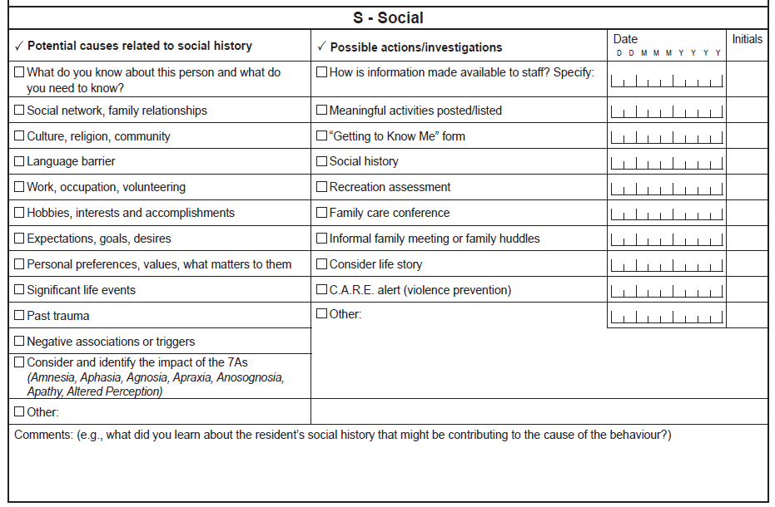
What are the possible C.A.U.S.E.s?
Notes:
Continuing to move through the CAUSE acronym we look at any Social or Emotional causes for the behaviour. On the left side assessing to see if any of the listed items might apply to the resident such as language barriers, personal preferences, past trauma, need for purpose and stimulation through hobbies and interests or habits from previous work history, etc.
On the right column are some possible actions that might help explore social causes in more depth.

Slide 21
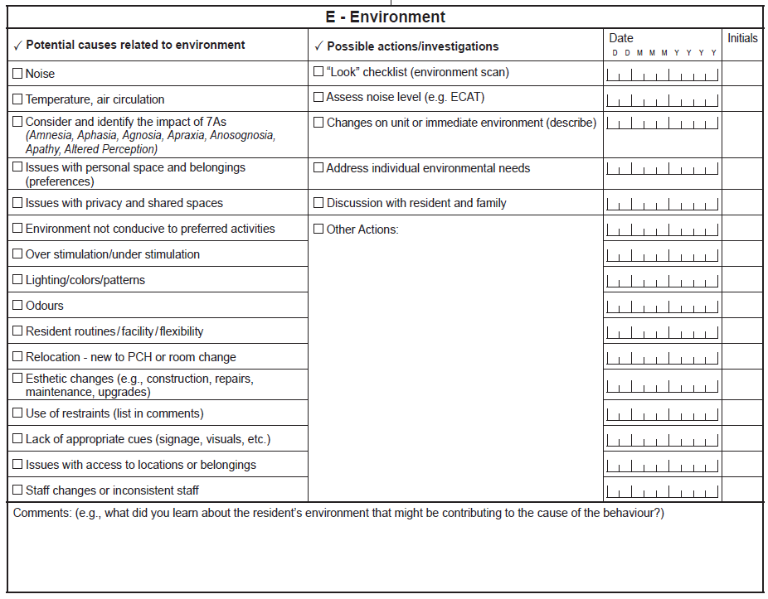
What are the possible C.A.U.S.E.s?
Notes:
And finally finishing the CAUSE acronym we look for potential environmental causes for the behaviour. Looking on the left side column and assessing if any of these items might apply to the resident and identify environmental contributing factors such as temperature, noise, relocation, use of restraints, etc.
The right hand column offers possible actions or investigations that may help further investigate if the environment is a contributing factor.

Slide 22
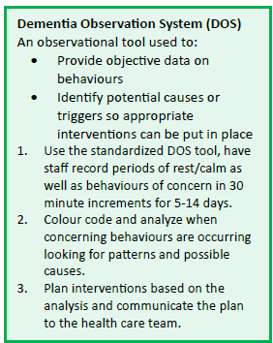
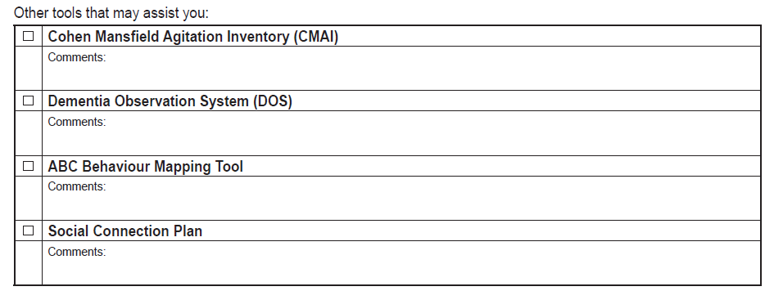
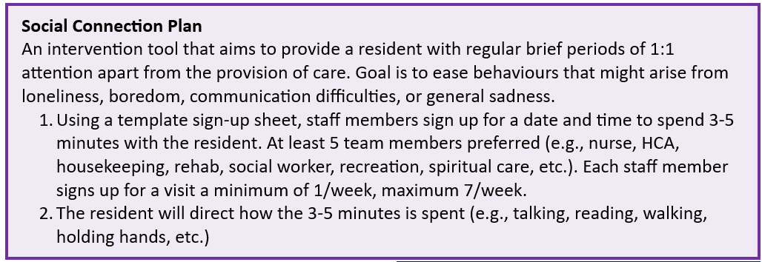
Other
Tools
Notes:
At the end of the CAUSES section there is a list of a few other tools that can help staff determine the frequencies of specific behaviour (CMAI), assess the rhythm of the resident’s day to look for patterns and triggers (DOS), more closely assess the triggered behaviour (Behaviour Mapping) and a suggested intervention of the Social Connection Plan formerly known as the Pro Attention Plan.
Transition – more details on the DOS can be found on the QRG
Transition – more details on the Social Connection Plan can also be found on the QRG.
Next steps in providing resources to assist in the Behavioural Assessment include providing copies of the tools suggested along with instructions on their use and interpretation of results. These will be added to a resource folder on the LTC Professional Website along with all of the materials and other resources shared today. This will happen gradually over the next several months.
Additional education materials will also be available around how to complete a DOS and a link to a quick video tutorial on Behaviour Mapping Tool
A template sign up sheet has also been developed for the Social Connection Plan and will also be available in the Resources Folder.

Slide 23
Notes:
The final part of the behavioural assessment process as identified on Part 1 of the pathway is determining a plan of care that looks at care approaches, communication strategies and any modifiable causes to best address identified needs, as well as looking to how best to communicate this plan of care to your team. This is mirrored on the Behaviour Assessment form . . .

Slide 24
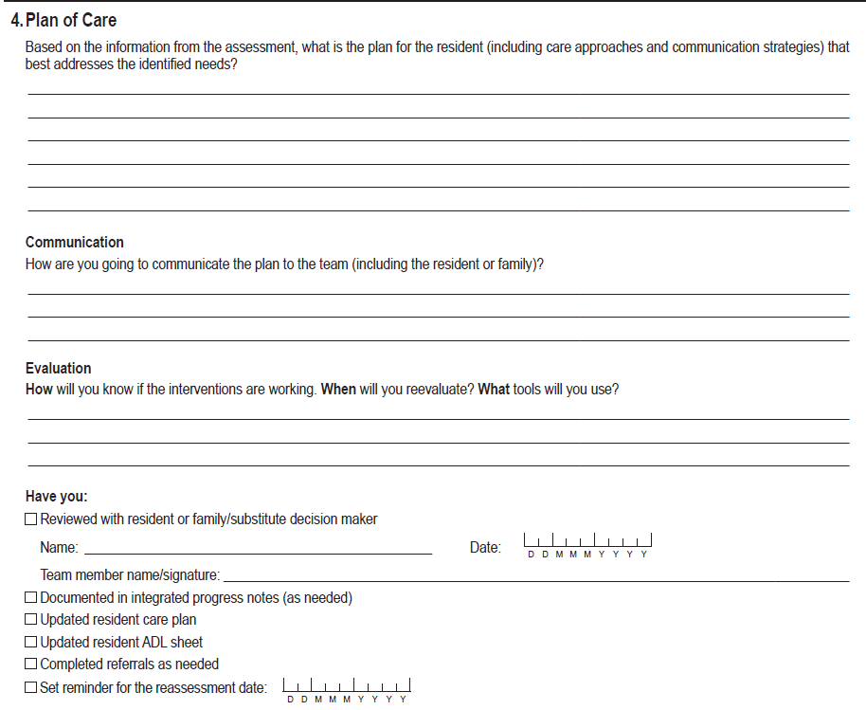
4. Plan of Care
Notes:
We see this section fully represented on page 6 the assessment provides the final question: What is your plan of care and how will you communicate and evaluate your plan?
It encourages an individualized approach specific to the resident and the possible cause, as well as engaging the family in the process. Communication of the plan may include updating the care plan, C.A.R.E.: Use Caution and Respect Every Day – Provincial Violence Prevention Plan Care Plan, the ADL sheet, shift report/communication binder so that all staff including agency staff are apprised of the specific approaches you have identified through your assessment.
Evaluation of the care we provide is an important step that is often missed so the process includes a prompt on how this will take place – a date for evaluation and details on how you will evaluate – perhaps repeating a DOS for a few days a few weeks after implementing your interventions.
Finally a short checklist to help ensure that the plan is well documented and communicated.

Slide 25
4. Plan of Care
Notes:
The end of the document provides space for the names and signatures of the interdisciplinary team that contributed to the assessment.

Slide 26
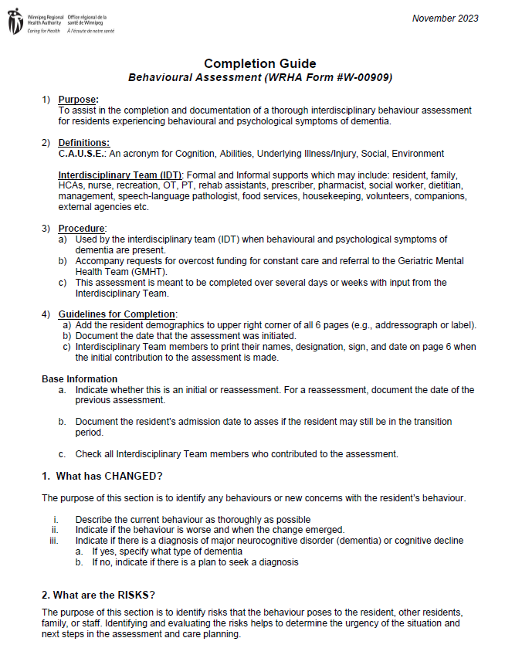
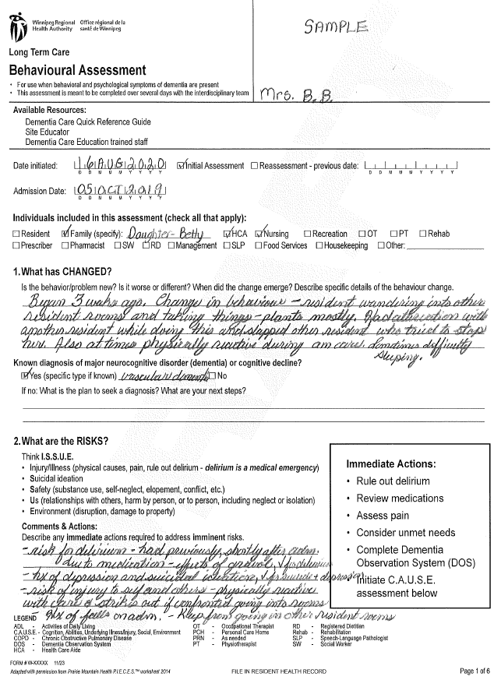
Supportive Resources
Behavioural Assessment Completion Guide
SAMPLE Behavioural Assessment
Notes:
Supportive Resources: Completion Guide and Samples of the Behavioural Assessment were created to help support the Behavioural Assessment Process. Having these items available to staff will be an important part of the transition.

Slide 27
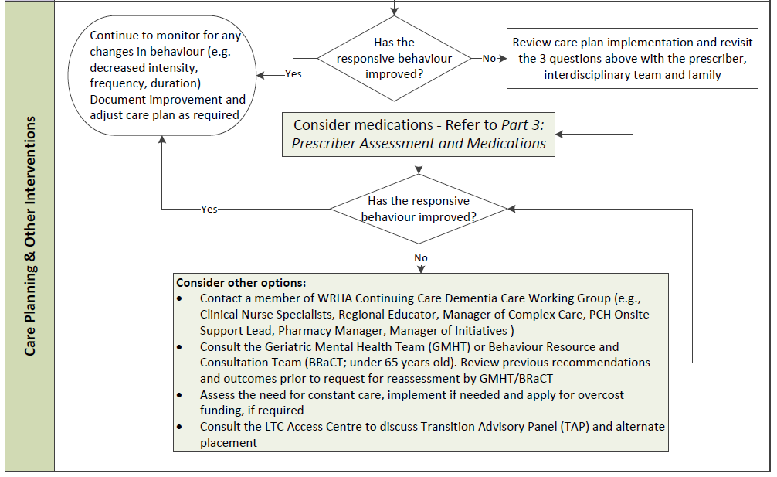
Notes:
The final portion of Part 1 of the Responsive Behaviour pathway looks at evaluating if the interventions have been successful or if there is a need to consider medications which would guide staff to Part 3 of the pathway – Prescriber Assessment and Medication.

Slide 28
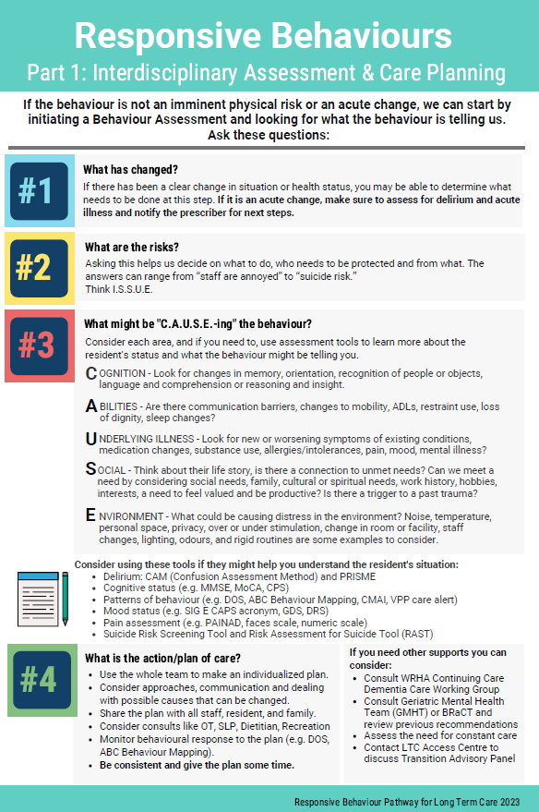
Responsive Behaviour Pathway
Part 1: Interdisciplinary Assessment & Care Planning
Notes:
To enhance the learning and understanding of the pathways, corresponding infographics have been created. Some people don’t relate to algorithms and might prefer the content presented in this way.

Slide 29
Notes:
Part 2 of the Responsive Behaviour Pathway for LTC outlines a process for dealing with a behaviour crisis.
These strategies can be used when the responsive behaviour is physical in nature or when there is an imminent risk to themselves or others.
The first section outlines de-escalation strategies including the ABCDE acronym. The QR code links to a short video about the ABCDE acronym.
A new resource that PCHs may not be aware of is the WRHA Mobile Crisis Service. They can be contacted for phone consultation to discuss de-escalation strategies and are available 24 hours a day, 7 days per week.
If the de-escalation strategies are effective, then the team can return to part 1 to complete the interdisciplinary assessment and care planning.
If the de-escalation strategies were not effective, then you can continue down the crisis management pathway.

Slide 30
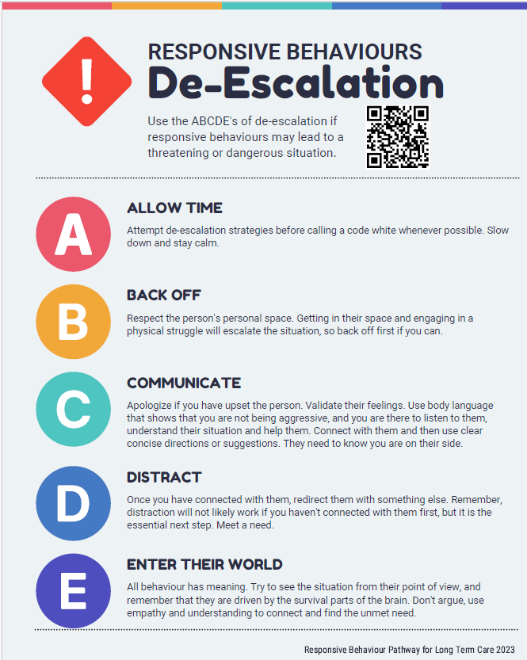
Notes:
This is an infographic outlining additional information on the ABCDE de-escalation process as well as a QR code linked to a short video on it

Slide 31
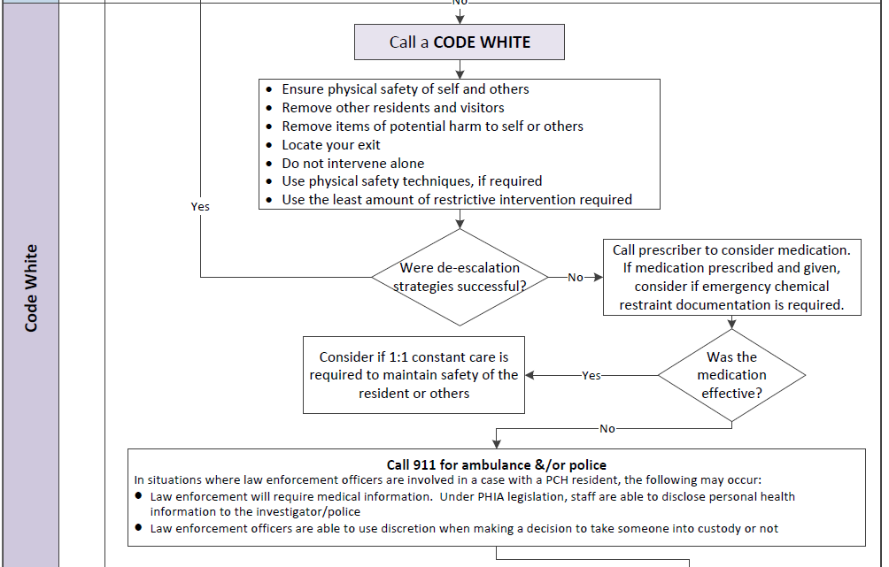
Notes:
The next section of the Crisis Management part of the Responsive Behaviour Pathway indicates to call a Code White.
PCHs may have their own policies and procedures for Code White, so this section provides a general overview.
If further de-escalation strategies are not effective, then the prescriber can be contacted for medication orders. This medication may be a chemical restraint so emergency restraint documentation may be required.
Constant care may needed to maintain safety of the resident or others.
If the de-escalation strategies, medications, and constant care are not effective, then emergency services, through calling 911, may be required.

Slide 32
Notes:
After a Code White has been called, it is important to debrief and document the event.
An interdisciplinary huddle can be used to debrief about what worked, what didn’t work, and lessons learned.
Documentation should include an IPN, RL Safety/Security report, and VPP CARE Alert. If the medication is continued, a basic restraint assessment may be required.
After documentation, the team can return to part 1 to complete the interdisciplinary assessment and care planning.

Slide 33
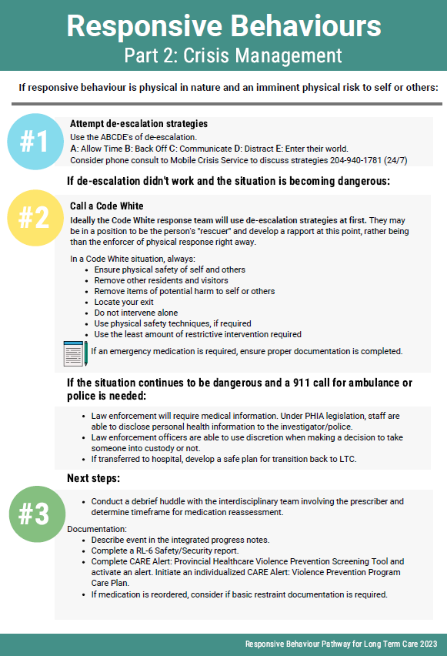
Responsive Behaviour Pathway
Part 2: Crisis Management
Notes:
There is an infographic available on Part 2 of the Responsive Behaviour Pathway on Crisis Management for those who prefer this information format.

Slide 34
Notes:
The next part of the Responsive Behaviour Pathway is Part 3 which is the Prescriber Assessment and Medications. This pathway can be referred to as part of the interdisciplinary assessment in Part 1.
Before adding a medication, consider if the behaviour could be related to an untreated medical condition such as pain, constipation, or delirium. The current medication list should be reviewed for possible side effects contributing to the behaviour.
If an interdisciplinary assessment has not been completed and non-pharmacological strategies have not been tried, the team is encouraged return to part 1 to use these first.
Pharmacologic treatment may be considered if the behaviour is persistent and dangerous, distressing, disturbing, or damaging to social relationships.
Many behaviours may not respond to medication, as outlined in the list, so this should be considered as well.

Slide 35
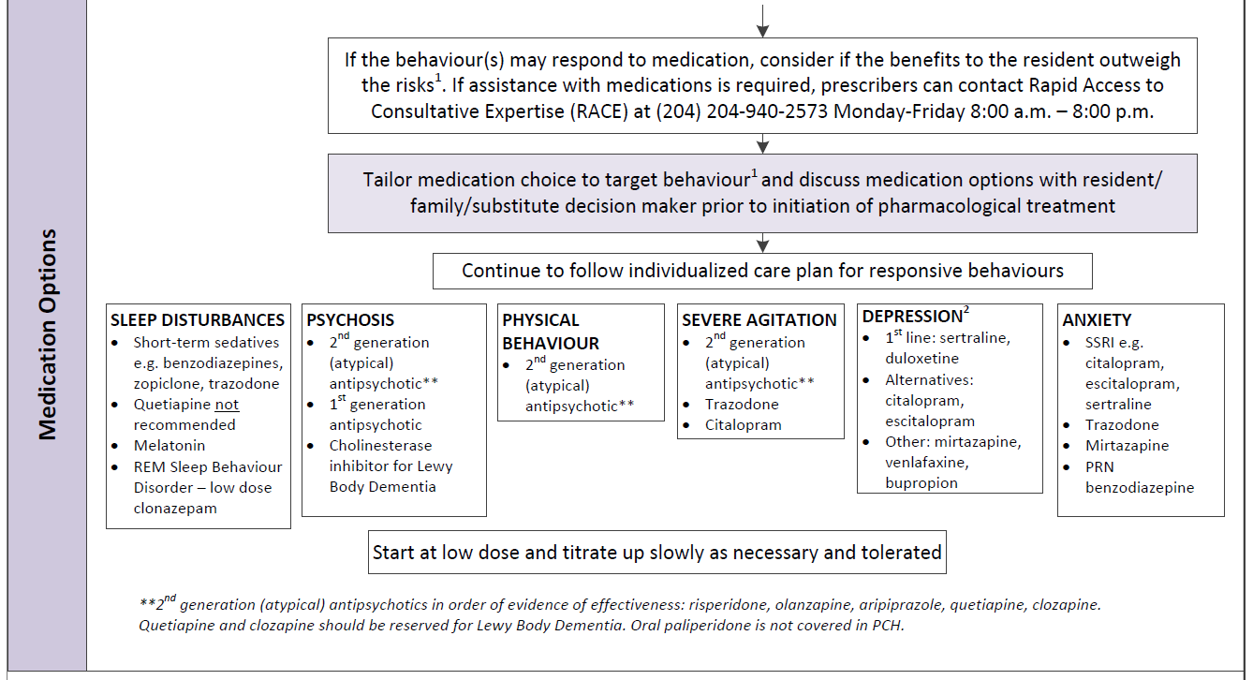
Notes:
If it’s determined a medication could be helpful for the resident, the next section of the pathway outlines medication options based on the type of behaviour that is being targeted.
As with any medication, the risk versus the benefit must be considered for the specific resident. A discussion with the resident/family/SDM is recommended prior to starting the medication.
Prescribers can call the Rapid Assess to Consultative Expertise (RACE) line to speak with a geriatrician or geriatric psychiatrist if medication assistance is required.
It’s important to continue to utilize the non-pharmacological approaches in addition to medication.
These medications should be started at a low dose and titrated up slowly as necessary and as tolerated.

Slide 36
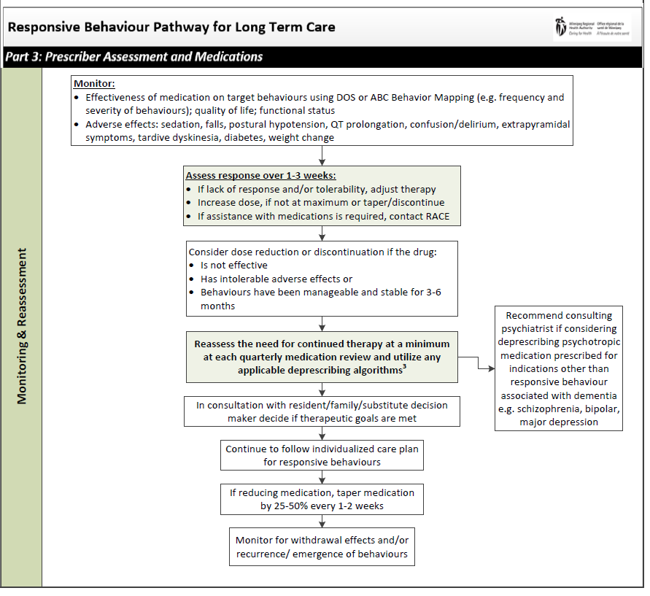
Notes:
The last section of the part 3 pathway outlines the monitoring and reassessment of medications for responsive behaviours.
After starting the medication, target behaviour(s) should be monitored using tools like the DOS or ABC Behaviour Mapping. The frequency and severity of the behaviours should be compared to baseline to assess medication effectiveness. Changes in quality of life, functional status, and appearance of adverse effects should also be monitored after the starting the medication.
These medications can take some time to work so response should be assessed over 1-3 weeks before making changes.
Consider dose reduction or discontinuation if the medication has not been effective, has caused intolerable adverse effects, and if the behaviours have been manageable and stable for 3-6 months.
The need for continued medication use should be reassessed at the quarterly medication reviews. Tapering and monitoring for withdrawal effects is recommended if deprescribing these medications.

Slide 37
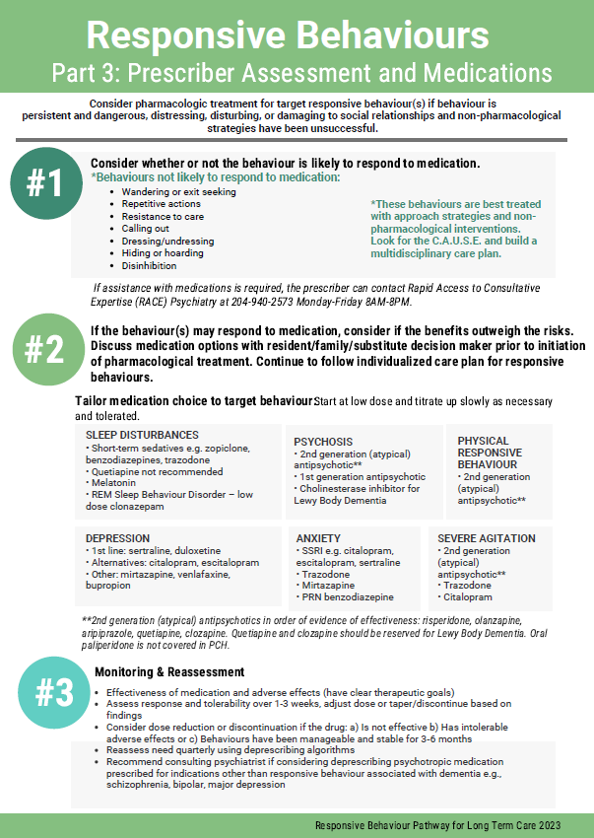
Responsive Behaviour Pathway
Part 3:
Prescriber Assessment and Medications
Notes:
There is an infographic available to go along with Part 3 of the Responsive Behaviour Pathway on medications.

Slide 38
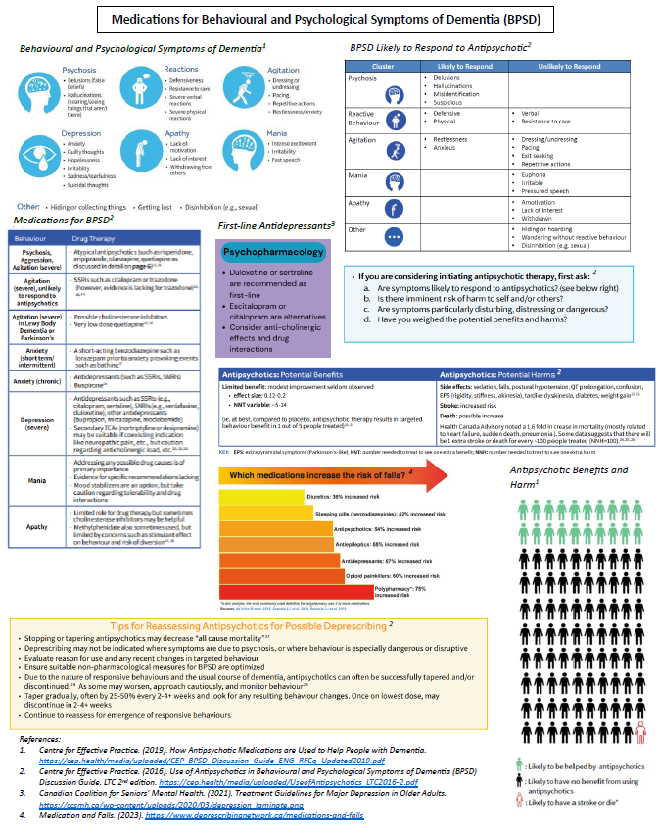
Dementia Care
Quick Reference Guide
Use of Medications for Behavioural and Psychological Symptoms of Dementia (BPSD)
Notes:
On page 2 of the Dementia Care Quick Reference Guide (formerly known as the “yellow laminate”), there are resources on the Use of Medications for Behavioural and Psychological Symptoms of Dementia (BPSD).
There is a description of behavioural and psychological symptoms associated with dementia, medications for BPSD, behaviour likely to respond to antipsychotics, potential benefits and harms of antipsychotics, BPSD medications and their risk of falls, and tips for reassessing antipsychotic medications.

Slide 39
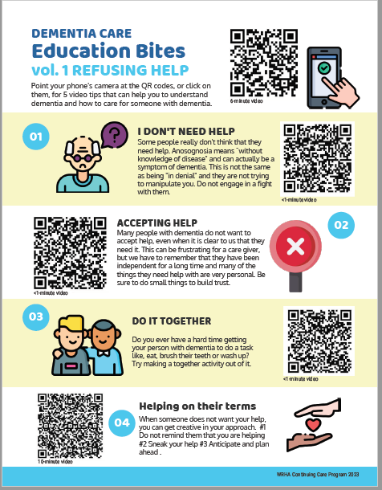
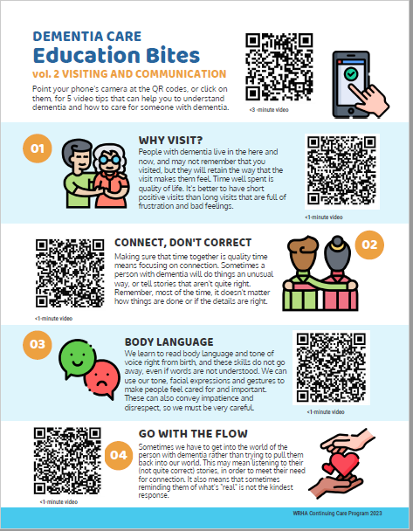
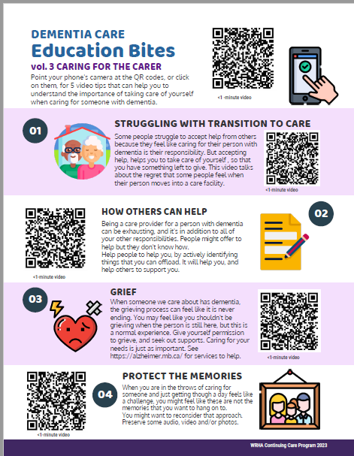
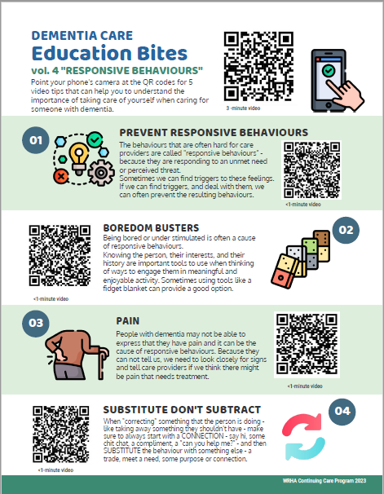
Resident & Family Engagement
4 Infographics with video tips on topics to help caregivers understand dementia and caregiving strategies
Notes:
4 infographics were included in the implementation package. They are meant to help PCHs engage and educate families to improve resident outcomes. The infographics include QR codes with video tips that help caregivers to understand dementia and how to care for someone with dementia. Topics include Strategies when the person with dementia does not want to accept help, Visiting and Communication, Caring for the caregiver, and responsive behaviours
Familiarize yourself with the content of the videos and use the ones that would work best based on the situation.

Slide 40
Resident & Family Engagement
Infographics are a resource for education
Admission
Care conferences
Resident/family meetings to address specific issues
Resident/Family Councils
Family Education Sessions
Family Information Bulletin Boards
Raise awareness that dementia care education for staff is ongoing
Notes:
The infographics are a resource for education:
Infographics can be provided to families during the admission process.
brought to care conferences,
Shared with family when meeting to discuss a specific care issue, send to family members who live out of town, situations where families would benefit from understanding the resident’s needs and how they can help–
Other forums where education is announcement or promoted such as:
Share at Resident Council, if applicable family council
Family education sessions,
Post on family information Bulletin Boards, Infographics can be posted in common areas.
Let families know that PCH staff do receive ongoing Dementia Care Education on site and through the region – resumption of in person education sessions and that virtual sessions were provided during the pandemic. This information can be communicated to families through newsletters, website.

Slide 41
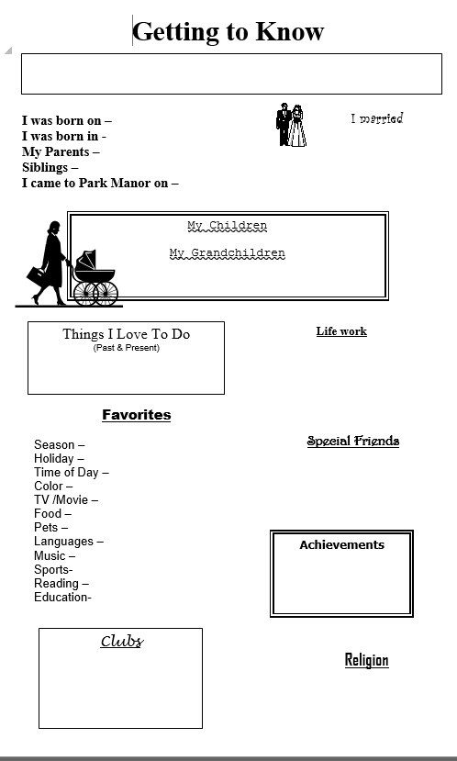
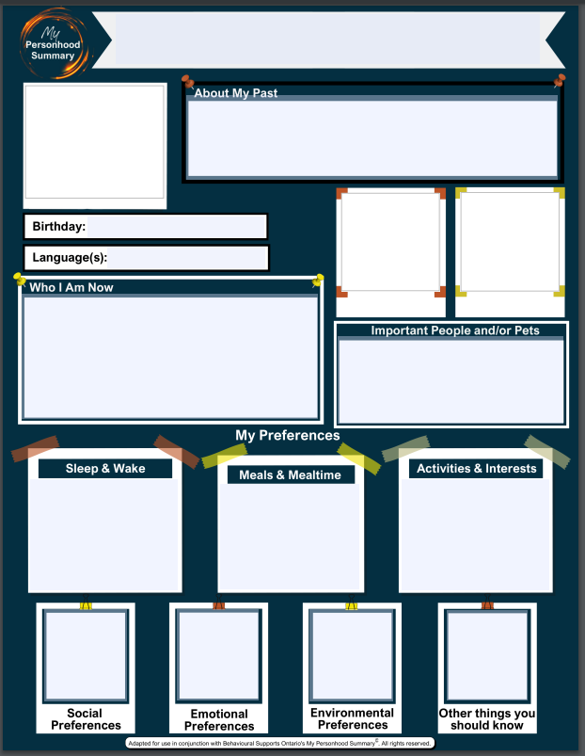
Resident & Family Engagement
Notes:
It is important to learn about the resident as an individual and to learn about their social history. This will help staff understand the resident’s individual needs and preferences and will help them in their interactions with residents and family. There are several templates available to assist with this. Three examples are shown on this slide- these tools can be used to collect and share the residents social history information. – Many of you will recognize the “getting to know ” template which was developed by a Winnipeg PCH.
The Alzheimer Society of Manitoba also has an “All About Me” template.
Template from Ontario called “My Personhood Summary” that PCHs could use for their resident’s social history and there is a French version:
My Personhood Summary© | brainXchange
My Personhood Summary©: Poster Templates | brainXchange
These forms give residents/families an opportunity to provide specific information about the resident’s social background, things the resident enjoys, their likes and dislikes, preferences, social and leisure activities, daily routine.
These can be displayed in the resident’s room and can be used as a conversation starter.
The Alzheimer Society also has a more comprehensive “All About me” booklet. It is a resource to obtain additional information about the resident.
May consider including these in the admission package and encourage residents and families to fill out the templates, may need to follow up to request that the template be completed, explain the importance of having this information accessible to staff. the information can be shared at care conferences to get to know the resident and the family.

Slide 42
Resources for Sponsors
Handouts
Dementia Comparison Table
Quick Resource Guide
Language and Labels Table
Behavioural Assessment and Completion Guide
Sponsor Guideline
Recorded Tutorial (30 min)
Notes:
These items were part of the original package for the sponsorship program and are currently being updated to ensure they contain the new CAUSE acronym, forms, processes and pathways.
The recorded tutorial will be developed and shared for those new to the concept and as a refresher support to others.

Slide 43
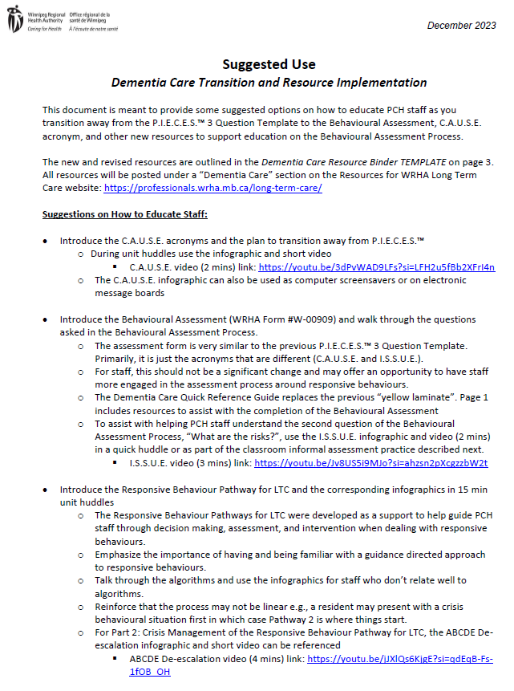
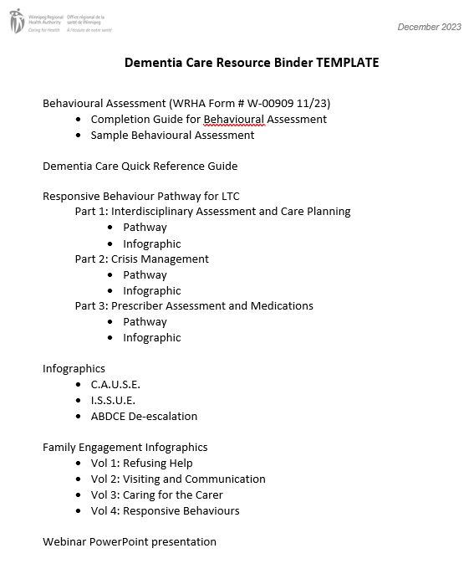
Implementation – Educator Resources
Suggested Use Document
Template for Dementia Care Binder
Notes:
To assist PCH Educators in the transition to the new Behavioural Assessment Process and Pathways, a Suggested Use Document has been developed with some ideas on how to inform and educate staff. These suggested options include ideas discussed by focus groups in preparation for this implementation. Some key messaging is included in the suggestions to highlight important aspects of the transition. The last page of the Suggested Use Document includes a template for a Dementia Care Resource Binder should your PCH wish to create one.

Slide 44
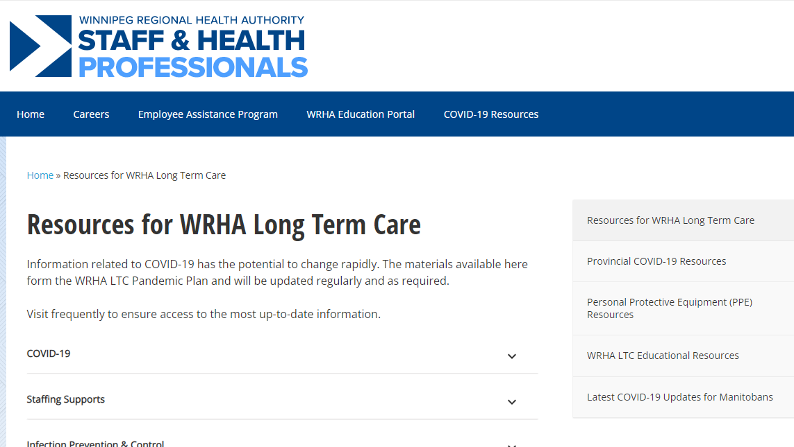
Implementation
Online access to the Dementia Care Resources:
Resources for WRHA Long Term Care - WRHA Professionals
Under a new “Dementia Care” heading
Notes:
All of the resources presented today will be available from the LTC Resources Webpage Resources for WRHA Long Term Care - WRHA Professionals

Slide 45
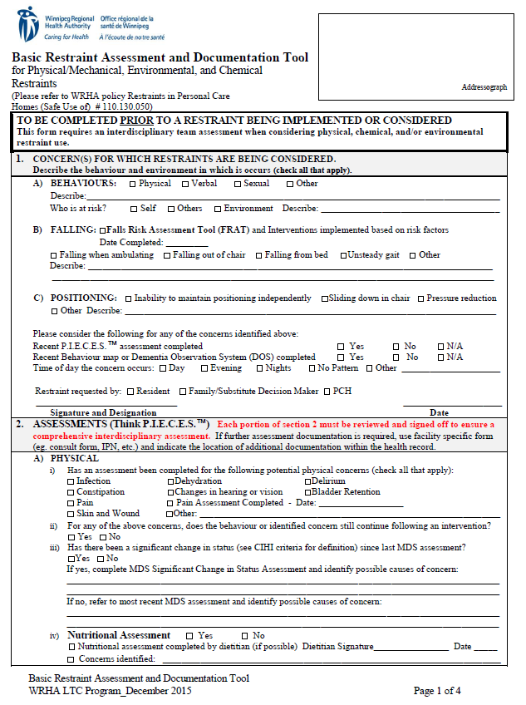
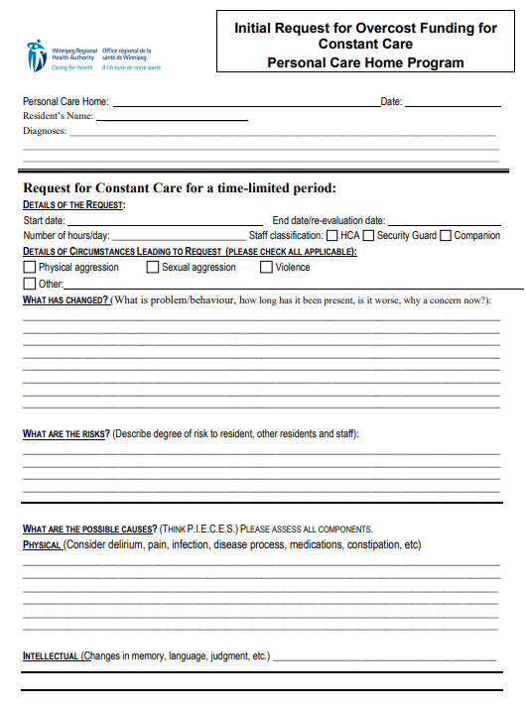
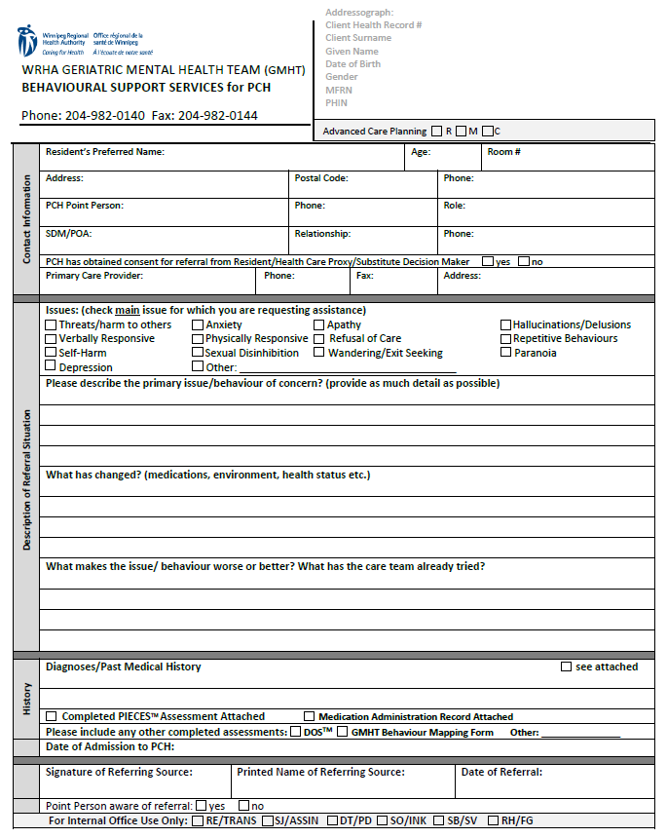
Existing Forms
Some existing forms may reference P.I.E.C.E.S.™ and will be revised as they are reviewed in the future
Basic Restraint Assessment & Documentation Tool
Request for Overcost Funding for Constant Care
GMHT PCH Referral
Notes:
What about all the forms that reference PIECES – will these forms be updated? Will the old forms still be accepted?
Yes, forms that reference P.I.E.C.E.S.™ such as the restraint assessment forms, overcost request form, and GMHT PCH referral form will be revised in the future. Once available, it is best to used the new forms, but the existing forms are okay to use and will be accepted.

Slide 46
Implementation Timeline
PCHs should plan to implement the new behavioural assessment and resources by March 31, 2024
As the new tools and resources are implemented and used in clinical practice, we are interested in your feedback regarding potential revisions
Reassessment of resources will occur in 6 months (June 2024)
Notes:
We recognize this change over will take time.
Likely an email or possible survey will be sent out at the end of June 2024 as a reminder for any feedback on this new process, resources and tools.

Slide 47
Dementia Care Education Sessions
Jan-Mar 2024 (in-person)
Three 2-day sessions for Professional Staff
Four 1-day sessions for Support Staff
Registration information coming soon
Funding is available for staff who are replaced to attend the education sessions
Notes:
Dates to be announced with registration form on Monday, December 11
Between Jan-March there will be 3 – 2 day Professional Staff sessions and 4 – 1 day Support Staff sessions offered in-person

Slide 48
Dementia Care Education Sessions
Do staff who participated in the previous dementia education have to retake it?
No, people do not have to retake the education in order to learn the new resources. The principles are the same, and the introduction of C.A.U.S.E. and pathways can be done at each PCH
Will participants be given a textbook?
No, textbooks haven’t been given out for a number of years, and there is not a textbook that accompanies the current dementia care education
Notes:
Just to address a couple of anticipated questions . . .

Slide 49
WRHA Continuing Care Dementia Care Working Group
Primary contact: Sheila Smith 204-940-8558 or ssmith32@wrha.mb.ca

