Slide 1
Journey of Nutrition
Decline Initiative Presentation to Directors of Care
Jean Helps,
Regional Nutrition Manager for LTC
March 21, 2023
1
Notes:
1

Slide 2
Journey of Nutrition Decline
Working Group Plan
“Journey of Nutrition Decline Working Group” was formed to develop resources for staff, resident, substitute decision maker and family addressing the anticipated nutrition decline over the course of admission to support CONVERSATIONS.

Slide 3
Outline
History:
Working Group Plan / Purpose
Working Group Members
Guiding Principles
Overview of Resources
Today:
Deliverables
Draft Infographics

Slide 4
Working Group Members
Carla Kehler, Spiritual Health, Simkin Centre
Indira Mike, Regional Speech Language Pathology Manager
Jean Helps, Regional Clinical Nutrition Manager - LTC
Jodi Fernandes, Director of Nutrition and Food Services, Middlechurch Home
Joyce Klassen, Educator, Alzheimer Society of Manitoba
Kelly Tye Vallis, Speech Language Pathologist, SLP – LTC Program
Lisa Back, Clinical Dietitian, Holy Family Home and Simkin Centre
Meagan Fitzpatrick, Social Worker, Beacon Hill Lodge
Nada Ivankovic, Nurse Manager, Simkin Centre
Ruth Krupka, EOL WG member, Clinical Dietitian, Calvary Place & Lion’s Personal Care Home

Slide 5
General Guiding Principles
The vast majority of individuals who live in a PCH will remain in this setting to end of life, but we do not always meet end of life needs.
On-going communication is essential to allow informed decision making. Lack of conversation may be as a result of uncertainty and discomfort about what needs to be said and how it needs to be said.
Consistency in the messages provided by the health care team to resident and family supports is essential to ensure understanding and comfort. Good communication is required between the healthcare team
5
Notes:
5

Slide 6
Resources for Health Care Professionals
Resources for Residents, Substitute Decision Makers and Family
Conversations in LTC: Changes in Food Intake and Nutrition in the Older Adult
Conversations in LTC: Feeding and Swallowing Concerns
Conversations in LTC: Meals in Long Term Care Homes
Conversations in LTC: When a Person has Trouble Eating
Conversations in LTC: Difficulties with Meals for those with Dementia
Conversations in LTC: Nourishing the Whole Person
Conversations in LTC: Eating at End of Life
Notes:
The working group developed a total of 7 resources.
The first two resources on the left were developed specifically for Health Care Professionals in LTC to provide evidence-based information that can be utilized by members of the HCT who may need to have conversations with resident, family or supports.
The resources include Changes in Food Intake and Nutrition in the Older Adult; as well as Feeding and Swallowing Concerns.
The next 5 resources were developed for Residents and their family supports. These client resources were created with a readability level of grade 8.
These resources are intended to support conversation (and are NOT to be handed out without context and discussion). Again, they are tools to enhance conversation.

Slide 7
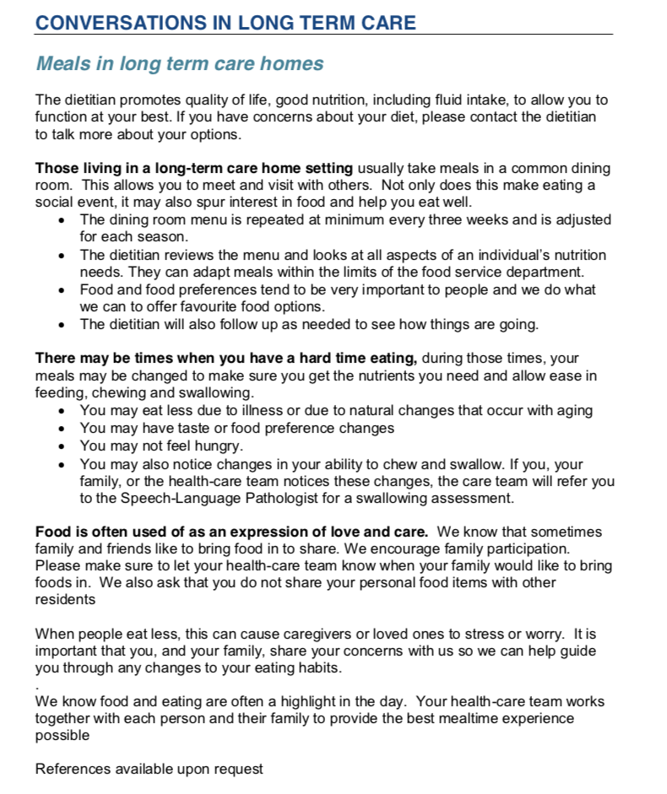
Resources for Residents, Substitute Decision Maker and Family
Conversations in LTC: Meals in Long Term Care Homes
Purpose: to aid in conversation soon after admission:
Describe meal provision in PCH
But also conveys that:
there will be times when a resident will eat less
when people eat less it can be stressful due to the special meaning food can have
Notes:
The first Resource - titled Meals in LTC Homes:
The purpose of this resource is to let residents and family know what meals look like in LTC and that there are supports in setting up the meal plan. However, this resource also conveys the gentle message that nutrition decline is expected
When a person eats less it can be a source of stress to those involved. Therefore, regular communication at this time can help ensure the resident, and family supports understand what is occurring and what the care team is doing to provide care in line with the resident’s wishes. It can also prevent the need for crisis management later on.

Slide 8
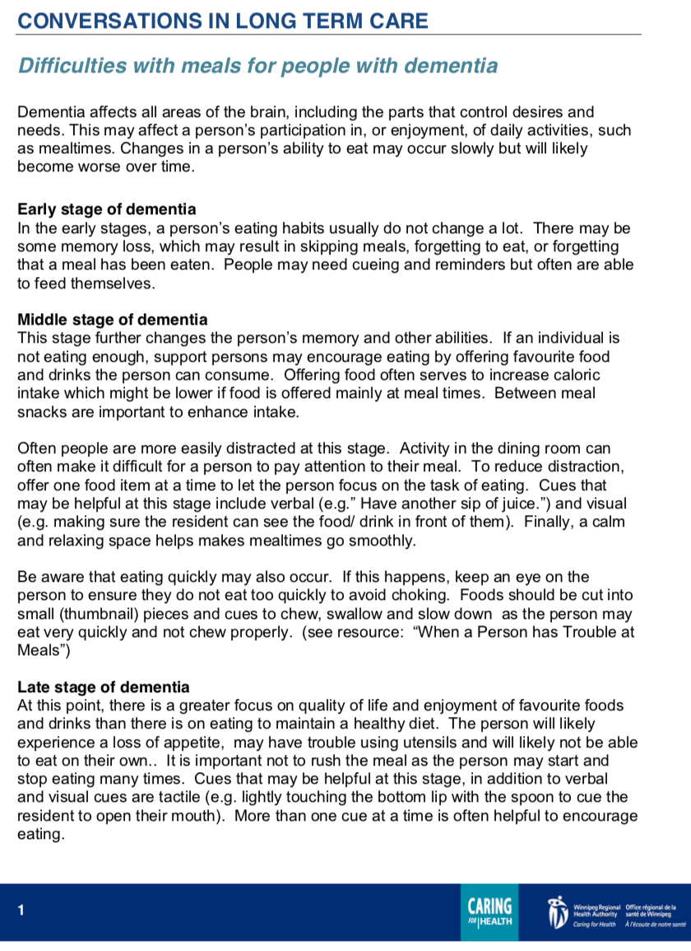
Resources for Residents, Substitute Decision Maker and Family
Conversations in LTC: Difficulties with Meals for those with Dementia
Purpose: to aid in conversation when dementia impacts intake:
To increase understanding about the progression of dementia for the person and how it may affect the person’s meals.
Notes:
This next resource - titled Difficulties with meals for those with dementia.
This resource describes what is seen in each of the phases of dementia and how the resident may respond to food. In most cases, changes in a person’s ability to eat occur slowly but often worsen over time.
For example in early stages of dementia, a person’s eating habits may not change a lot, but there may be some memory loss which can lead to the resident missing meals or forgetting that they have eaten. Therefore, residents at this stage may need cueing. On the other hand, if someone is in a later stage of dementia, the focus may be more on enjoyment of their favourite foods, rather than maintaining a healthy diet. The resource goes on to describe the transition to comfort-based nutrition care for residents with dementia towards end of life.

Slide 9
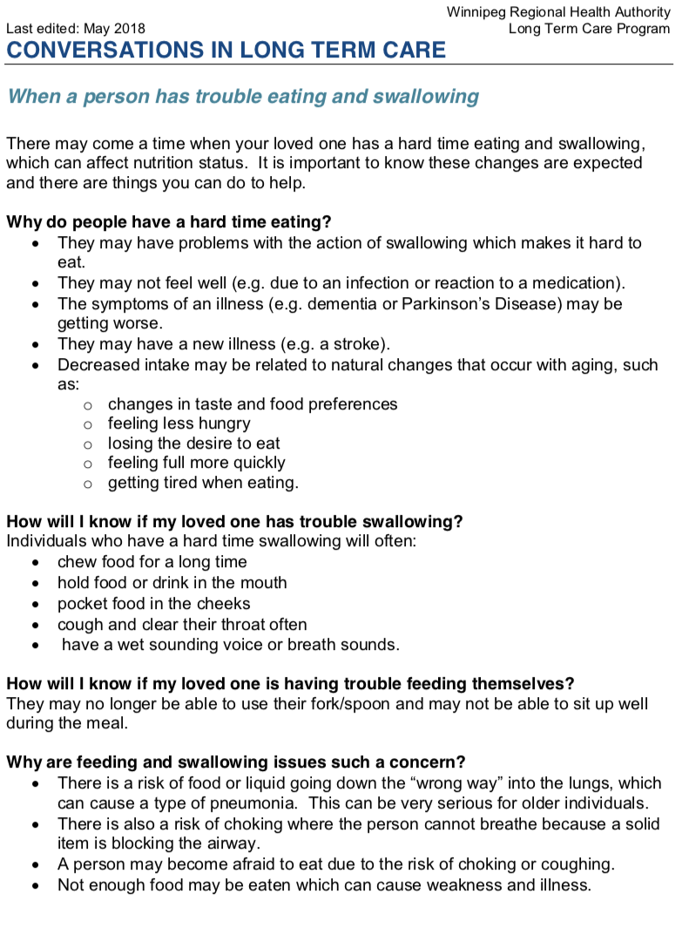
Resources for Residents, Substitute Decision Maker and Family
Conversations in LTC: When a Person Has Trouble Eating
Purpose: to aid in conversation whenever there is difficulty with eating.
To increase understanding about changes in status and how we can help
To provide information that with progression of a condition, food will not help
Notes:
This next resource is called: Conversation in LTC: When a Person Has Trouble Eating.
In this handout, it addresses WHY people often have a difficult time eating- which either could related to swallowing issues, acute illness, and/or progressive conditions.
For example: if someone has a UTI, they typically may not feel well, which may lead to them eating less, and therefore affecting their nutrition status.
If family is concerned, because they notice their family member eating less, this resource can accompany that conversation.The resource assures the family that a team approach will be taken to help manage the issues and reiterates the importance of making mealtimes a pleasant experience.
Lastly, this handout also includes information about the expected change in nutrition… in the resource it says: “Decreased intake may be related to natural changes that occur with aging”.. And as a resident approaches end of life, this same resource may be provided as part of the conversation.

Slide 10
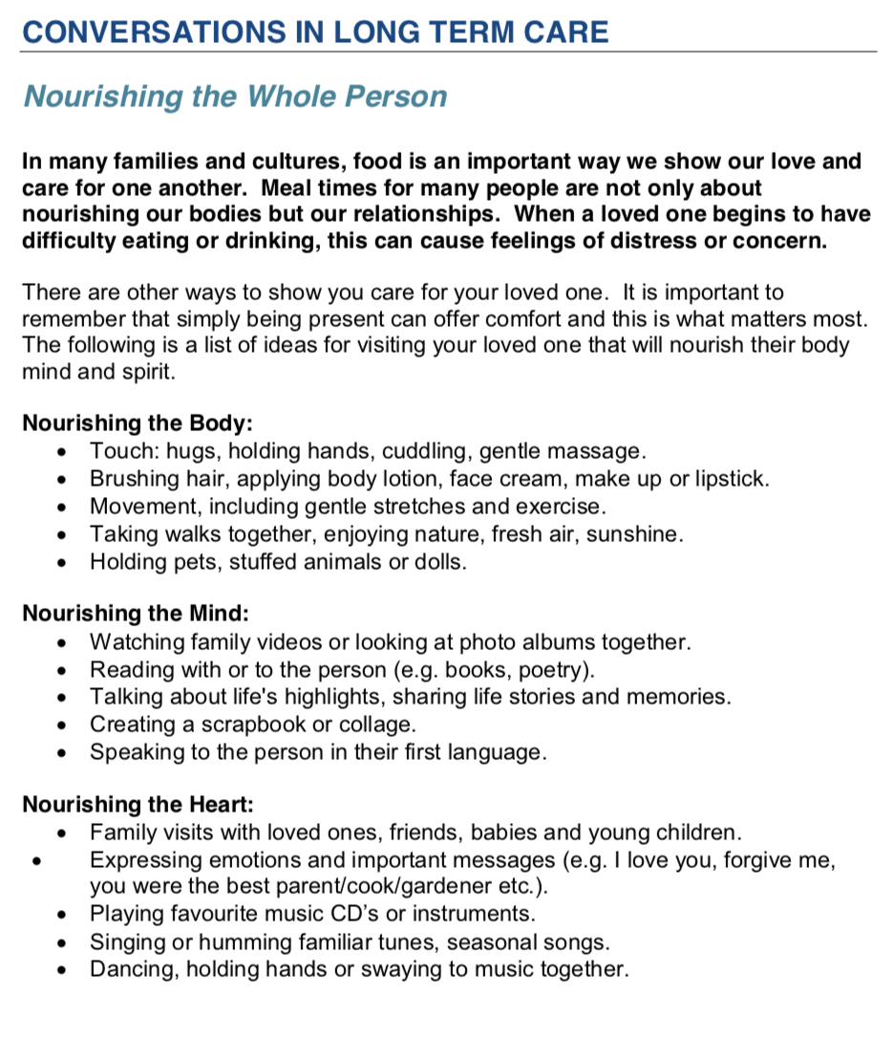
Resources for Residents, Substitute Decision Maker and Family
Conversations in LTC: Nourishing the Whole Person
Purpose: to aid in conversation when other means of providing care rather than food is important:
To expand perspectives of “nourishment" beyond food and eating issues
Categorized as ways of providing care from the perspective of body, mind and heart
Notes:
This next resource is called: conversations in LTC: Nourishing the Whole Person.
The purpose of this resource is to identify non-food related ways of being “nourishing” and providing care. This resource offers suggestions for activities that focus on quality time and nurturing relationships during visits in long term care. The list is divided into Body, Mind, Heart, Soul and Spirit
We want to ensure the family knows that we are not abandoning their loved one when a person is eating less or not eating, but we are changing the focus of our care.

Slide 11
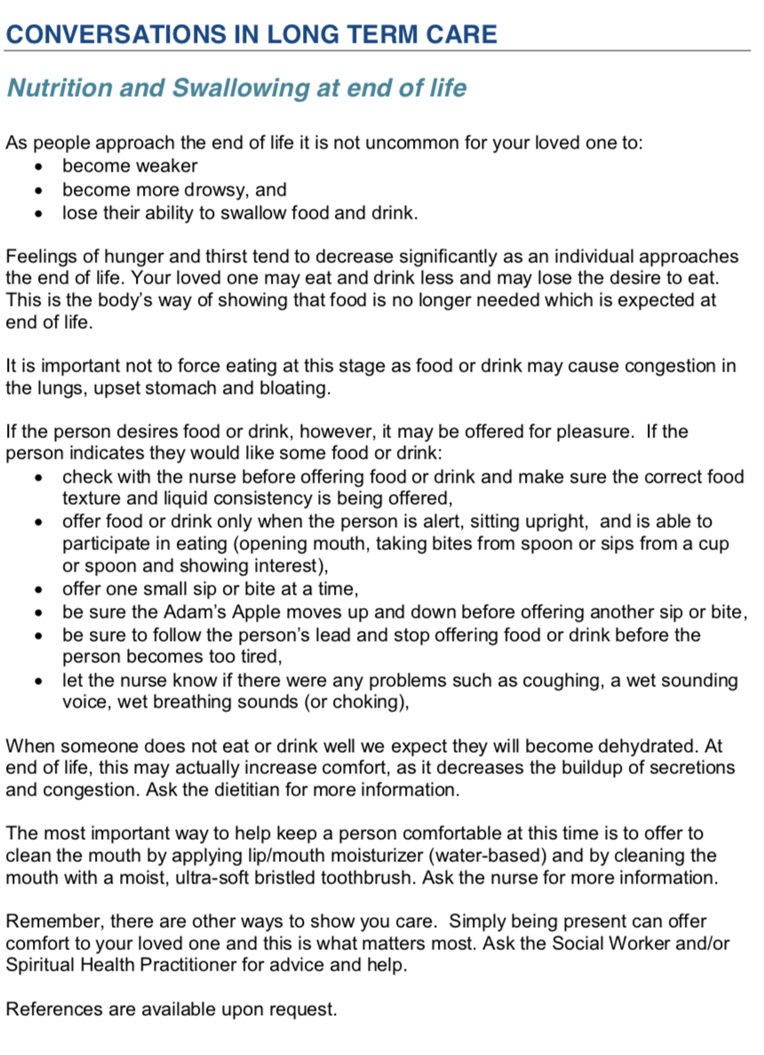
Resources for Residents, Substitute Decision Maker and Family
Conversations in LTC: Eating at End of Life
Purpose: to aid in conversation with substitute decision maker and family as the person nears the final days of life:
Notes:
Lastly, this resource is titled: Conversations in LTC: Eating at End of Life.
As the resident’s conditions progresses towards end of life, what we typically see:
Many people at end of life become, weaker, more drowsy, less able to swallow. The resident may eat or drink less and may overall lose their desire to eat. However, at this time, food or drink may be offered for pleasure, in a controlled situation, as food has less of a nutritional purpose.
In this handout, it reinforces the importance of keeping the resident comfortable, and offers other ways of providing care, such as oral care.
Therefore, the purpose is….
to increase understanding of the family and supports on the anticipated changes that occur as a resident approaches the end of life. And Aims to highlight the importance of keeping the person comfortable at this time.

Slide 12
Project Deliverables
PowerPoint Presentations:
With representations from Clinical Nutrition, Speech Language Pathology, Social Work, Spiritual Health, Nursing, and Health Care Aides, and others
Allied Health (28 attendees)
LTC RD Practice Council (45 attendees)
Calvary Place (25 attendees)
Concordia Place (15 Attendees)
Huddles:
4 sites, 15 huddles, 115 staff
Sites: Misericordia, Concordia, Deer Lodge, Middlechurch Home

Slide 13
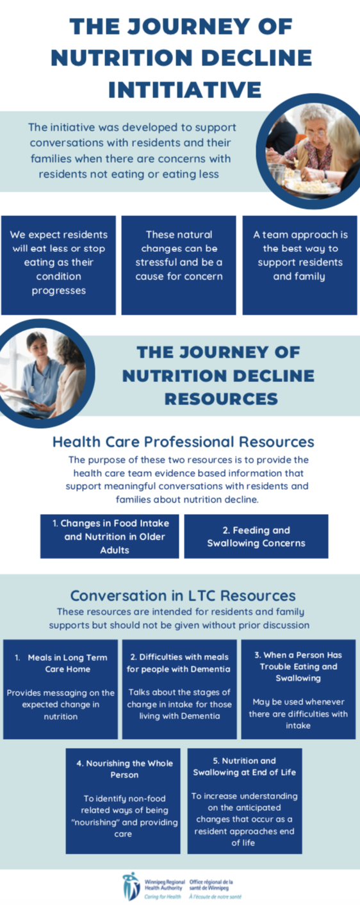
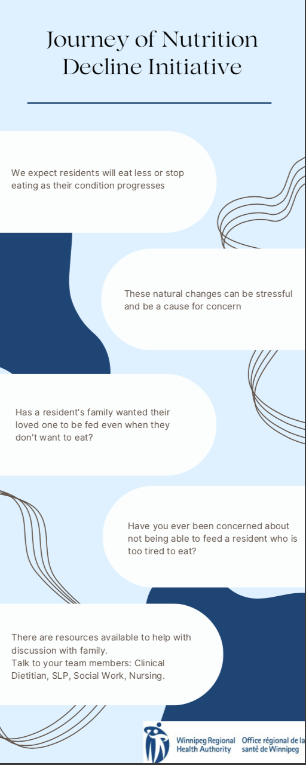
Project Deliverables Continued
PowerPoint Voiceover
10 minute Huddle Script
Three Infographic Drafts
Notes:
Voiceover PP
Presentation on the Journey of nutrition decline initiative
This will serve as a tool that can be replayed and used at multiple sites.
10 minute huddle voiceover + script
The Huddle script is a summary of the could be used for sharing information to front line staff.
Infographic drafts: 3
First: infographic huddle advertisement
The other two are on the next slide, which we would like to request feedback for future use
Overall there are several tools being developed and resources that will soon be available to help reinforce this initiative.

Slide 14
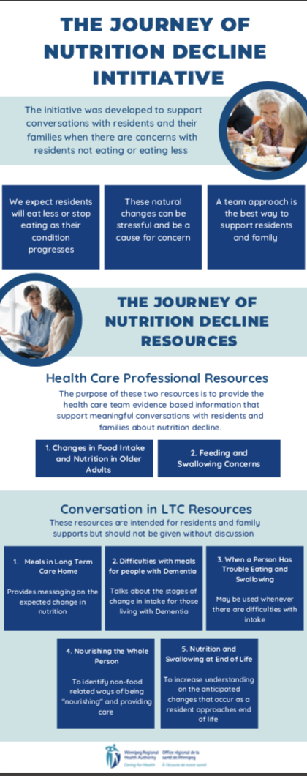
The purpose of the initiative
Why do residents decline?
Two resources intended for healthcare professionals
These tools may also be used as references
Five resources intended for residents and families to support in conversation
Notes:
This infographic can be used as a poster. This can be displayed at your site.
In this infographic it discusses the purpose of the initiative, as well as summarizes the intended use of each of the seven resources.
OVERALL FEEDBACK
How should the resources be used – posting
Use in education: education fairs… other things
e.g. posted on units, in elevators, staff room,

Slide 15
“We expect residents will eat less or stop eating as their condition progresses”
“The natural changes can be stressful and be a cause for concern”
“Has a resident’s family wanted their loved one to be fed even when they don’t want to eat?”
“Have you been concerned about not being able to feed a resident who is too tired to eat?”
“These are resources available to help with discussion with family. Talk to your team member: Clinical Dietitian, SLP, Social Work, Nursing”
Notes:
This is the second infographic created. This can serve as an advertisement tool of the initiative.
The points quoted above display the text written on the infographic.
OVERALL FEEDBACK
How should the resources be used – posting
Use in education: education fairs… other things
e.g. posted on units, in elevators, staff room,

Slide 16
Meeting with PCH Educators
Interest expressed in the initiative
Awareness/Implementation varied
To review the infographics

Slide 17
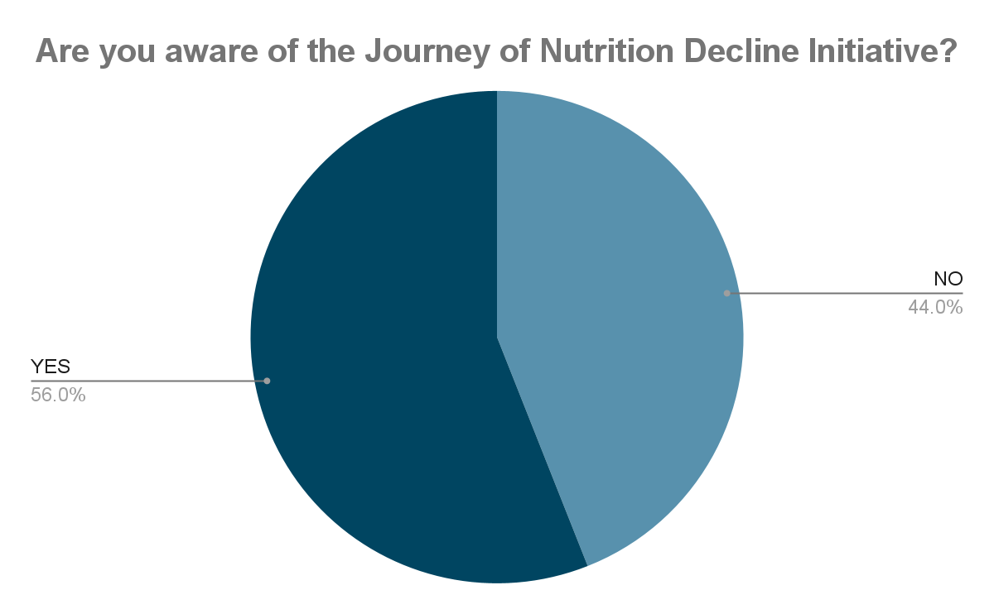
PCH Educator Survey Results
NO (44%)
YES (56%)
Notes:
Are you aware of the Journey of Nutrition Decline Initiative?
56% YES (16 participants)
44% NO (~13 participants)

Slide 18
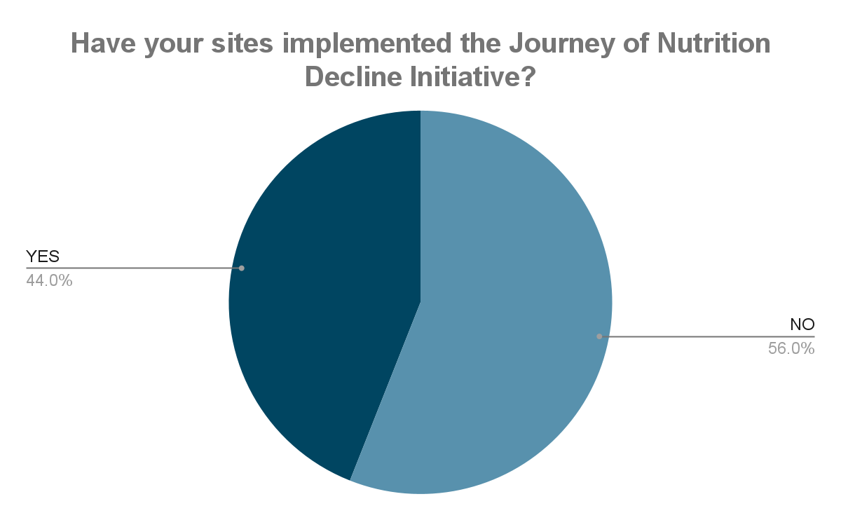
PCH Educator Survey Results
YES (44%)
NO (56%)
Notes:
Has your site implemented the Journey of Nutrition Decline Initiative?
44% YES (~13 participants)
56% NO (16 participants)
Implementation is awareness of all staff of this initiative with the goal of consistent communication with family, and involvement of the team members involved in the initiative when there are concerns or distress on the part of family.

Slide 19
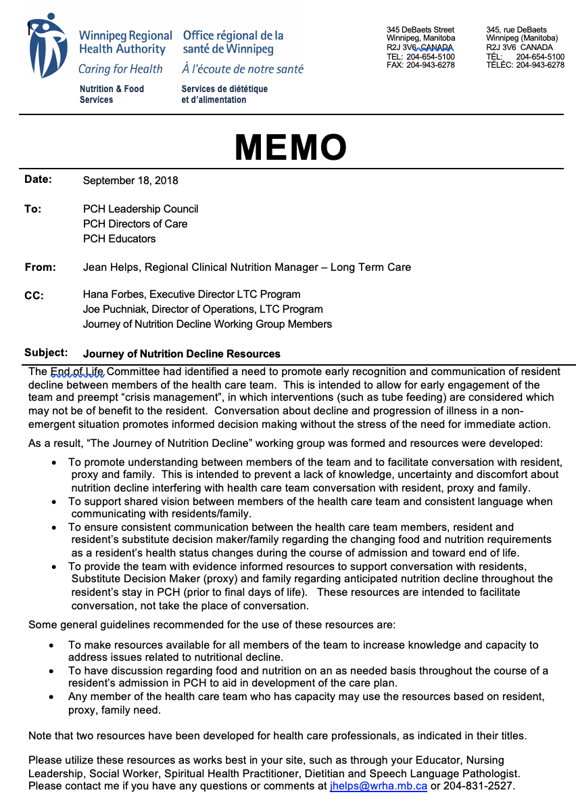
What’s Next? “Conversation about decline and progression of illness in a non-emergent situation promotes informed decision making without the stress of the need for immediate action” Memo 2018
Re-new awareness and knowledge, and desire to implement this initiative
Re-examine current use of this initiative
Use of resources to support CONVERSATIONS
Resources may be used by any member of the team
Notes:
A memo was sent out in the fall of 2018 promoting this initiative. (Which the photo on the right)
We had a year and bit to implement before our focus changed to addressing the pandemic.
Some sites have fully implemented this initiative
Some disciplines use the resources to support messages consistently
We are bringing this initiative back to people’s attention. Hence this presentation
So that more sites and more disciplines can use this initiative and the resources developed to support conversation.

Slide 20
Questions/Comments

