Slide 1
Journey of Nutrition
Decline Initiative
1
Notes:
Hello everybody,
Through this presentation, we want to bring back to people’s awareness the Journey of Nutrition Decline initiative, which was completed in September 2018. Since then, implementation has varied among sites with some sites using the resources developed, and others likely not aware of the initiative.
The key activity of this initiative is to promote conversation, with resources available to support those conversations.
1

Slide 2
Table of Contents
Working Group Members
Working Group Plan / Purpose
Guiding Principles
Overview of Resources
Conclusion
Tools Currently Available
Notes:
We will be discussing the following:
We will start of by introducing the Working Group Members that developed the project
Working Group Plan / Purpose
Guiding Principles that shaped this initiative
We will discuss all the resources that were developed (7 of them in total)
Finally, wrap it up with our conclusion
And share the some of the tools available and what’s next?

Slide 3
Working Group Members
Carla Kehler, Spiritual Health, Simkin Centre
Indira Mike, Regional Speech Language Pathology Manager
Jean Helps, Regional Clinical Nutrition Manager - LTC
Jodi Fernandes, Director of Nutrition and Food Services, Middlechurch Home
Joyce Klassen, Educator, Alzheimer Society of Manitoba
Kelly Tye Vallis, Speech Language Pathologist, SLP – LTC Program
Lisa Back, Clinical Dietitian, Holy Family Home and Simkin Centre
Meagan Fitzpatrick, Social Worker, Beacon Hill Lodge
Nada Ivankovic, Nurse Manager, Simkin Centre
Ruth Krupka, EOL WG member, Clinical Dietitian, Calvary Place & Lion’s Personal Care Home
Notes:
I want to begin by acknowledging the working group members, which are listed above.
They are an inter-professional group, which come from a variety of sites. The working group was formed in January of 2016, as a subgroup of the LTC End of Life Working Group.
The working group include members from Spiritual Health, Speech Language Pathology, Social Work, Nursing, Clinical Nutrition as well as representation from the Alzheimer's society.
Again, this a group from multiple professions, across several sites.

Slide 4
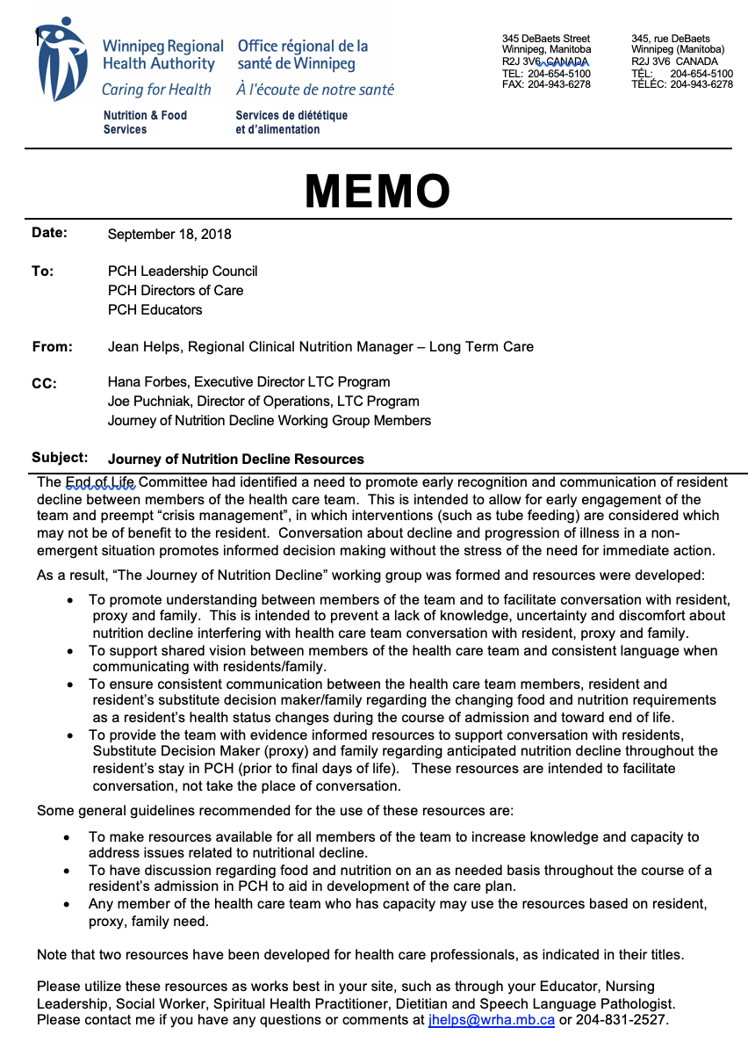
Journey of Nutrition Decline
Working Group Plan
“Journey of Nutrition Decline Working Group” was formed to develop resources for staff, resident, substitute decision maker and family addressing the changing needs over the course of admission to support CONVERSATIONS.
Notes:
A memo was sent out in the fall of 2018 promoting this initiative. (Which the photo on the right)
The journey of nutrition decline working group was formed based on a recommendation from the LTC End of Life Committee to promote conversation with support from resources. The goals are to…
(1) ensure common understanding and consistent language between the healthcare team when facilitating conversation with the residents and/ or their family supports
These resources are there to help the team engage in meaningful conversations with residents and family supports on the anticipated nutrition decline their loved ones may experience during the course of their admission.
When we say “over the course of admission” we are referring to the entire time that the resident is living in a PCH.
And lastly, the goal is to pre-empt interventions that may not have benefit, such as tube feeding at end of life for residents living with dementia.
These resources are intended to support conversation (and are NOT to be handed out without context and discussion). Again, they are tools to enhance conversation.

Slide 5
General Guiding Principles
The vast majority of individuals who live in a PCH will remain in this setting to end of life, but we do not always meet end of life needs.
On-going communication is essential to allow informed decision making
Lack of conversation may be as a result of uncertainty and discomfort about what needs to be said and how it needs to be said.
5
Notes:
Next, I’ll be discussing the 5 guiding principles of this initiative.
The majority of individuals who live in PCH will remain in this setting until end of life, but despite our best efforts, we do not always meet end of life needs.
Therefore, the second guiding principle talks about ongoing conversation and how essential it is to allow for informed decision making in a non-emergency situation.
What i mean by that, is people may not always be able to make the best decisions in short time periods, When under stress and when emotions are high
Therefore, our goal is to start conversations early, even as early as the the point of admission.
If we have on-going conversation about where the residents are in their health and what options are available to them, we will be more likely to provide the best care to the resident
Lack of conversation may be as a result of uncertainty and discomfort about WHAT needs to be said and HOW it needs to be said.
We may not always feel comfortable about having these conversations when residents are eating less or stop eating. Therefore one of the intentions of this material is to enhance comfort around conversation in this area.
5

Slide 6
General Guiding Principles
4. Consistency in the messages provided by the health care team to resident and family supports is essential to ensure understanding and comfort.
5. Good communication is required between the healthcare team members in order for consistency in messaging to occur.
6
Notes:
4. Consistency in the messages provided by the health care team to resident and their family supports is essential to ensure understanding and comfort with information provided.
5. Finally, Good communication is required between the healthcare team members in order for consistency in messaging to occur.
The goal is that everyone on the team is on the same page with regards to approach to care and have a common understanding of where the resident’s are in their health.
6

Slide 7
Guiding Principles – “Whole Person Care”
“Whole person care” refers to addressing the physical, mental, emotional, relational and spiritual needs of each person living in LTC.
Each person is intrinsically unique with individual needs, preferences and wishes which must be recognized and respected throughout their journey in LTC.
Good palliative care is about meeting the needs of the whole person not just their condition, and ensuring the person is living safely with dignity, comfort and without distress.
Notes:
During the original work of the team, the Spiritual Health Practitioner recommended the term “whole person”.
The Whole person care principle addresses the physical, mental, emotional, relational, and spiritual needs of people living in PCH, as every person is uniquely different in their needs, preferences, and wishes.
The care we provide to residents at each point of their time in PCH, including end of life care, should be done so by meeting the needs of the person rather than the condition. Moreover, ensuring the person is safe, dignified, and comfortable is something that cannot be stressed enough.
The resources developed for the journey of nutrition decline aim to meet these sensitive and specific needs of each resident at all points of their time in PCH.

Slide 8
Resources for Health Care Professionals
Resources for Residents, Substitute Decision Makers and Family
Conversations in LTC: Changes in Food Intake and Nutrition in the Older Adult
Conversations in LTC: Feeding and Swallowing Concerns
Conversations in LTC: Meals in Long Term Care Homes
Conversations in LTC: When a Person has Trouble Eating
Conversations in LTC: Difficulties with Meals for Those with Dementia
Conversations in LTC: Nourishing the Whole Person
Conversations in LTC: Eating at End of Life
Notes:
Let’s now briefly review the resources.
The working group developed a total of 7 resources.
The first two resources on the left were developed specifically for Health Care Professionals in LTC to provide evidence-based information that can be utilized by members of the HCT who may need to have conversations with resident, family or supports.
The resources include Changes in Food Intake and Nutrition in the Older Adult; as well as Feeding and Swallowing Concerns.

Slide 9
Health Care Professional Resources:
Conversations in LTC: Changes in Food Intake and Nutrition in the Older Adult
Key components:
Expected Physiological changes
Social and emotional meaning of food
Points for practice
Notes:
The first health care professional resource is: Conversations in LTC: Changes in Food Intake and Nutrition in the Older Adult
This resource speaks to how the focus of care when a person is first admitted to a long-term care facility typically is to optimize nutrition. As malnutrition has been associated strongly with negative consequences including impaired immune response, impaired muscle and respiratory function, delayed wound healing, and overall reduced functioning, promoting adequate nutrition is of benefit.
However, needs change over time as a person’s medical status progresses
As mentioned, this resource is intended for professional use and goes on to highlight several important points:
First, it discusses the Expected Physiological changes: So, as people decline, food is not used in the same way by the body and in fact, food may cause discomfort at end of life.
EXAMPLE: When the person is nearing end of life, they may no longer accept food or fluids due to the shutting down of the body’s systems, including the digestive system. However, maintaining resident comfort is the team’s goal.
Next, we know that food has meaning beyond nutrients to support life. Food has a strong social and emotional meaning. As professionals, we need to be aware of this as there is nutrition decline.
EXAMPLE: The meaning of food from a cultural perspective may become even more important during this time. Therefore, it is important to remember that:
a. We must take our cues from the person to determine what is important to them.
b. Thinking logically, WE may understand that food is not as important as one approaches end of life, but from an emotional perspective, there may be great difficulty for family to accept this fact. It is important to ensure there is understanding that a person is not ‘starving’ and that there are other types of care that can be provided to give comfort (such as pleasure feeds).
3. Lastly, some important points to be mindful of in practice include:
As a basic part of person-centered care, we need to give thought to respect for the individual and give consideration to the unique values and personal history each individual comes with, so we are best able to determine the importance of foods and fluids during their stay, especially as decline in intake occurs.

Slide 10
Health Care Professional Resources:
Conversations in LTC: Feeding and Swallowing Concerns
Key components:
Common feeding and swallowing concerns
Why feeding and swallowing issues are of concern
Strategies for prevention of choking and aspiration
Important points for everyone to know
Notes:
The second resource that is intended for professional use highlights feeding and swallowing concerns in PCH. Speech Language Pathology took responsibility for this resource
The document discusses several points:
First, what some of the common feeding and swallowing concerns are - this refers to the difficulties with chewing, holding, pocketing, coughing and throat clearing
Next is WHY feeding and swallowing issues are such a concern in LTC - this ties the previously mentioned concerns to the risks associated with aspiration and choking.
Next is what can be done to help prevent choking and aspiration - this refers to the benefits of early identification, training of staff and families who assist, and a review of general feeding and swallowing strategies.
Finally - This resource discusses what is important for families to know - again reiterating the important concepts related to the anticipated overall decline, and the encouragement of conversations around options and outcomes.
Key point to remember with this resource - is that building on the health care team’s knowledge and comfort around having these conversations will benefit everyone involved.

Slide 11
Resources for Health Care Professionals
Resources for Residents, Substitute Decision Makers and Family
Conversations in LTC: Changes in Food Intake and Nutrition in the Older Adult
Conversations in LTC: Feeding and Swallowing Concerns
Conversations in LTC: Meals in Long Term Care Homes
Conversations in LTC: When a Person has Trouble Eating
Conversations in LTC: Difficulties with Meals for Those with Dementia
Conversations in LTC: Nourishing the Whole Person
Conversations in LTC: Eating at End of Life
Notes:
Next, we’ll be discussing the other 5 resources on that right. These resources were created to support conversations on “nutrition decline” with residents and their family supports.
Because these resources were developed for resident and their family, all 5 of these have been created with the goal of a readability at a grade 8 level. Therefore, it meant to be simple and easy to read.
And again they are not intended to be given without conversation or take the place of conversation. Therefore, it is important to provide context and to have discussion with the resident and or family when sharing these resources.

Slide 12
Resources for Residents, Substitute Decision Maker and Family
Conversations in LTC: Meals in Long Term Care Homes
Purpose: to aid in conversation soon after admission and thereafter as needed to:
Describe meal provision in PCH
But also conveys that:
there will be times when a resident will eat less, and the team becomes involved to help support the resident during that time
when people eat less it can be stressful due to the special meaning food can have
Notes:
The first Resource - titled Meals in LTC Homes –
The purpose of this resource is to let residents and family know what meals look like in LTC and that there are supports in setting up the meal plan. Our goal is to meet with residents upon admission to discuss the cycle menu, determine food preferences, and take into account personal, cultural, and historical aspects of food, in order to create an individualized nutrition care plan.
However, this resource also conveys the gentle message that nutrition decline is expected
When a person eats less it can be a source of stress to those involved. We know food has a greater meaning than just the intake of nutrients to support life. We need to pay attention to the cues that the resident and family are giving to ensure we are providing the best care possible. Regular communication at this time can help ensure the resident, and family supports understand what is occurring and what the care team is doing to provide care in line with the resident’s wishes. It can also prevent the need for crisis management later on.
We know that food has special meaning and that eating is often a highlight of the day for people in LTC. We recognize that what the meal time means to one person will be quite different from another. This may also change throughout the person’s LTC stay, however regular communication by the team can help us stay in tune with how the person is feeling and what is important to them.
Again, our goal is always providing the best care possible.

Slide 13
Resources for Residents, Substitute Decision Maker and Family
Conversations in LTC: Difficulties with Meals for those with Dementia
Purpose: to aid in conversation soon after admission and thereafter as needed:
To increase understanding about the progression of dementia for the person and how it may affect the person’s meals.
Notes:
This next resource - titled Difficulties with meals for those with dementia - applies to the decline in food intake and nutrition specifically to residents affected by dementia.
The resource explains how the changes in the brain caused by dementia may affect their intake at mealtimes. In most cases, changes in a person’s ability to eat occur slowly but often worsen over time. The resource describes what is seen in each of the phases of dementia and how the resident may respond to food.
For example in early stages of dementia, a person’s eating habits may not change a lot, but there may be some memory loss which can lead to the resident missing meals or forgetting that they have eaten. Therefore, residents at this stage may need cueing.
On the other hand, if someone is in a later stage of dementia, the focus may be more on enjoyment of their favourite foods, rather than maintaining a healthy diet.
This is an important reinforcement as we must keep person centred care at the forefront of the care we provide.
The resource goes on to describe the transition to comfort-based nutrition care for residents with dementia towards end of life.

Slide 14
Resources for Residents, Substitute Decision Maker and Family
Conversations in LTC: When a Person Has Trouble Eating
Purpose: to aid in conversation whenever there is difficulty with eating. May be provided more than one time.
To increase understanding about changes in status and reasons for those changes
To provide information that when resident status changes, food may not help
To provide information on what we may focus on when intake is poor and is not expected to improve.
Notes:
This next resource is called: Conversation in LTC: When a Person Has Trouble Eating.
This resource would be useful when it is identified that the person is having more difficulties eating and changes have been noted.
In this handout, it addresses WHY people often have a difficult time eating- which either could related to swallowing issues, acute illness, and/or progressive conditions.
For example: if someone has a UTI, they typically may not feel well, which may lead to them eating less, and therefore affecting their nutrition status.
If family is concerned, because they notice their family member eating less, this resource can accompany that conversation.
As the health care provider, this resource can be used to guide conversations such as:
how to identify if their love one has difficulties swallowing
why feeding/ swallowing issues are such a concern
what does the care team do to help loved ones when difficulties come up
what do I (as the family member) need to know about my loved one’s difficulties with eating.
Therefore, this handout addresses common questions that arise and serves as a conversation GUIDE for the healthcare team. The resource assures the family that a team approach will be taken to help manage the issues and reiterates the importance of making mealtimes a pleasant experience.
Lastly, this handout also includes information about the expected change in nutrition… in the resource it says: “Decreased intake may be related to natural changes that occur with aging”.. And as a resident approaches end of life, this same resource may be provided as part of the conversation.
So again, this resource can be used multiple times as needed.

Slide 15
Resources for Residents, Substitute Decision Maker and Family
Conversations in LTC: Nourishing the Whole Person
Purpose: to aid in conversation upon admission and thereafter as needed when intake is normal or declining:
To expand perspectives of “nourishment" beyond food and eating issues
To provide ideas for alternate ways of showing love and care to loved ones
To emphasize the value of presence when visiting loved ones in LTC
To ease stress by providing ideas for meaningful interaction during these visits
Notes:
This next resource is called: conversations in LTC: Nourishing the Whole Person.
The purpose of this resource is to identify non-food related ways of being “nourishing” and providing care. This resource offers suggestions for activities that focus on quality time and nurturing relationships during visits in long term care.
The list is divided into Body, Mind, Heart, Soul and Spirit
For example, this includes:
Nourishing the body: through movement, talking walks together, enjoying nature.
Nourishing the mind: through reading, watching family videos, looking at photo albums together, and sharing stories together
Spiritual Health and Social Work team members may find this tool particularly helpful. We want to ensure the family knows that we are not abandoning their loved one when a person is eating less or not eating, but we are changing the focus of our care.
Overall, the handout focuses on ways to nourish the physical, emotional, psychological, spiritual needs of The Whole Person.

Slide 16
Resources for Residents, Substitute Decision Maker and Family
Conversations in LTC: Eating at End of Life
Purpose: to aid in conversation with substitute decision maker and family as the person nears the final days of life:
To increase understanding of usual status of people at end of life.
To reinforce reduced role of food and potential negative consequences of eating and drinking
To inform of the possible role of food and drink for pleasure and providing guidelines for consumption with comfort
To focus on other ways to show care
Notes:
Lastly, this resource is titled: Conversations in LTC: Eating at End of Life.
As the resident’s conditions progresses towards end of life, what we typically see:
Many people at end of life become, weaker, more drowsy, less able to swallow
In addition, feelings of hunger and thirst tend to decrease significantly as an individual approaches end of life. The resident may eat or drink less and may overall lose their desire to eat.
However, at this time, food or drink may be offered for pleasure, in a controlled situation, as food has less of a nutritional purpose.
In this handout, it reinforces the importance of keeping the resident comfortable, and offers other ways of providing care, such as oral care.
Therefore, the purpose is….
to increase understanding of the family and supports on the anticipated changes that occur as a resident approaches the end of life.
And Aims to highlight the importance of keeping the person comfortable at this time.

Slide 17
In Summary
Best care is supported by:
Understanding resident status, including resident decline, by all members of the health care team.
Including resident, substitute decision maker and family in this understanding of resident status
Using the resources as needed in communicating messages around nutrition decline
Notes:
Best care is supported by:
All members of the HCT having an understanding of the resident’s status – communication is obviously crucial for this to happen
One of our biggest challenges is communication (both between the HCT and with resident/family).
In this presentation, we have had a number of conversations about who this practice is intended for:
To reiterate, these conversations are intended for any resident and their family/supports, when it’s identified to be valuable. In other words, not all family would necessarily need these conversations if they are comfortable with changes in the resident.
While you may only need to check in with some residents/family; with others you may have a longer conversation earlier in the person’s stay in the facility, depending on the residents health status.
To sum up, the handouts can support meaningful conversation with residents, and their family and supports on the expected change in food intake their loved one may have during personal care home admission.

Slide 18
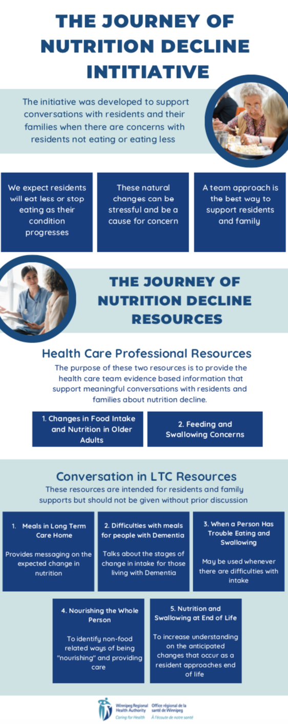
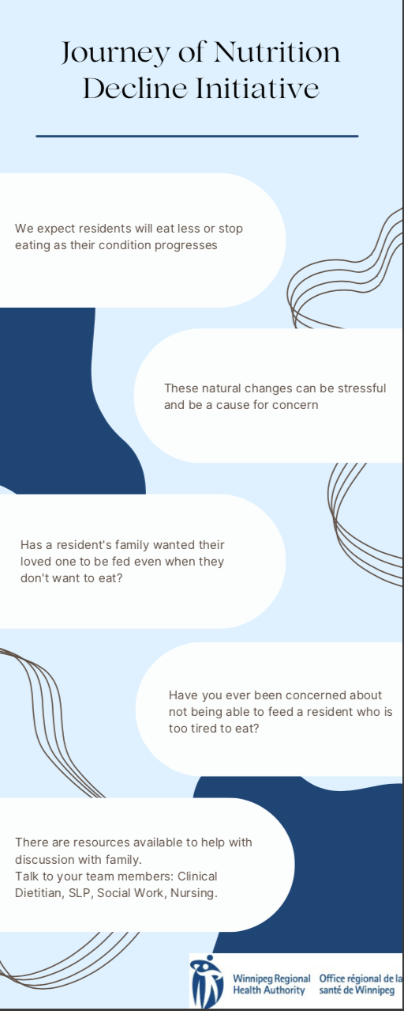
Tools Currently Available
PowerPoint presentation voiceover
Huddle Script:
a 10 minute conversation
Infographics:
A poster for ongoing awareness and reinforcement
Notes:
Tools currently available to help reinforce the important concepts of this initiative:
We’ve developed the following:
PowerPoint presentation voiceover:
This is an educational tool that can be shared at multiple sites to bring awareness of the initiative and the resources to equip the staff on the intended use of the resources.
Secondly, is a Huddle Script that was developed that summarizes this presentation in less than 10 minutes.
This could be used for sharing information for front line staff.
Infographics
I will share a picture of both of them on the next slide.

Slide 19
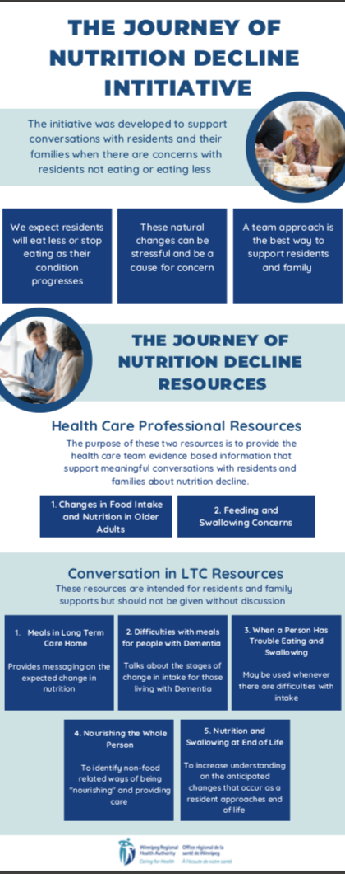
The purpose of the initiative
Why do residents decline?
Two resources intended for Healthcare Professionals
These tools may also be used as references
Five resources intended for residents and families to support in conversation
Notes:
This infographic can be used as a poster. This can be displayed at your site.
In this infographic it discusses the purpose of the initiative, and summarizes the intended use of each of the seven resources.

Slide 20
“We expect residents will eat less of stop eating as their condition progresses”
“The natural changes can be stressful and be a cause for concern”
“Has a resident’s family wanted their loved one to be fed even when they don’t want to eat?”
“Have you been concerned about not being able to feed a resident who is too tired to eat?”
“These are resources available to help with discussion with family. Talk to your team member: Clinical Dietitian, SLP, Social Work, Nursing”
Notes:
This is the second infographic created. This can serve as an advertisement tool for the initiative.
The points quoted above display the text written on the infographic.

Slide 21
We hope this initiative and its resources can help you to have meaningful conversations with residents and families if needed on the topic of Nutrition Decline.
Notes:
If it hasn’t been said enough throughout this presentation, we want to share the key message is about conversation, and comfortably using the resources as you see fit, to support those conversations you have whether its with the resident or the family.
You may use these tools routinely as part of your practice.
The site(s) you work in may or may not already use these in practice.
We hope this initiative and its resources can help you to have meaningful conversations with residents and families if needed on the topic of Nutrition Decline.

