Slide 1
Abdominal Assessment
Case Study 1
Notes:
Welcome to the abdominal assessment video on inspection.

Slide 2
Using this case study
There is no voice over for this case study.
Read the scenarios and talk the assessments through – best as a group so you can learn from each other
Combine your clinical expertise to find the solutions
Have fun learning!

Slide 3
Mr. Anderson, 74y.o.
Parkinson’s and lewy body dementia
Difficulty expressing himself
Uses an incontinence brief
OA of the knees and chronic low back pain
Overactive bladder
HTN
Unsteady gait – has stopped walking as much as he used to
VS normal: 36.5, 80, 14, 132/84, SPO2 96%

Slide 4
Ferrous sulfate 300 mg po BID
Calcium Carbonate 1250 mg po daily
Vitamin D 10, 000 Units once a week
Duloxetine (Cymbalta) 60 mg daily
Quetiapine 12.5 mg orally at hs
Quetiapine 12.5 mg TID prn for agitation
carbidopa-levodopa 100/25 mg po FIVE times a day
Metoprolol 50 mg BID (1% incidence of constipation)
Tolterodine LA (Detrol) 4 mg daily
Hydromorphone 0.5 mg TID
Hydromorphone 0.5 – 1 mg TID prn for breakthrough pain
Notes:
Ferrous sulfate 300 mg po BID
Calcium Carbonate 1250 mg po daily
Potassium Chloride 600 mg po daily (the medication itself doesn’t contribute to ileus but hypokalemia can-maybe we need to check levels if they haven’t been checked in a while)
Vitamin D 10, 000 Units once a week (doesn’t contribute but most residents are on this, to make it look like a “real” medication list J)
Duloxetine (Cymbalta) 60 mg daily
Quetiapine 12.5 mg orally at hs
Quetiapine 12.5 mg TID prn for agitation
carbidopa-levodopa 100/25 mg po FIVE times a day
Metoprolol 50 mg BID (1% incidence of constipation)
Tolterodine LA (Detrol) 4 mg daily (anticholinergic; for overactive bladder)
Hydromorphone 0.5 mg TID
Hydromorphone 0.5 – 1 mg TID prn for breakthrough pain

Slide 5
Today is Friday
You enter his room to find Mr. Anderson in his bed moaning, hands on his abdomen
What information would you look for?

Slide 6
Last BM
Appetite
PQRST pain assessment, and non verbal signs

Slide 7
You check the flow sheets:
Last BM was Monday
Appetite reduced, including not drinking or eating as much as usual
No issues voiding except that he hasn’t been going often and it is very dark in colour
Pain assessment: Use PAINAD scale – holding abdomen RLQ – seems to relax for a few minutes and then grabs at side and makes groaning sounds off and on
Notes:
Pain
P: no clear provocative or palliative influences
Q: describes pain as crampy
R: not radiating – identifies it as right lower quadrant mostly
S: rates the pain 7/10
T: continuous pain

Slide 8
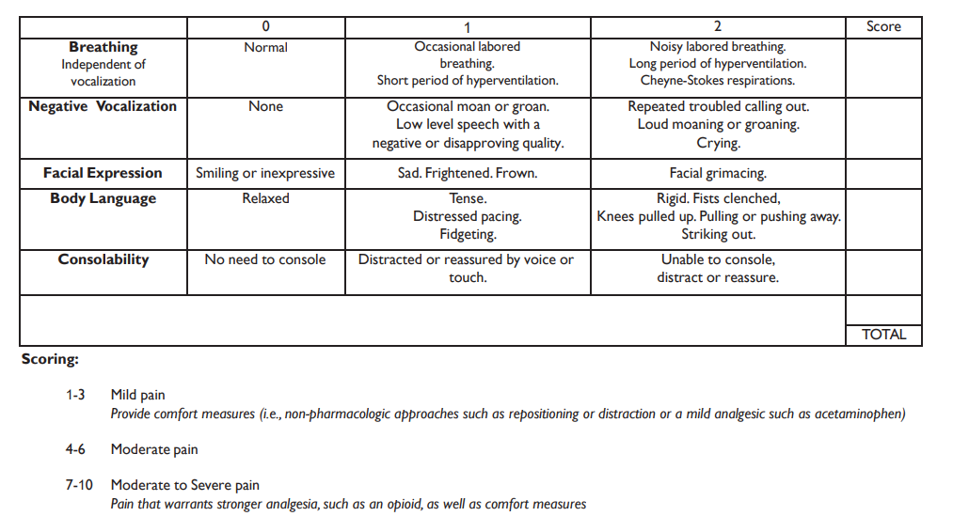
1
1
2
2
1
7

Slide 9
You decide more physical assessment is required.
What will you assess?

Slide 10
38, 92, 20, 140/92, SPO2 96%
Abdomen protuberant, firm
Bowel sounds hypoactive to all four quadrants
No masses palpated with light or deep palpation
Mucous membranes dry
Eyes sunken, skin tenting
Notes:
https://www.amboss.com/us/knowledge/Bowel_obstruction

Slide 11
You decide that you should call the doctor
What will you include in your SBAR report?

Slide 12
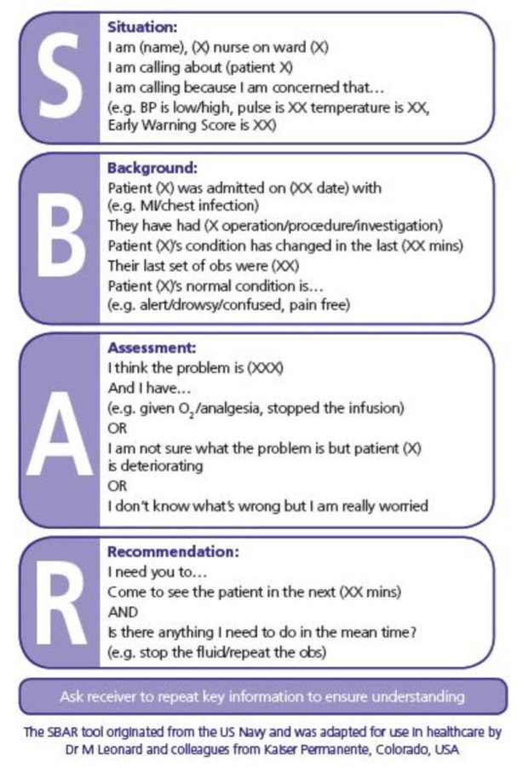
Hello it’s nurse Jane calling from the Happy Doors Personal Care Home. I am calling about Mr. John Anderson. I am concerned that he has a GI problem.
Mr Anderson is 74 years old. He has Parkinson’s disease and is on several medications that could contribute to ileus, including iron, duloxetine, quetiapine, tolterodine LA and hydromorphone. He is having acute pain and is holding his abdomen. He has pain meds for back pain and knee pain, but this acute pain is new. He has had no BM since Monday (4 days) and he usually has a BM at least EOD. He is dehydrated, urine is concentrated, appetite has decreased, and he is not drinking much. His abdomen is distended and firm, bowel sounds are hypoactive to all quadrants. There are no increased signs of pain on palpation.
I think that he may have a bowel obstruction or ileus. I have asked the HCA to hold off on oral intake for now. I think he could use additional fluid.
What would you like me to do as the next steps?
Notes:
Ferrous sulfate 300 mg po BID
Calcium Carbonate 1250 mg po daily
Potassium Chloride 600 mg po daily (the medication itself doesn’t contribute to ileus but hypokalemia can-maybe we need to check levels if they haven’t been checked in a while)
Vitamin D 10, 000 Units once a week (doesn’t contribute but most residents are on this, to make it look like a “real” medication list J)
Duloxetine (Cymbalta) 60 mg daily
Quetiapine 12.5 mg orally at hs
Quetiapine 12.5 mg TID prn for agitation
carbidopa-levodopa 100/25 mg po FIVE times a day
Metoprolol 50 mg BID (1% incidence of constipation)
Tolterodine LA (Detrol) 4 mg daily (anticholinergic; for overactive bladder)
Hydromorphone 0.5 mg TID
Hydromorphone 0.5 – 1 mg TID prn for breakthrough pain

Slide 13
What might you include in your nursing notes?

Slide 14
Entered Mr. Anderson’s room to find him holding his abdomen and moaning in pain, and scores 7 (mod-severe pain) on PAINAD tool. He has had no BM since Monday (4 days) and he usually has a BM at least EOD. Mucous membranes dry, skin tenting, eyes sunken, urine dark amber. Food and fluid intake have dropped significantly in the last few days. His abdomen is distended and firm, bowel sounds are hypoactive to all quadrants. There are no increased signs of pain on palpation. TC to Dr. Seuss. Start hypodermoclysis and monitor closely, keep NPO and monitor vital signs, bowel sounds and abdominal girth. Medication review will be completed by doctor and pharmacist. ------------------------Jane Nightengale RNBN

