Slide 1
Abdominal Assessment
Case Study 2
Notes:
Welcome to the abdominal assessment case study #2

Slide 2
Using this case study
There is no voice over for this case study.
Read the scenarios and talk the assessments through – best as a group so you can learn from each other
Combine your clinical expertise to find the solutions
Have fun learning!

Slide 3
Mrs. Peabody is 85 years old.
Alzheimer’s disease
HTN
Able to communicate simple messages effectively
Walks with a walker and is usually on the go, chatting with the staff and residents
Generally, very pleasant demeanor
VS baseline: 36.6, 76, 14, 132/80, SPO2 97%

Slide 4
Was particularly irritable last week and a urinalysis and urine culture showed trace leukocytes and 10⁵ CFU/L of bacteria. She was started on antibiotics as a result.
Her daughter who usually visits daily had a bad cold and stayed away from the facility last week as a result. She is back today and has come to you to express concern as Mrs. Peabody has soiled her brief with very loose stools three times already this morning and she has been complaining of a sore stomach.

Slide 5
You decide that you should do a focused GI assessment of Mrs. Peabody.
What questions do you have?
What will you do for a physical assessment?

Slide 6
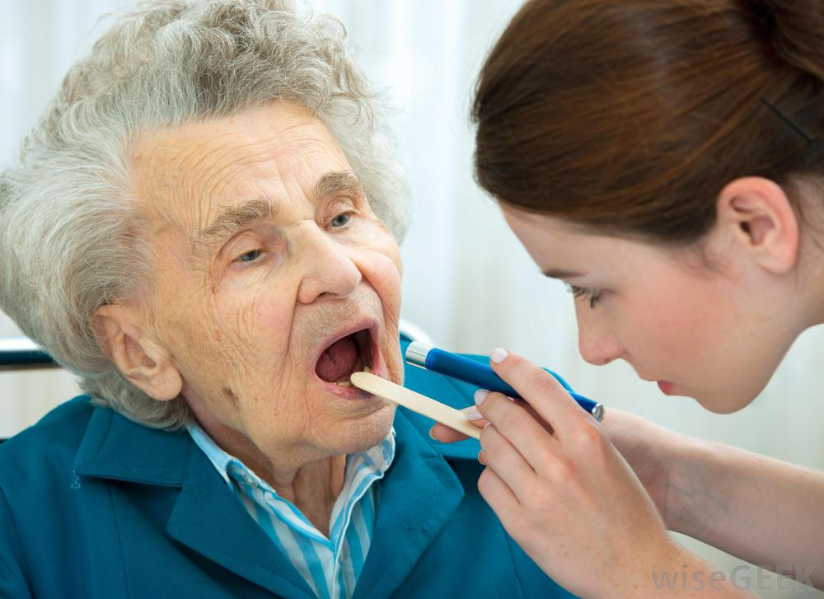
Hydration status
Appetite/fluid intake
BM hx
Pain assessment
Abdominal assessment
Vital signs

Slide 7
Mucous membranes moist
Liquid stool last night before bed – last BM before that was the evening before and that was formed
Appetite was normal for her except last night and this morning she only ate and drank half of her usual amount
Abdomen soft, rounded no palpable masses, tender on palpation
Bowel sounds hyperactive x4 quadrants
VS : 37, 80, 14, 136/78, SPO2 97%

Slide 9
Monitor closely
Consider COVID swab
Culture stool
Encourage fluids and food
Fluid monitoring
Begin Infection control Precautions (consult enteritis protocol)
Notification of family and prescriber

Slide 10
You decide that you should call the doctor
What will you include in your SBAR report?

Slide 11
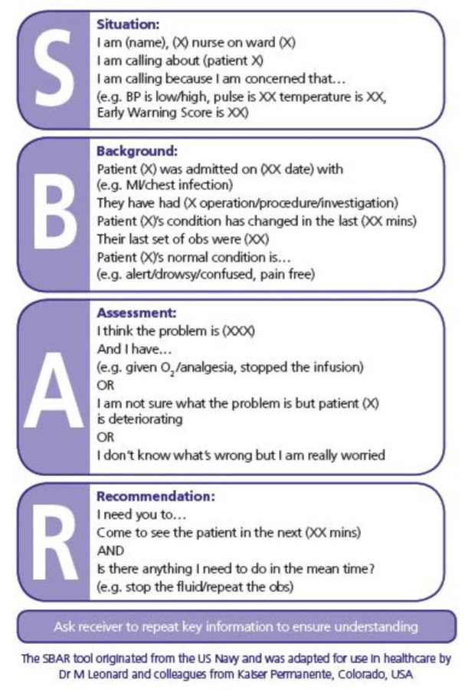
Hello it’s nurse Natalie calling from the Golden Windows Personal Care Home. I am calling about Mrs. Betty Peabody. I am concerned that she has a GI problem.
Mrs. Peabody is 85 years old. She has Alzheimer’s disease and controlled HTN. She is on day 5 of a 10 day course of antibiotics for a UTI. She is having acute achy which comes and goes and she rates a 5/10. She has had loose watery stools last night and again twice this morning. She is well hydrated at this time. Her urine is yellow. Her appetite has decreased, and she is not drinking much. Her abdomen is soft and rounded, bowel sounds are hyperactive to all quadrants, and she expresses pain on palpation. VS : 37, 80, 14, 136/78, SPO2 97%.
I think that she may have gastro secondary to her antibiotics. I have sent a culture of stool and initiated increased monitoring of VS and GI status and encouraging fluids.
Is there anything else that you like me to do as the next steps?
Notes:
Ferrous sulfate 300 mg po BID
Calcium Carbonate 1250 mg po daily
Potassium Chloride 600 mg po daily (the medication itself doesn’t contribute to ileus but hypokalemia can-maybe we need to check levels if they haven’t been checked in a while)
Vitamin D 10, 000 Units once a week (doesn’t contribute but most residents are on this, to make it look like a “real” medication list J)
Duloxetine (Cymbalta) 60 mg daily
Quetiapine 12.5 mg orally at hs
Quetiapine 12.5 mg TID prn for agitation
carbidopa-levodopa 100/25 mg po FIVE times a day
Metoprolol 50 mg BID (1% incidence of constipation)
Tolterodine LA (Detrol) 4 mg daily (anticholinergic; for overactive bladder)
Hydromorphone 0.5 mg TID
Hydromorphone 0.5 – 1 mg TID prn for breakthrough pain

Slide 12
What might you include in your nursing notes?

Slide 13
Mrs. Peabody has had loose/watery stool last night and again this morning x2. She is complaining of abdominal pain (rates as 5 on pain scale, “achy”, intermittent, tender on palpation). Bowel sounds hyperactive x4 quadrants. Her appetite has decreased in the last day. Mucous membranes moist. No signs of dehydration at this time. On antibiotics x5 days of 10 day course. VS : 37, 80, 14, 136/78, SPO2 97%. Notified family (in person) and prescriber. Discussed with daughter and Mrs. Peabody that it is important to keep fluid intake up as much as tolerated. Stool sent for culture. Initiating Gastroenteritis precautions pending culture results. Will monitor intake and output, signs of dehydration, vital signs and abdominal assessment closely. -----Natalie Nurse RNBN

Slide 14
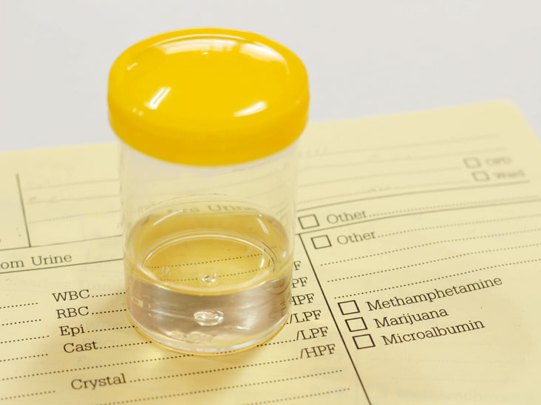
Afterthought…
Is it possible that she had antibiotics unnecessarily?
Next in the learning series: Genito-Urinary Assessment

