Slide 1
Respiratory Assessment
Case Study 2

Slide 2
Using this case study
There is no voice over for this case study.
Read the scenarios and talk the assessments through – best as a group so you can learn from each other
Play this as a slide show so that you can use the interactive components
Combine your clinical expertise to find the solutions
Have fun learning!

Slide 3
Mrs. Lim
84 years old
Mild cognitive impairment
Post COVID, type 2 diabetes
Has been recovering well and getting stronger every day on 2L oxygen. She had no oxygen needs pre-COVID
Baseline VS: 36.8, 78, 18, 124/74, SPO2 96% on 2L

Slide 4
Mrs. Lim
Has been determined that she will “beat this bug” and in good spirits
This afternoon she is irritable and confused, unsure of where she is and snapping at people when they come to talk to her.
You decide to do a respiratory assessment and vital signs

Slide 5
What things are you looking for at this time? (before you touch her)

Slide 6
Things to observe
Notice her posture – in bed.
Irritability and confusion are unusual
Look at work of breathing – is she speaking in short phrases because she is dyspneic?
Colour – Pale? Pink? Cyanosis?
Accessory muscle use visible? Breathing sounds from where you are?
Cough?

Slide 7
You can see that she is breathing quickly
Colour – Pale – you look at her mucous membranes and the inside of her lips is blue-tinged
You do not see accessory muscle use at this point
You ask about a cough. She says she has had no cough and you have not seen otherwise
What do you do next?

Slide 8
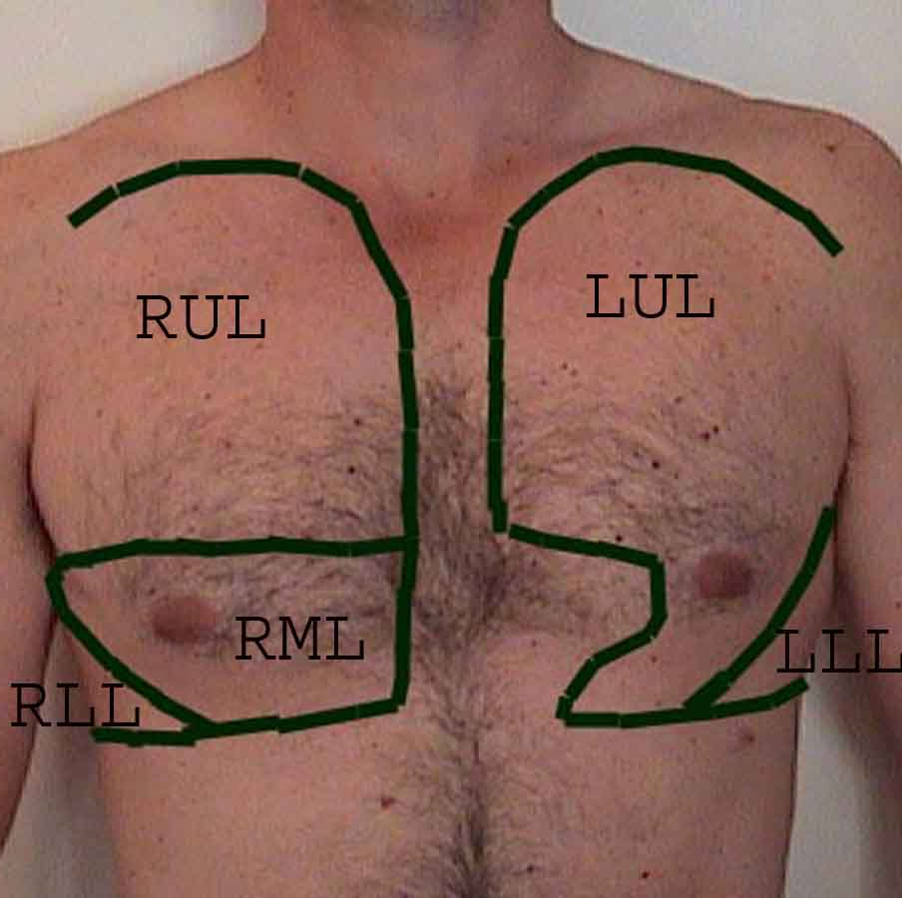
Click on the circles to hear her lungs (ideally listen to front and back)
Don’t forget to use the stepladder (side to side) method so that you can compare sides
What do you hear?
How would you document this?

Slide 9
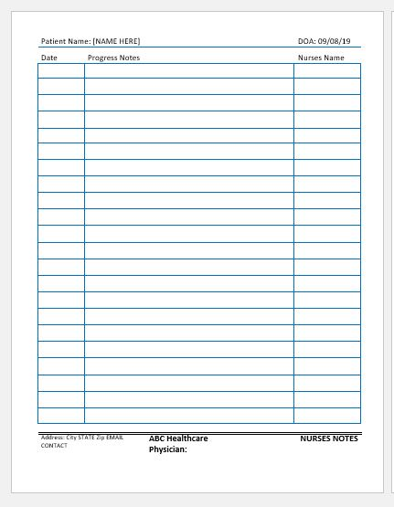
Resident tachypneic, and pale supine in bed. No accessory muscles used for breathing. No cough. She is confused and agitated. Anterior chest assessed. Breath sounds clear to right upper lobe. Coarse crackles to right middle and lower lobes. Expiratory wheeze to upper and lower left lobes.
What else should you assess?

Slide 10
24, regular, deep, symmetrical chest
Respiratory Rate
Pulse
104, regular
BP 140/85
68% on Room air, pulse on probe 88-92
O2 Saturation
Click the circles to see the assessment results

Slide 11
Does anything here seem unusual?
What checks should you do?

Slide 12
Check to make sure that there is nothing that might be complicating the reading on the pulse oximeter, such as:
Nail polish
Bright lights
Impaired perfusion to hands
Dark skin

Slide 13
You double check and redo the O2 saturation to find that the pulse is now reading withing 5BPM of your assessment.
The SPO2 is now 89%
What do you do now? Is there anything else that you haven’t checked?

Slide 14
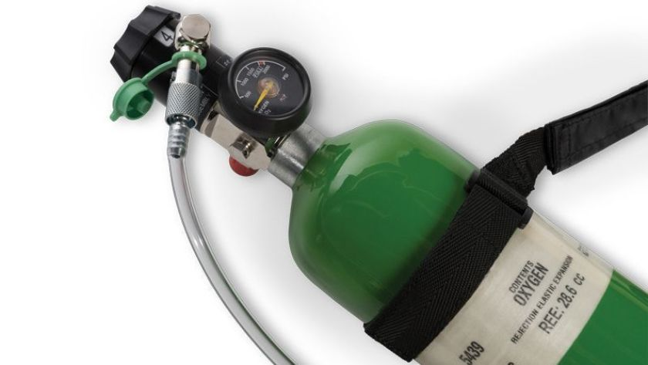
You notice now that the oxygen cylinder is empty!
What do you do?

Slide 15
The oxygen is replaced. You reassess and her SPO2 is now 92%. She is starting to feel more like herself.

Slide 16
Great thinking!
The best way to keep assessment skills sharp is to use them. We hope this review has been helpful.

