Slide 1
Respiratory Assessment
Case Study 1

Slide 2
Using this case study
There is no voice over for this case study.
Read the scenarios and talk the assessments through – best as a group so you can learn from each other
Play this as a slide show so that you can use the interactive components
Combine your clinical expertise to find the solutions
Have fun learning!

Slide 3
Mr. Jones
80 years old
Dementia with expressive aphasia. He has trouble finding words and doesn’t speak very much.
Hx COPD (chronic bronchitis)
Baseline VS: 36.5, 84, 16, 130/84, SPO2 94% on room air

Slide 4
Mr. Jones
Has a pleasant disposition and always happy to see you.
You come into his room in the morning and find him sitting in a chair.
Night staff report he was restless over night.

Slide 5
You say good morning and ask him how he is doing. He says “Oh yes! Very nice. Very nice.”
What things are you looking for at this time? (before you touch him)

Slide 6
Things to observe
Notice his posture – tripod position.
Restless over night may mean something is up
His words are not providing much to go on
Look at work of breathing – is he speaking in short phrases because he is dyspneic?
Colour – Pale? Pink? Cyanosis?
Accessory muscle use visible? Breathing sounds from where you are?
Cough?

Slide 7
You can see that he is breathing quickly
Colour – Pale
You can see pulling at the trachea when he breathes, and hear a rattle
You ask about a cough. He says “very good” and then coughs and the rattle sound clears for now. He swallowed any sputum that may have come up.
What do you do next?

Slide 8
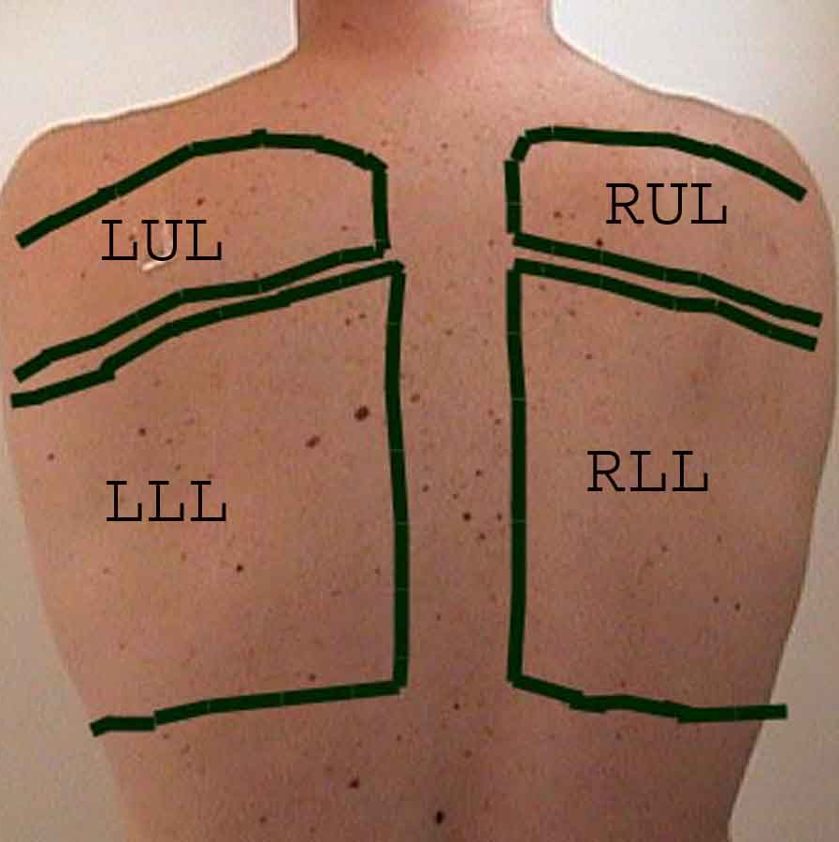
Click on the circles to hear his lungs (ideally listen to front and back)
Don’t forget to use the stepladder (side to side) method so that you can compare sides
What do you hear?
How would you document this?

Slide 9
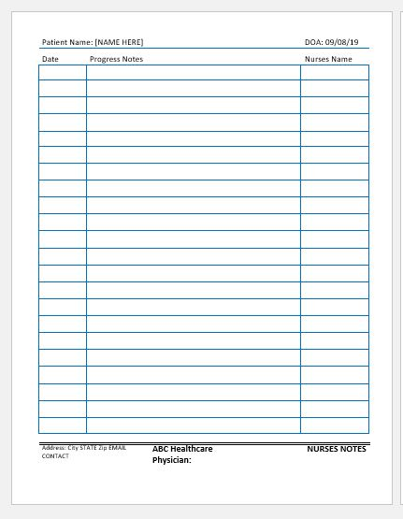
Resident dyspneic, and pale, sitting in tripod position, and accessory muscles used for breathing. (trach tug). Audible rattle with breathing cleared with a productive cough. Unable to assess sputum as it was swallowed. Posterior chest assessed. Breath sounds clear to bilateral upper lobes. Coarse crackles to lower lobes bilaterally.
What else should you assess?

Slide 10
26, regular, deep, symmetrical chest
Respiratory Rate
96, regular
BP 145/95
Pulse
91% on Room air, pulse on probe 94-96
O2 Saturation
Click the circles to see the assessment results

Slide 11
RR 26 and regular, deep, symmetrical chest movements. P 96 and regular. BP 145/95, SPO2 91% on room air.

Slide 12
What will you do next?

Slide 13
Things to consider:
How does his current status compare to his baseline?
How will you monitor him going forward?
What would you tell other staff to look for?
When would you intervene? (call the doctor/NP, oxygen)

Slide 14
Great thinking!
The best way to keep assessment skills sharp is to use them. We hope this review has been helpful.

