Slide 1
Targeted Surveillance
Infection Prevention and Control
Notes:
Strongly suggest handing out copies of the surveillance form for each attendee to use along with the examples included in this presentation.

Slide 2
Part One: LTC Surveillance
By the end of this session you should be able to:
Recognize the impact of society and culture on surveillance practices
Understand the definitions that fit an elderly population and why it is an important paradigm shift
Understand how to operationalize surveillance definitions incorporating them into assessment, documentation and quality improvement initiatives

Slide 3
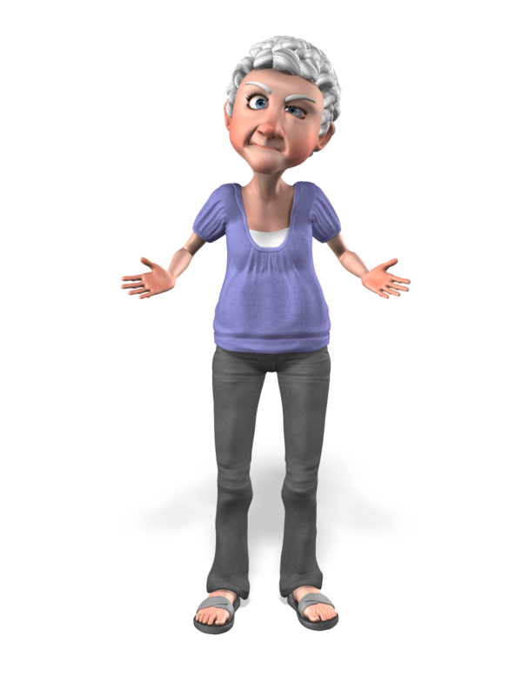
Ageism
“Stereotyping or discriminating against people based on their age – Ageism is the most tolerated form of social prejudice in Canada” Revera Report on Ageism 2012
http://everydayfeminism.com/2013/01/20-examples-of-age-privilege/
Notes:
Age has been used as a criterion for rationing scarce healthcare resources (for example, kidney transplantation), and has been justified on the basis of the greater good versus the individual: that older people have a shorter duration of benefit from treatment and they have had a ‘fair innings’.1 If resources are scarce, it is assumed that they should be assigned to younger people.
Preferential treatment for younger people may have made sense in 1948, when 40% of people died before they reached 65 years of age, compared with the current 7%. It is less defensible now, given the improvement in longevity, the effectiveness of medical interventions for older people which is apparent in clinical practice, and the compression of morbidity into the last years, or even months, of long and active lives
e.g., MB Museum of Human Rts – Ray St. Germain…”want a younger performer”

Slide 4
Targeted Surveillance
In 2013 the format and methodology for surveillance in the WRHA LTC sector was revised to reflect the newest best practice evidence (Stone et al, 2012)
As a result of this research informed approach the program moved to examine a targeted group of infections that are preventable rather than those that little can be done to prevent
The focus and intent of the surveillance program has now become collecting data to inform assessment, infection prevention, and quality improvement initiatives

Slide 5
Total vs Targeted
Data
Action
Data
Total Surveillance included;
Eye, ear, nose, mouth, urinary and gastrointestinal tract infections, skin infections and scabies infestations.
ILI, pneumonias, LRTIs, colds, herpes zoster and simplex infections
Primary bloodstream infection and unexplained febrile episodes
Scabies and fungal skin infections
Targeted Surveillance includes;
Skin, urinary tract infections
Scabies infestations
ILI, colds, pneumonias, LRTIs
Gastrointestinal infections now divided into CDAD and other pathogens
Focus= Using reported rates for continuous improvement
Focus= Reporting rates within literature established benchmarks
Notes:
Data to action! Instead of reporting rates and ensuring they are within ‘acceptable’ published limits, targeted surveillance looks at collecting data on those items you can do something about and then using that data to inspire change and improvement or as evidence of the need for said change - then using the next set of data to measure that improvement/change – this cycle repeats itself until infection rates are as low as possible. Target zero??

Slide 6
Everyone’s Responsibility
Infection Prevention and Control is EVERYONE’s responsibility, this includes surveillance of infections
Surveillance form is to be filled out by frontline nursing staff for each Patient/Resident presenting with signs & symptoms of infection (i.e., even before an antibiotic is ordered)
Used to track the rate and type of infections throughout the facility
Allows IP&C and ward staff to assess and document infectious processes, observe trends, and ensure intervention is timely and appropriate

Slide 7
Example One
Mr. Distal Phalange is an 82 year old male with a hot, red, and swollen lump on his right great toe
His daughter complains that his new
orthotic shoe has been rubbing against
the toe since he got them last week
How would you intervene at this time?
Investigate for other signs and symptoms and DOCUMENT them
In the event that either pus, or a fourth sign occurred it could then be considered an infection!
Notes:
Speaker marginalia (timing tips); After case info shows click to advance to question then pause to discuss. Did anyone answer “call doc for abx” did anyone consider assessing the site to rule out an infection first e.g., is this a stage 1 pressure ulcer. If it isn’t an ulcer and it is indeed an infection, or if it IS an ulcer that is now infected what other clinical data could be used to complete the picture? E.g., if the wound had draining pus it could be considered an infection. Note: Drainage does not always indicate pus – melting slough for example can often be mistaken for pus and it can be difficult to discern between pus and other sources of drainage. Use the entire clinical presentation to determine if/when a particular case meets definition and should be treated. Use the next slide (of the data collection form) to walk through how and when to report) using the example of adding the sign of pus to meet definition (the slide after this expands on the topic of pus)

Slide 9
Side Note
Not all pus is actually pus
Melting slough in a wound can appear very similar to pus
Lab results from a pus filled wound will contain organisms outside the spectrum of normal flora but can also be mixed with flora that is inhabiting the wound but not causing infection
Swab wound bed NOT pus!
Use clinical signs and symptoms in conjunction with lab results to put the puzzle pieces together
The PUS among us
Pus is a protein-rich fluid called liquor puris, usually whitish-yellow, yellow, or yellow brown in color.
Pus consists of a buildup of dead leukocytes (white blood cells) from the body's immune system in response to infection.
It accumulates at the site of inflammation
When the buildup is on or very near the surface of the skin it is called a pustule or pimple. An accumulation of pus in an enclosed tissue space is called an abscess.

Slide 10
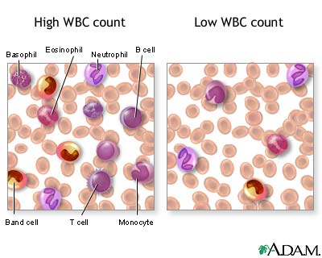
Side Note
Leukocytosis
(WBC >11X10⁹ /L OR left shift (lab reports will indicate ‘left shift’ on smear results)
Leukocytosis refers to an increase in the total number of WBCs due to any cause. It can be caused by infection, inflammation, allergic reaction, malignancy, hereditary disorders, or other miscellaneous causes.
In general, the WBC and neutrophil counts alone are not sensitive or specific enough to accurately predict bacterial infection. Although viral infections generally do not cause neutrophilia, it can occur during the early phases of infection
Notes:
Marginalia:
Neutrophil granulocytes [also known as neutrophils or polymorphonuclear leukocytes (PMNs)] are the most abundant (40 to 75 %) type of white blood cells. They are formed from stem cells in the bone marrow. They are short lived and highly motile. They form part of the polymorphonuclear cell family (PMNs) together with basophils and eosinophils.^{[1][2][3]}
Neutrophils are a type of phagocyte and are normally found in the blood stream. During the beginning (acute) phase of inflammation, particularly as a result of bacterial infection, environmental exposure,^{[4]} and some cancers,^{[5][6]} neutrophils are one of the first-responders of inflammatory cells to migrate towards the site of inflammation. They migrate through the blood vessels, then through interstitial tissue, following chemical signals such as Interleukin-8 (IL-8), C5a, fMLP and Leukotriene B4 in a process called chemotaxis. They are the predominant cells in pus, accounting for its whitish/yellowish appearance.
Neutrophils are recruited to the site of injury within minutes following trauma and are the hallmark of acute inflammation.^{[7]}

Slide 11
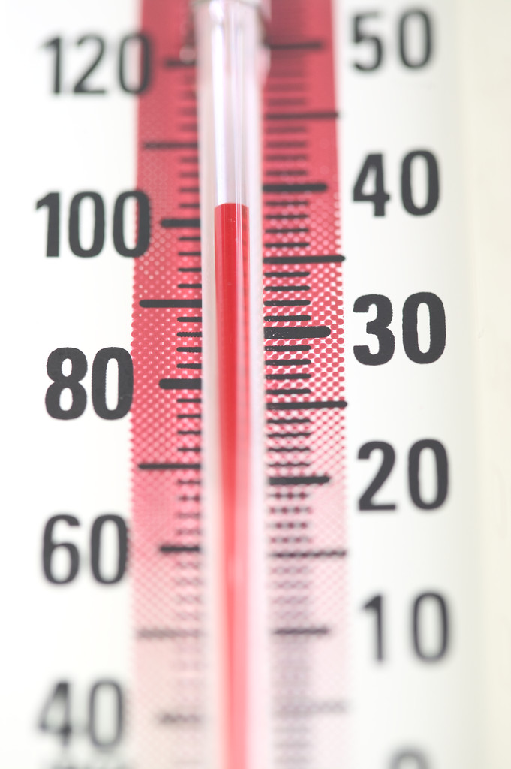
Side Note
Fever
New definition! Accounts for immunosenescence
A single oral temperature >37.8⁰C
or
repeated oral temperatures >37.2⁰C
or
a single oral temp >1.1⁰C above baseline from any site
Notes:
Discussion point: What is baseline?
Next 2 slides discuss other changes to the definitions (table comparing versions)

Slide 12
Definition | Targeted Surveillance
Cellulitis/Soft Tissue/Wound | Pus, heat, redness, serous drainage, swelling, tenderness/pain, fever, leukocytosis, acute change in mental status from baseline, acute functional decline
Scabies | Maculopapular rash and/or itching, MD dx, Lab confirmation or link to another person with lab confirmed scabies
Pneumonia | CXR demonstrating pneumonia or presence of a new infiltrate and one of the following; New/increased cough, new/increased sputum, Sp0₂ <94% RA or decrease > 3% from baseline, new or changed abnormalities on lung examination, RR>25 breaths/min, at least one constitutional criterion
LRTI | CXR not performed or negative for pneumonia or new infiltrate, at least 2 of the signs and symptoms listed in the pneumonia definition, at least 2 constitutional criteria
UTI (non-cath) | Significant lab results, and one of the following; acute dysuria or acute pain, swelling/tenderness of the testes/epididymis/prostate with fever or leukocytosis and one of; acute CVA pain/tenderness, suprapubic pain, gross hematuria, new/increased incontinence, new/increased urgency or frequency without fever/leukocytosis at least 2 of; suprapubic pain, gross hematuria, new/increased incontinence / urgency / frequency
Notes:
These slides are small and difficult to read but you can use them to walk through the differences by having attendees follow the copy of the form you’ve handed out to accompany the talk (if you’ve done so)
Red font=additions to the definitions
Matched color of fonts point out the differences in language btwn the 2 versions when addressing the same issue

Slide 13
Definition | New/Targeted Surveillance
UTI (catheter) | Significant lab results, and one of the following; fever, rigors, or new onset hypotension with no alternate site of infection Acute change in mental status or acute function decline with no alternate dx AND leukocytosis New onset suprapubic or CVA pain/tenderness Purulent discharge from around the catheter or acute pain/swelling/tenderness of the testes, epididymis, or prostate
Gastroenteritis | GASTROENTERITIS One of the following; 3 or more liquid or watery stools above what is normal for the resident within a 24 hr period 2 or more episodes of vomiting in a 24 hr period Both of the following; Stool culture positive for a pathogen that is not C.diff (Salmonella, Shigella, E.coli 0157:H7, campylobacter, rotavirus, norovirus etc.) At least one sign or symptom compatible with a GI tract infection (nausea, vomiting, abd pain/tenderness, or diarrhea)
 | CDAD Both of the following; 3 or more liquid or watery stools above what is normal for the resident within a 24 hr period and/or presence of toxic megacolon(abnormal dilation of the large bowel documented radiographically) A stool sample positive for C.diff/C.diff toxin and/or pseudomembranous colitis identified on endoscopy, surgery or examination of a bx specimen
Notes:
Red font=additions to the definitions
Matched color of fonts point out the differences in language btwn the 2 versions when addressing the same issue

Slide 14
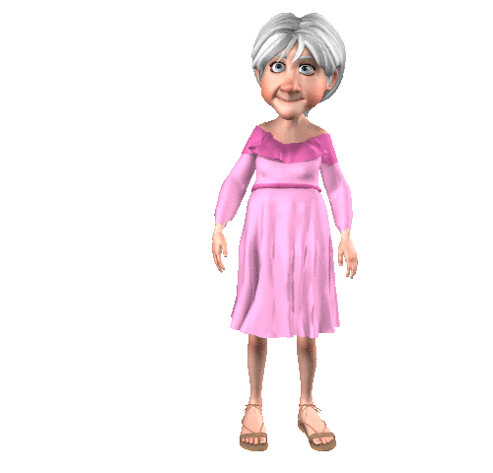
Constitutional Criterion
Includes new definition for fever
Includes the new sign of infection; leukocytosis
Also includes language to define acute change in mental status
From https://www.google.ca/search?q=constitutional+&sourceid=ie7&rls=com.microsoft:en-US&ie=utf8&oe=utf8&rlz=1I7SUNC_en&gws_rd=cr&ei=7FtpUrXGJs3YyAHu3YC4BA
Acute change in mental status from baseline =
New fluctuating behavior (e.g., that comes and goes or changes in severity during the assessment)
New onset of difficulty focusing attention (e.g., unable to keep track of discussion or easily distracted)
New onset of incoherent thinking (e.g., rambling conversation, unclear flow of ideas, unpredictable switches in subject)
Resident’s level of consciousness is described as different from baseline (e.g., hyperalert, sleepy, drowsy, difficult to arouse)

Slide 15
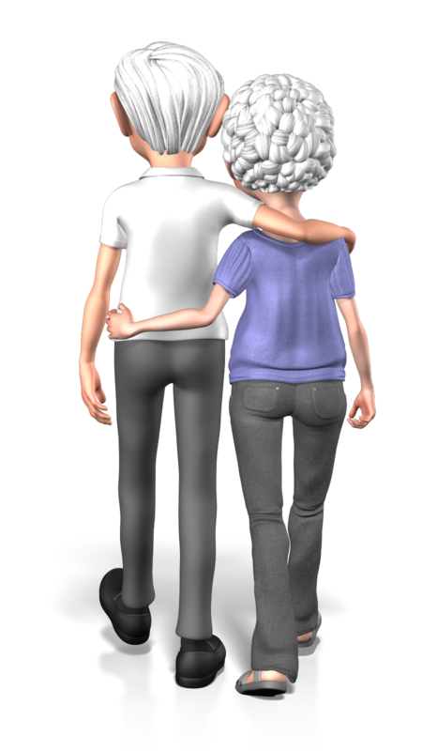
Example Two
Mr. Tinkle is a 90 year old man
IPNs indicate the following;
Oct 2, 2013: “Resident is receiving risperidone @ 1500 + 1900 which started 28.09. 13. Behaviour changes reported, not sure if related to increased risperidone or possible medical problems - ? UTI”
Oct 3, 2013: “lethargy increased, foul urine, some urinary symptoms, r/o UTI”
Oct 5, 2013: “Urinalysis result arrived = urinary tract infection. Physician called & ordered a/b x 7days”
Where’s the beef?
Notes:
Behavior changes can be due to many many things. It is important to conduct and document a thorough assessment. Perhaps this is a UTI and the resident doesn’t belong on risperidone or perhaps it isn’t an infection and then the abx would not be warranted– the only way to distinguish is through a complete and documented assessment. Urinalysis results can NEVER equal infection – they are only a piece of the puzzle not the whole picture. Foul urine is also not a reliable indictor of UTI – dehydration and asparagus can be causes of foul urine – you wouldn’t give abx for someone because they ate asparagus right? Lastly, what does urinary symptoms mean – this does not tell the person reading the chart note how the resident is presenting, in fact it is a waste of ink and time unless the exact urinary symptoms are spelled out.
And if you’ve never heard of the stinky urine asparagus phenomenon check out http://www.webmd.com/food-recipes/features/why-pee-smells-funny-eat-asparagus for an explaination

Slide 16
Example Three
82 year old female, T38.2⁰ C (oral) this morning, her urine is cloudy and foul smelling, and she has been increasingly confused over night. Her foley has drained 60cc in the last eight hours.
IPNs;
Sept 24, 2013 - Resident very confused over night and urine is foul smelling. Contacted Dr. who ordered Nitrofurantoin
Sept 26, 2013 – Resident A&O x3, improving nicely on antibiotics
Where’s the beef?
Sept 28, 2013 – Lab results back, no growth in specimen. Physician informed and Nitrofurantoin discontinued. Will collect another specimen to retest – resident still confused
Sept 30, 2013 – Blood work back, showing electrolyte imbalance – specifically serum sodium and potassium are high. Physician informed, subcut fluid ordered for re-hydration
Oct 8, 2013 – Resident has had 7 watery stools in the last 24 hours with abdominal cramping and nausea
Notes:
Highlight the importance of thorough assessment. Discuss that cloudy urine is not a UTI indicator.
Documentation is so important to inform other shifts and create a record of the critical thinking that has occurred. Acting without this critical thinking step can lead to harm. Antibiotics are often an example of this…it won’t hurt right – but abx can cause serious infections like C.diff as eluded to in the last chart note.

Slide 17
Here’s the Beef
D) “Is this the bus stop for Winnipeg, I want to go home to visit my kids”. Resident has been increasingly confused over the past few days and HCA’s report his urine is cloudy. A) Encouraged increased fluid intake. Resident denies any increased incontinence, frequency or urgency but he is not a good historian due to this increased confusion. No c/o pain on voiding. Assessment findings; palpation of costovertebral angle elicits wincing, palpation of the testes reveals they are tender and swollen. HCAs have noted increased incontinence for the past few days (suddenly leaking through brief despite q2 h changes). T 37.6 (axilla) (resident is on scheduled Tylenol 4x/day). P). Attending contacted re: assessment findings and has ordered Cipro 500mg orally, two times a day for 10 days. Will collect and send MSU for C&S before abx start. Continue to monitor for signs/symptoms and document to assess treatment efficacy. Lab results pending.
Use the surveillance form as a guide for what to assess and then chart on!
Notes:
Example of critical thinking, thorough assessment, and excellent documentation
Suggest that you use the form and have audience check off the boxes that correspond to this note – do you have an infection?
Explain the process for the ICP to validate the report of an infection against the IPN (ideally the date of suspected infection will be the same date the first chart note appears)

Slide 18
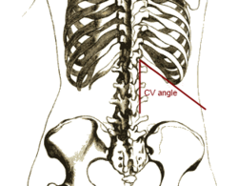
Side Note
Costovertebral Angle (CVA) Pain and Tenderness
http://en.wikipedia.org/wiki/Costovertebral_angle_tenderness
Notes:
Marginalia:
Neutrophil granulocytes [also known as neutrophils or polymorphonuclear leukocytes (PMNs)] are the most abundant (40 to 75 %) type of white blood cells. They are formed from stem cells in the bone marrow. They are short lived and highly motile. They form part of the polymorphonuclear cell family (PMNs) together with basophils and eosinophils.^{[1][2][3]}
Neutrophils are a type of phagocyte and are normally found in the blood stream. During the beginning (acute) phase of inflammation, particularly as a result of bacterial infection, environmental exposure,^{[4]} and some cancers,^{[5][6]} neutrophils are one of the first-responders of inflammatory cells to migrate towards the site of inflammation. They migrate through the blood vessels, then through interstitial tissue, following chemical signals such as Interleukin-8 (IL-8), C5a, fMLP and Leukotriene B4 in a process called chemotaxis. They are the predominant cells in pus, accounting for its whitish/yellowish appearance.
Neutrophils are recruited to the site of injury within minutes following trauma and are the hallmark of acute inflammation.^{[7]}

Slide 19
Side Note
Significant labs and UTIs
Significant labs (for surveillance purposes) are now defined as;
At least 10⁸ cfu/L of no more than 2 organisms in a voided specimen
Any number of organisms in a straight catheter specimen
At least 10⁵ cfu/L of any organism (s) in a catheter specimen
Note: lab assigned significance and parameters on what is reported as significant may not be the same values or range of values as the surveillance definitions, this practice varies by laboratory

Slide 20
Add pic of form here…

Slide 21
DOCUMENT
DOCUMENT
DOCUMENT
DOCUMENT
DOCUMENT
DOCUMENT
DOCUMENT
DOCUMENT
Document your assessment findings in the IPN– if it isn’t written down it didn’t occur!
Take credit for your work and avoid appearing negligent
Notes:
It is very important to document your assessment findings and response in the IPN. This information will be used to validate the report of an infection and is vitally important to ensure that care needs are met – the shifts coming on after you need to know what you observed and what you did about it so they can add pieces of the puzzle together and know what to do with the observations they make.

Slide 22
Example Three
Mrs. Smith has been complaining of “achy” legs and arms for the past three days. Health care aides report she has been quite exhausted as of late and your assessment reveals T 38⁰c
What next??
Sore from PT
Coughing
Coughing
Coughing
Give analgesia
Aspirated 4 days ago
Has COPD
New onset
Monitor efficacy
?aspiration pneumonia
? exacerbation
? ILI
Prepare Outbreak Response*
Amend PT
CXR, Abx
Bronchodilators
TREAT w/TAMIFLU
Notes:
Discuss the impact of jumping to the conclusion that this influenza without making sure – you need to focus on ruling it out as much as ruling it in! Is this person sore from a strenuous new physio regimen and has a temp due to another infectious process or does this person have an infectious process brewing? And what could that be?
Use the form as a tool to guide assessment when in doubt.

Slide 23
Antimicrobial Stewardship (kind of)…
Not all bugs need drugs and not all illness is bug related.
The surveillance form assists the frontline nurse and the ICP with ensuring that the infection matches the antimicrobial prescribed.
Notes:
Every year we see several common cold outbreaks where the affected residents are given antibiotics for viruses. This does NOT assist recovery (people will tell you they are getting better on abx but that is either d/t time or b/c the pathogen is bacterial not viral). Inappropriate abx use can cause harm – CDAD and antimicrobial resistance

Slide 24
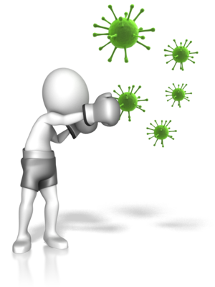
Completing your Surveillance forms…
Facilitates making appropriate requests for antibiotic treatment (not all bugs need drugs and not all illness is bug related – gather evidence and use it to make an informed request)
Guides assessments – know what to look for when an infection is suspected
Guides documentation - used as an outline for documentation
Allows timely intervention when infection occurs (including quasi antibiotic stewardship)
Illuminates clusters of infection and can signal potential outbreaks
Enhances Patient/Resident safety and improves the quality of care!
Improvements in quality and safety of care can’t happen without your participation!
Ask your site ICP how you can get involved both with collecting the data and then using it to make care safer!
Notes:
“quasi” antimicrobial stewardship – the concept that when the abx is reported with the infection, the ICP can check that the drug is effective for the pathogen implicated and intervene if/when it is not.
Tip: Next slide goes over what a report will look like and how to interpret

Slide 25
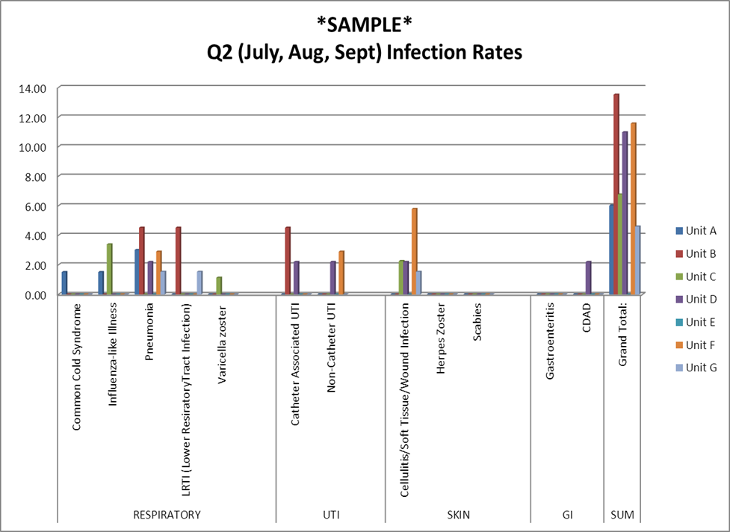
Stay tuned!
Next steps include using the data you’ve collected to improve the care we deliver.
The ICP will interpret the data for you and give you back reports reflecting the rates of infection for each type under surveillance
These rates should be used to discuss the risk each resident in your facility has of acquiring a specific type of infection
The next step is to discuss ways to reduce that risk, making the care we provide safer.
For every 1000 days a resident is admitted to this facility the risk of getting an infection is 7.3 on average. That is to say every 1000 days 7.3 residents will get an infection…
Facility average= 7.3/1000 resident days
GOAL=NO HEALTHCARE ASSOCIATED INFECTIONS!
What can we do to work our way toward zero?
Here each unit in the facility is compared to one other
Here the rate of infection for each type is represented for each unit (e.g., unit A is the blue bar

Slide 26
Questions?

