Slide 1
Managing the Healthcare Environment
An Infection Prevention and Control
Routine Practices Module

Slide 2
Managing the Healthcare Environment
In this course, you will learn how to Manage the HealthCare Environment. You will have a knowledge test at the end of this course.
Please note: in this course we use the term “person receiving care” to refer to patients, residents and clients depending on the healthcare delivery setting.

Slide 3
Overview of Managing the Healthcare Environment
Objectives
After completing this module, the learner will be able to:
Identify what is considered the healthcare environment
Identify where the healthcare environment is located
Identify who needs to know how to manage the healthcare environment
Recognize when to use the information on how to manage the healthcare environment
Describe how to clean, disinfect, and handle the environment of the person receiving care and the area supporting that care

Slide 4
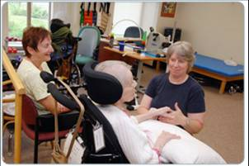
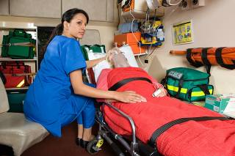
Managing the Healthcare Environment
The Healthcare environment includes the environment of the person receiving care and the areas supporting that care

Slide 5
Where is the Healthcare Environment Located?
The healthcare environment is the environment of the person receiving care and the area that support the person receiving care including that person’s immediate area
The next few slides contain examples of the healthcare environment.

Slide 6
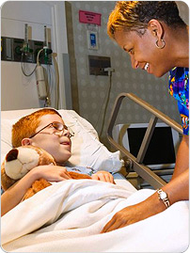
Examples of the Healthcare Environment
The healthcare environment includes the environment of the person receiving care. If it is a single room, this is everything in the person’s room. In a multi-bed room, this is the area inside the privacy curtain (not including the curtain).

Slide 7
Examples of the Healthcare Environment
The environment is the home if this is where they receive care.

Slide 8
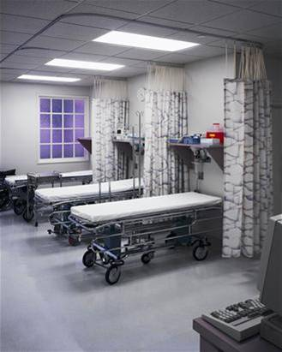
Examples of the Healthcare Environment
The areas that support care include places beyond the immediate area. For example, in a multi-bed room, this is the area outside the curtain.
It is the stretcher, bassinette or isolette and the equipment nearby if there is no curtain.

Slide 9
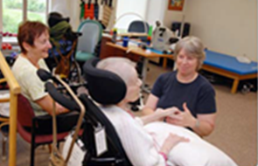
Managing the Healthcare Environment Areas that Support Care
The areas that support care include places beyond the patients immediate area, such as:
clean supply rooms; medication rooms; shared bathrooms; waiting rooms; dining rooms; shared therapy areas; nursing stations; patient lounges; reprocessing areas; lab areas.

Slide 10
Managing the Healthcare Environment Who?
Who needs to know how to MANAGE THE HEALTHCARE ENVIRONMENT?
Everyone who interacts with patients or their environment needs to know how to manage the healthcare environment.
Acute care staff
Long term care staff
Clinical staff
Non-clinical staff

Slide 11
Managing the Healthcare Environment When?
When is this information about how to MANAGE THE HEALTHCARE ENVIRONMENT used?
This information must be used whenever you are in the healthcare environment.

Slide 12
Managing the Healthcare Environment Introduction
Before entering the healthcare environment, you must perform a Point of Care Risk Assessment (PCRA).
The Point of Care Risk Assessment (PCRA) helps you decide what additional steps need to be taken to protect yourself, persons receiving care, and others in the environment.

Slide 13
3 Ways to Manage the Healthcare Environment
Minimize Contamination
Clean and Disinfect
Handling Items

Slide 14
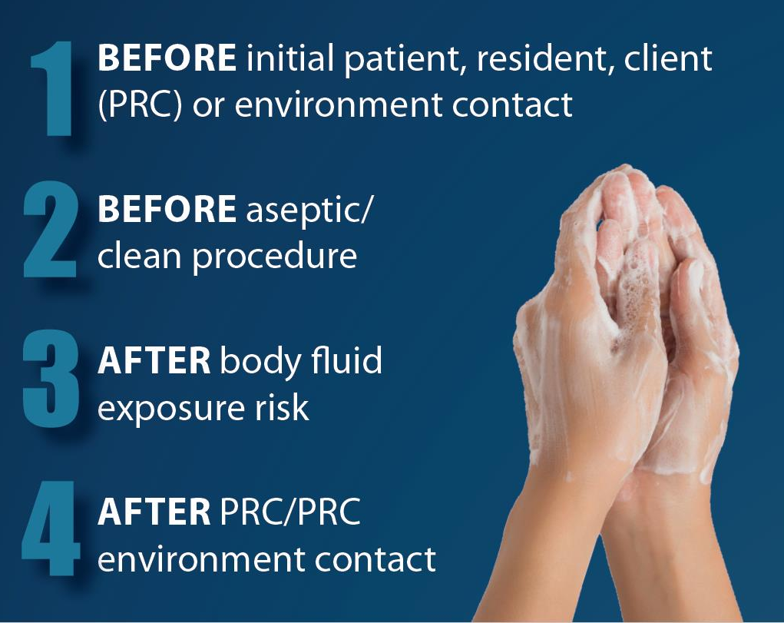
Managing the Healthcare Environment Minimize Contamination
Remember to follow the 4 moments for hand hygiene:
Before initial contact with the person receiving care (PRC)
Before aseptic or clean procedures
After body fluid exposure risk
After contact with person receiving care or their environment

Slide 15
Managing the Healthcare Environment Minimize Contamination
Keep the healthcare environment clean by contaminating it as little as possible:
Do not contaminate your clothing or the healthcare environment when handling used items

Slide 16
Managing the Healthcare Environment Minimize Contamination
Do not eat or drink in any healthcare environment, such as:
nursing stations
medication rooms
clean supply rooms
reprocessing areas
lab areas
waiting rooms
patient lounges
patient homes

Slide 17
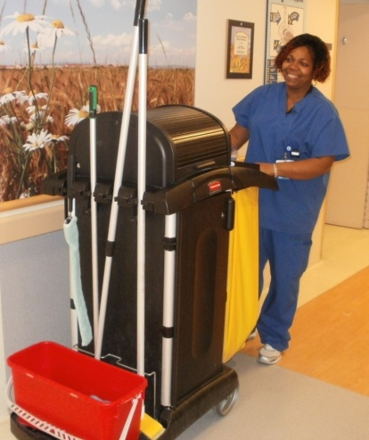
Managing the Healthcare Environment Cleaning and Disinfecting The Healthcare Environment
Follow your site, program, or area’s procedures when cleaning and disinfecting
Use the approved product that is appropriate for the item you are cleaning

Slide 18
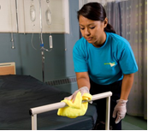
Managing the Healthcare Environment How to Clean and Disinfect
Cleaning removes dirt but may not kill germs.
Disinfecting kills germs but is not effective when visible dirt is present.
Visible dirt must be removed before a surface or item can be disinfected.

Slide 19
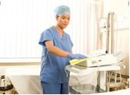
Managing the Healthcare Environment Cleaning and Disinfecting The Healthcare Environment
Clean: If there is visible dirt, clean it before disinfecting; clean:
using a rubbing action
in all grooves and joints

Slide 20
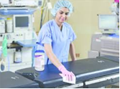
Managing the Healthcare Environment Cleaning and Disinfecting The Healthcare Environment
Disinfect:
After visible dirt has been removed, disinfect by repeating the cleaning process with a disinfectant.
Many facility approved cleaners are also disinfectants and can be used for both the cleaning and the disinfecting steps.
Be sure to follow manufacturer’s recommended wet contact time and allow to air-dry.

Slide 21
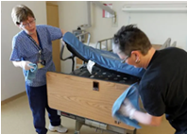
Managing the Healthcare Environment Cleaning and Disinfecting The Healthcare Environment
Clean and disinfect:
as scheduled; when visibly dirty; after transfer or discharge; after Additional Precautions are discontinued

Slide 22
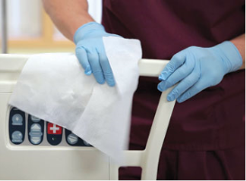
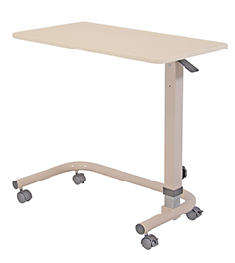
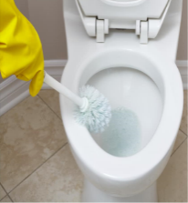
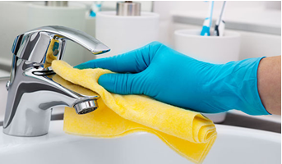
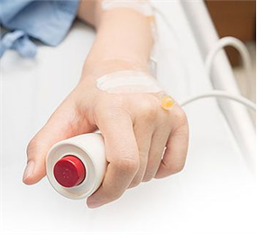
Managing the Healthcare Environment Frequently Touched Surfaces
Clean and disinfect frequently touched surfaces more often. Examples of frequently touched surfaces include:
surfaces close to the patient, such as
bedrails, call bells;
over bed tables, door knobs;
bathrooms;
shared dining areas;
shared bathing areas;
technology items

Slide 23
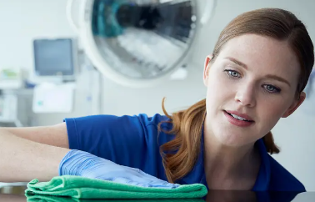
Managing the Healthcare Environment Non-critical Equipment
There is non-critical equipment in the environment of person receiving care which also needs to be cleaned and disinfected.

Slide 24
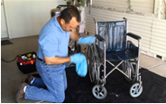
Managing the Healthcare Environment Non-critical Equipment
Non-critical equipment is equipment that may touch intact skin but not broken skin or mucous membranes. Items such as stethoscopes, IV poles, blood pressure machines or wheelchairs.

Slide 25
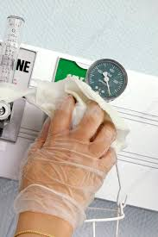
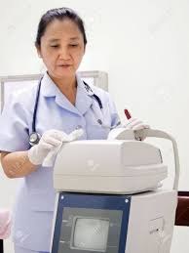
Managing the Healthcare Environment Cleaning Non-critical Equipment
Do not take unneeded or extra items into the care environment.
Dedicate equipment to a single person receiving care whenever possible.
Clean and disinfect items that have been in the environment or in direct contact with a person receiving care before using them with another.

Slide 26
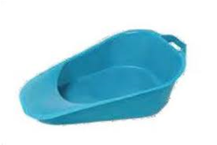
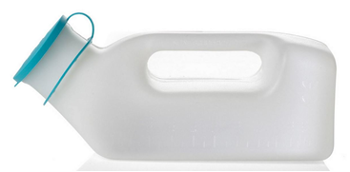
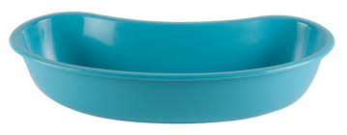
Managing the Healthcare Environment Dedicated Non-critical Equipment:
Items such as basins, bedpans and urinals are:
dedicated to a single patient
labeled and or stored appropriately to avoid use by another patient
are stored in a dedicated clean space.
are stored to prevent contamination by pets, pests, the client, family, visitors, moisture, dirt or dust when care is provided in the home.

Slide 27
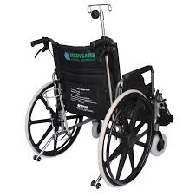
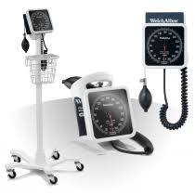
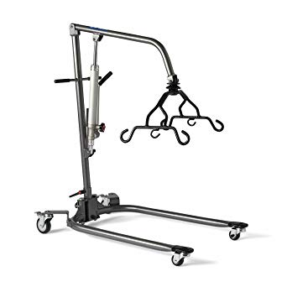
Managing the Healthcare Environment Dedicated Non-critical Equipment:
Dedicated Non-critical Equipment
must be cleaned and disinfected:
when visibly soiled
on a regular schedule
before being assigned to another person receiving care

Slide 28
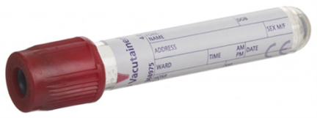
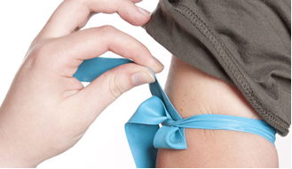
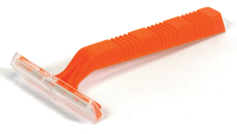
Managing the Healthcare Environment Sterile and Clean Supplies:
are NOT stored under sinks or near plumbing.
are NOT stored in the same area as staff’s personal items such as coats, purses or lunch bags.
Includes items such as:
soaps, lotion
tissue, razors
blood collection containers, tourniquets.
Discard these items after transfer, terminal clean or discharge.

Slide 29
Managing the Healthcare Environment Handling Linen
Clean linen and used linen are items which need proper handling when working in the environment of the person receiving care.

Slide 30
Managing the Healthcare Environment Handling Linen
Avoid contaminating clean linen by doing the following:
Perform hand hygiene before handling clean linen.
Handle linen away from your body.
Keep clean linen separate from soiled linen.
Handle linen as little as possible when storing or transporting it.

Slide 31
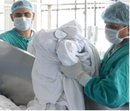
Managing the Healthcare Environment Avoid contaminating the healthcare environment from used linen:
Do not shake or throw linen.
Handle linen away from your body.
Roll or fold linen so the dirtiest part is on the inside.
Wrap dripping linen in a dry sheet or towel then place it in a linen bag.

Slide 32
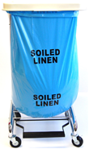
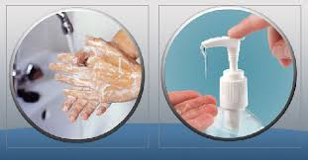
Managing the Healthcare Environment Avoid contaminating the healthcare environment from used linen:
Place used linen in linen bag at the point of use. Do not overfill linen bags.
Change linen after each patient, in all settings, including primary and ambulatory care.
Perform hand hygiene after handling used linen.

Slide 33
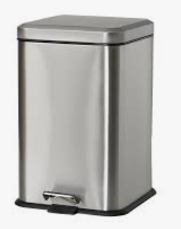
Managing the Healthcare Environment Handling Waste
Place waste containers in convenient locations.
Perform hand hygiene after handling waste.

Slide 34
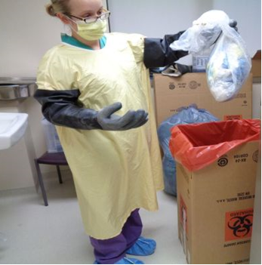
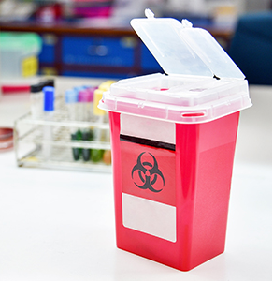
Managing the Healthcare Environment Handling Waste
Do not contaminate your clothing or the healthcare environment when handling waste.
Handle pharmaceutical waste, biomedical waste and sharps according to your facility’s policy.
Do not overfill waste containers.

Slide 35
Managing the Healthcare Environment Handling Dishes
Use Routine Practices for handling all dirty dishes.
Perform hand hygiene after handling dirty dishes.
Disposable dishes are not required to reduce the spread of infection.
Special precautions are not required for dishes that have been removed from isolation rooms.

Slide 36
Managing the Healthcare Environment Handling Deceased Bodies
Perform a Point of Care Risk Assessment (PCRA) before handling a deceased body to determine:
if personal protective equipment (PPE) is needed.
if Additional Precautions are still need.

Slide 37
Managing the Healthcare Environment Handling Deceased Bodies
Use Routine Practices if Additional Precautions are not required.
Follow Manitoba communicable disease regulations from the Dead Bodies Regulation in the Public Health Act.
Perform hand hygiene after handling deceased bodies.

Slide 38
Managing the Healthcare Environment
QUIZ: 5 Questions

Slide 39
Managing the Healthcare Environment
Question 1:
The healthcare environment includes:
A) the environment of the person receiving care.
B) the areas that support the care of the person receiving care.
C) the environment of the person receiving care and the areas that support the person receiving care.
D) the entire healthcare facility.

Slide 40
Managing the Healthcare Environment
Question 2:
I can help keep the healthcare environment clean by doing the following:
A) Not contaminating my clothing or the healthcare environment when handling used items.
B) Not eating or drinking in any healthcare environment.
C) Cleaning my hands following the Four Moments of Hand Hygiene.
D) All of the above.

Slide 41
Managing the Healthcare Environment
Question 3:
Which of the following statements is true?
A) Cleaning and disinfecting are the same thing.
B) Cleaning removes dirt and disinfecting kills germs.
C) Disinfecting should be done before cleaning.
D) Cleaning and disinfecting are only done when items are visibly soiled.

Slide 42
Managing the Healthcare Environment
Question 4:
Which of the following statements is true?
A) It is okay to store my belongings with clean or sterile supplies.
B) A wheelchair does not have to be cleaned and disinfected between uses on different people if it is not visibly soiled.
C) Basins may be stored in shared bathrooms without labeling.
D) Items that have been in the environment of the person receiving care must be cleaned and disinfected before using them with another person..

Slide 43
Managing the Healthcare Environment
Question 5:
When handling dishes, which of the following statements is true?
A) Use disposable dishes to reduce the spread of infection.
B) Use Routine Practices for handling all dirty dishes.
C) Use Additional Precautions for dishes that have been removed from isolation rooms.
D) All of the above.

Slide 44
Managing the Healthcare Environment
Answers:
C
D
B
D
B

Slide 45
Managing the Healthcare Environment
You have now completed Managing the Healthcare Environment.
THANK YOU!

Slide 46
Managing the Healthcare Environment References and Resources
Best Practices for Environmental Cleaning for Prevention and Control of Infections In All Healthcare Settings - 2nd edition. (2012, May) Provincial Infectious Diseases Advisory Committee (PIDAC).
WRHA IP&C Manual, Facility Approved Disinfectants.
Public Health Act, Dead Bodies Regulation. (2009, February). Manitoba Health.
Routine Practices and Additional Precautions: Preventing the Transmission of Infection in Healthcare. (2019, June). Manitoba Health.
Safe Handling of Cytotoxic Agents, Policy # 110.160.010
Sharps, Safe Handling, Use and Disposal (including Safety-Engineered Needle (SEN) Exemption) Policy # 20.20.020.

