Slide 1
Setting the Stage
Thank you to organizers to collectively participate in the strat planning session
  Opportunity and time to reflect on achievements—our own and others that influence our achievements
  Time to think beyond the day-to-day detail----to contemplate what is possible

Slide 2
PH Nutrition Professionals need many skills
Understand the complex science of nutrition and use strategies to make nutrition easier to understand and relevant to people’s lives
Understand food production, economies, politics, composition, preparation, storage and safety
Understand food laws, labeling and technology and accurately interpret these to the public
Understand eating behaviours and habits and use evidence-based techniques to support change

Slide 3
3 Main Approaches
Education- knowledge and skills to make healthier choices
Environmental Support- healthy foods more available and socially acceptable
Policy Development- National, provincial and regional

Slide 4
Canada’s first Food Guide
Borne out of need to reduce nutritional deficiencies resulting from war time food rationing

Slide 5


Slide 6
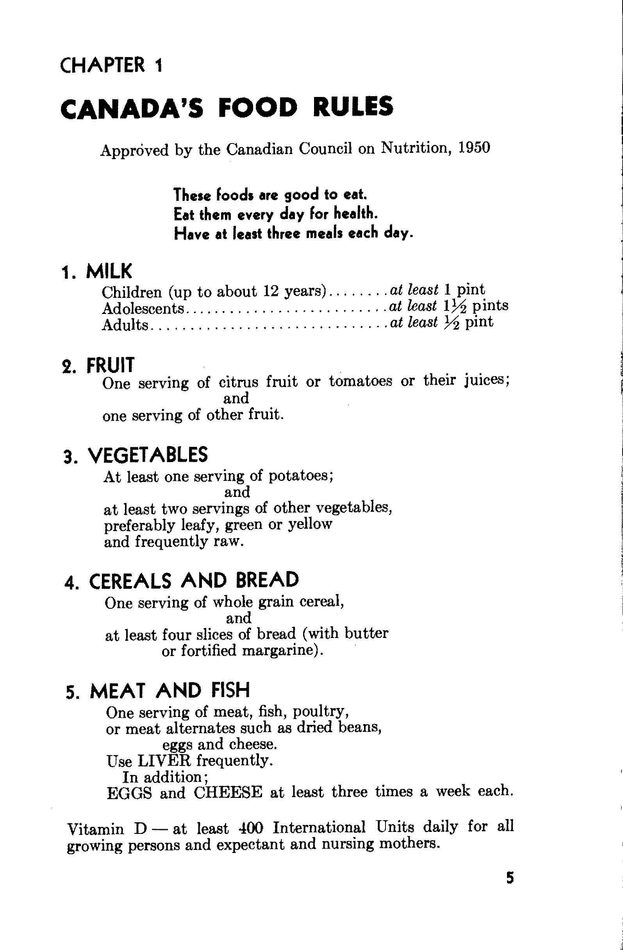

Slide 7
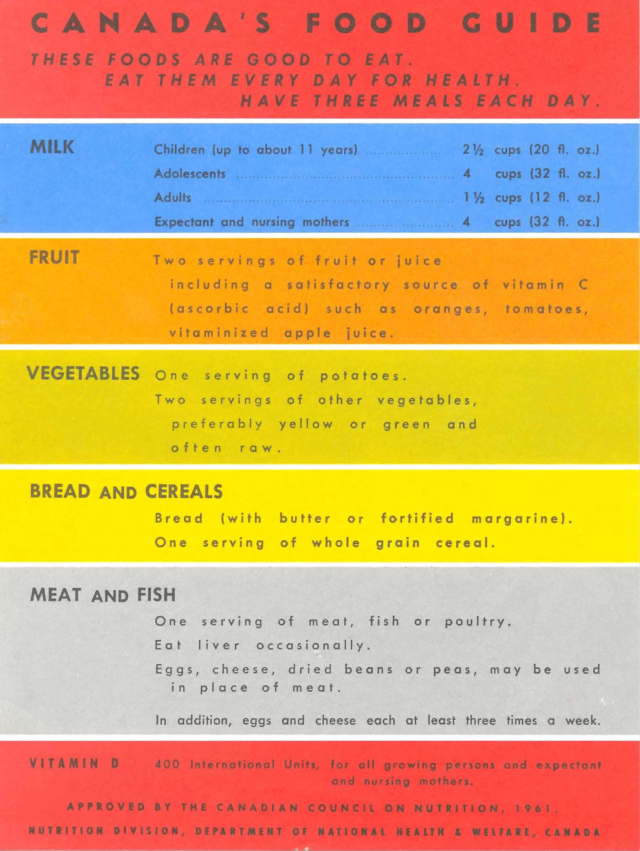

Slide 8
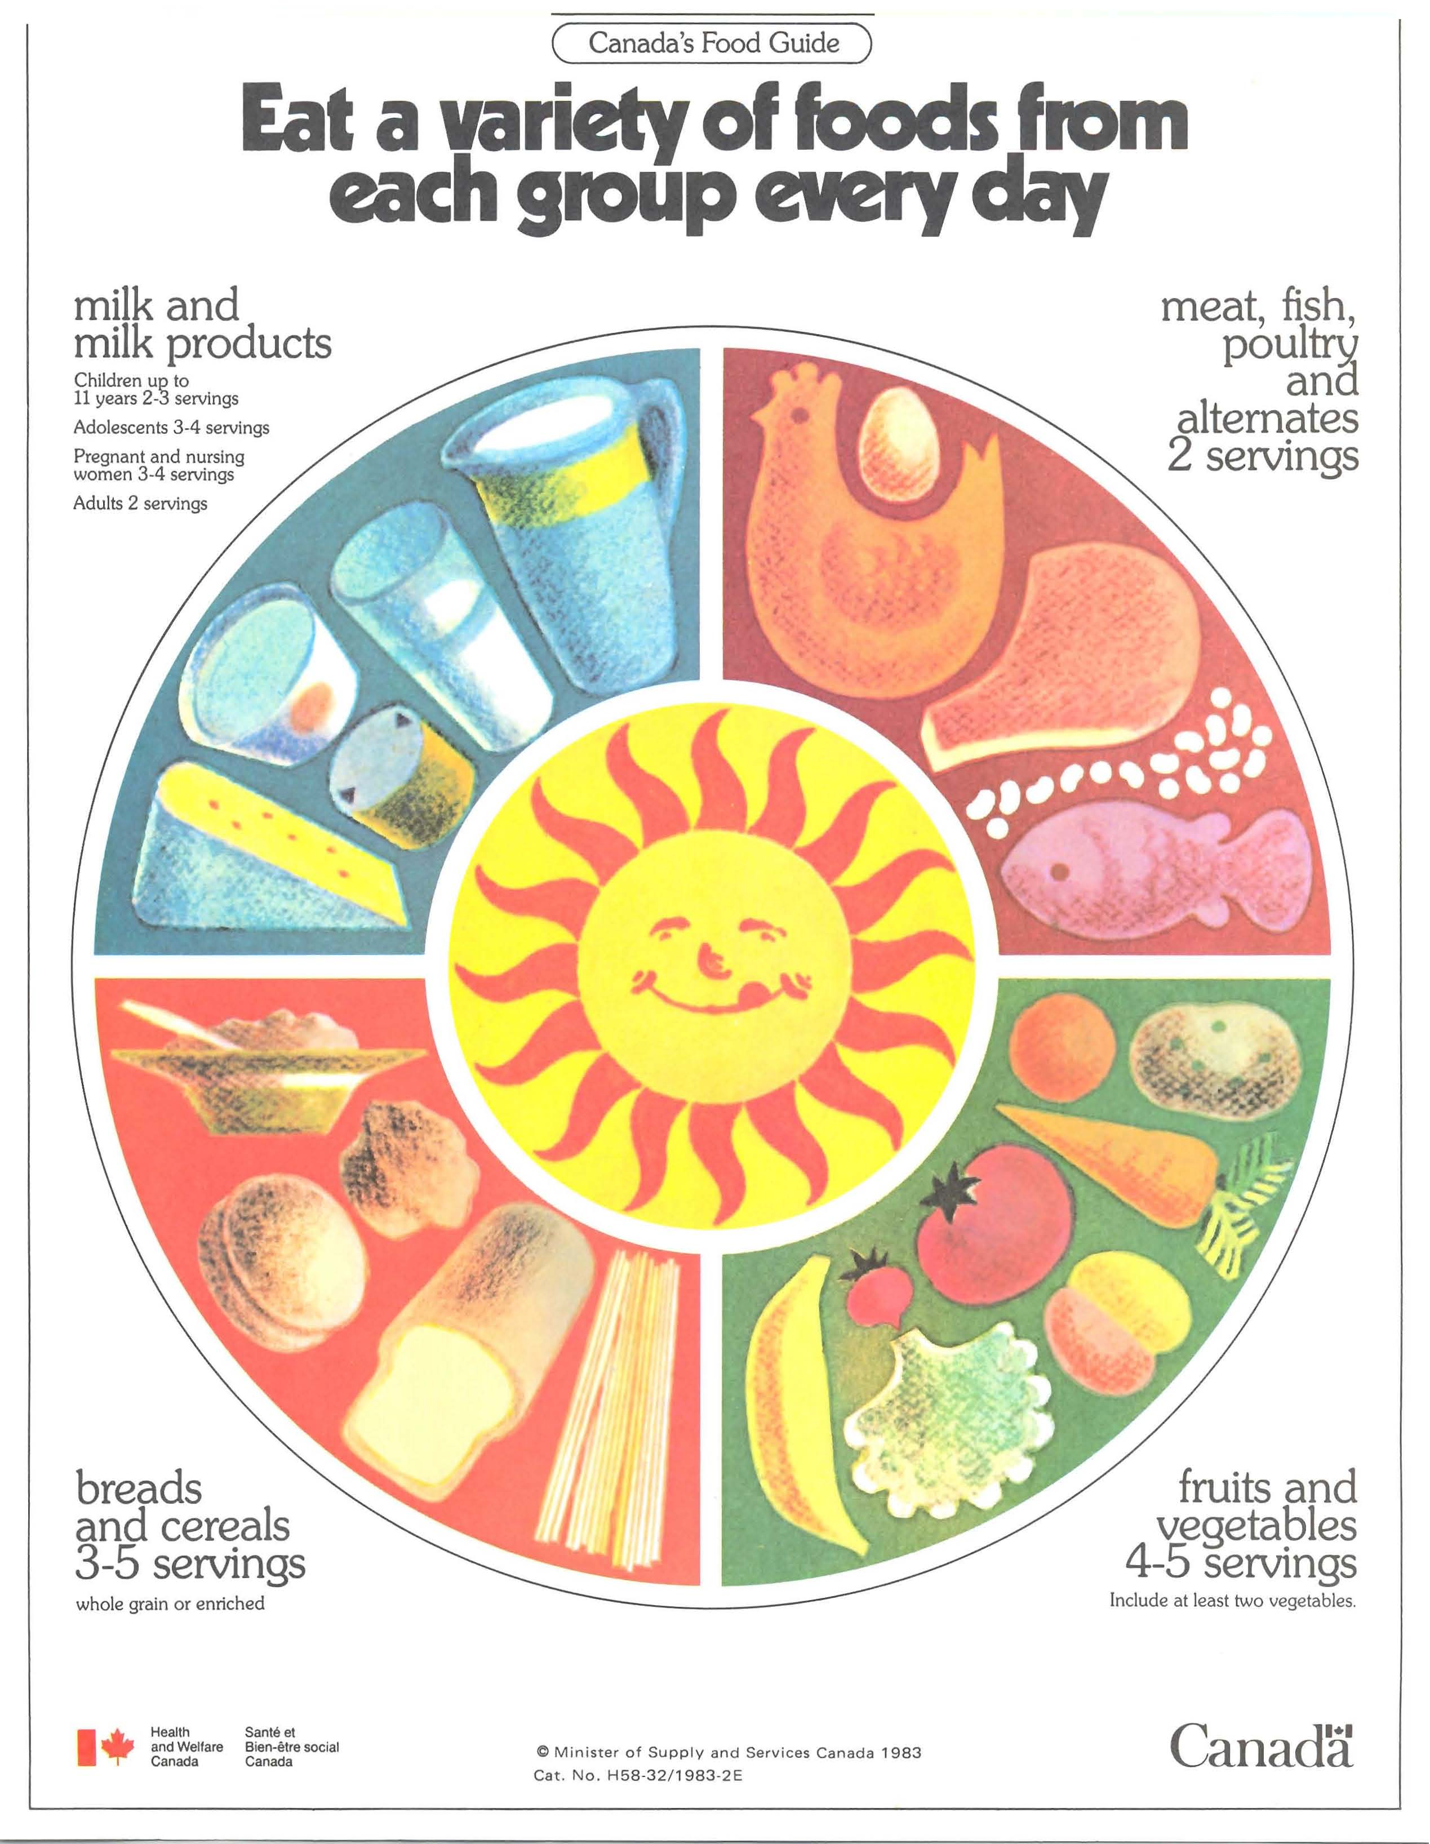

Slide 9

Eating Well with Canada’s Food Guide
Information for the Population
Prevention of: Obesity, Diabetes, CVD, Certain Cancers and Osteoarthritis
Enough Vitamins, Minerals and other nutrients
Overall health and vitality
Notes:
9
Is based on current evidence
Communicates amounts and types of food needed to help:
Meet nutrient needs and promote health
Minimize the risk of obesity, type 2 diabetes, heart disease, certain types of cancer and osteoporosis
Provides the cornerstone for nutrition policies and programs

Slide 10
Evolution from
‘FOOD RULES’ to ‘FOOD GUIDE’
Since the first Food Guide the focus has changed from nutritional deficiencies to prevention/promotion
People are living longer, due in part to improvements in public health in general (immunization, safety). Leading cause of death is now chronic disease.

Slide 11
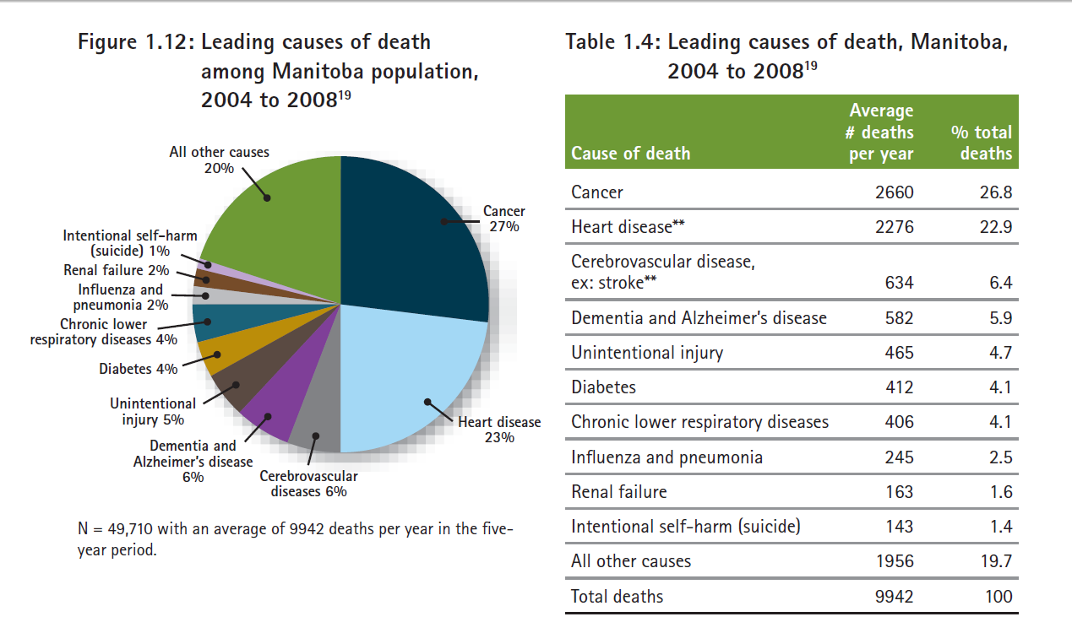
Report on the Health Status of Manitobans 2010
→62% of leading causes of death have a strong nutrition component

Slide 12
Notes:
Prevalent Cases
In the fiscal year ending in 2006 there were 76,608 persons one year of age and older living with diabetes in Manitoba.
The number of cases has more than doubled from the 32,468 living with diabetes in the fiscal year ending in 1989.
The proportion of female cases has gradually declined from 50.7% in 1988/89 to 49.7% in 2005/06.
The number of First Nations persons (registered with Manitoba Health and Healthy Living) living with diabetes has more than tripled between 1989 and 2006. The number of male First Nations persons living with diabetes has almost quadrupled in this time

Slide 13
Nutrition is a Complex Science
GOAL is not a single behaviour
  MORE
  LESS
  Different

Slide 14
Macronutrient Distribution Range
Reference Diet 2000 kcals/day
CHO 45-60% of energy
Reference diet - 250 grams
Fat < 35% of energy
Reference Diet - 75 grams
Protein about 15-20% of energy
Reference diet – 100 grams
Notes:
14
The acceptable macronutrient distribution range, or
percentage of total daily energy associated with reduced risk
of chronic disease for adults, is as follows: carbohydrate intake
of no less than 45% (in part to prevent high intakes of fat); and
fat intake of a maximum of 35% (26). Diets that provide
>60% of total daily energy from low-glycemic-index and
high-fibre carbohydrates improve glycemic and lipid control
in adults with type 2 diabetes (27).
Replacing high-glycemic-index carboh

Slide 15
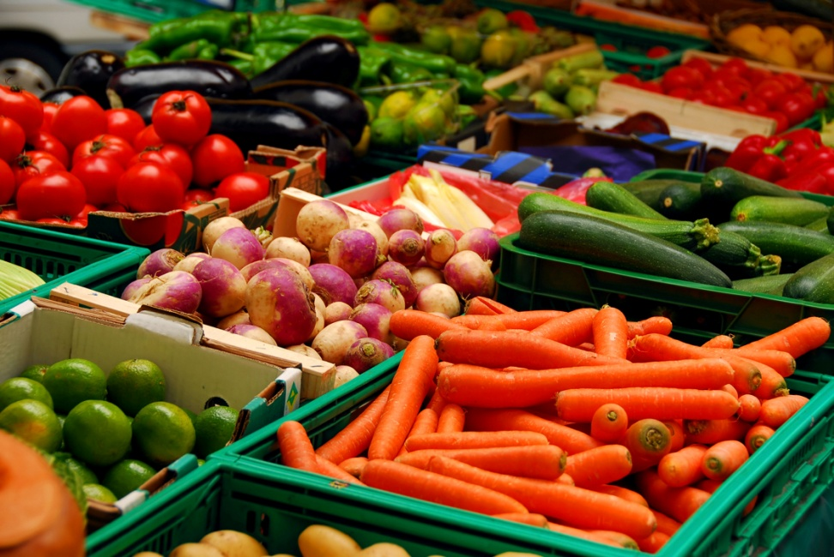
The Basics
Eat a variety of foods.
Emphasize cereals, breads and other whole grain products, fruits and vegetables.
Notes:
15

Slide 16

The Basics- cont’d.
Choose lower fat dairy products, leaner meats and foods prepared with less fat.
Achieve and maintain a healthy body weight through regular physical activity and healthy eating.
Limit salt, alcohol and caffeine.
Notes:
16

Slide 17
What do people really eat?
>35% of calories from fat (age 31-50)
Not enough F+V (50%)
Not enough milk products (80% by age 71)
41% of calories from snacks in ‘other foods’
No breakfast (10% and higher for 19-30years)
Source: 2007 CCHS, Cycle 2.2-Nutrition available at: www.statcan.ca
Notes:
17

Slide 18
Nutrition Status of Manitobans
Only one-third aged 12 and older report they consume fruits and vegetables five or more times a day.
The majority (82%) exceed the recommended amount of sodium (salt) in their diets.
Only 30% have adequate vitamin D intake
Only 6% have adequate fibre intake
Over one-half of Manitoba adults are overweight or obese.
Report on the Health Status of Manitobans 2010, p. xiii & 43

Slide 19
A Systematic Review: Diet and CVD
Strong evidence for protective role:
Vegetables
Nuts
Mediterranean Diet
Monounsaturated Fat
“Prudent” Diet
Mente A et al. Arch Intern Med 2009;169(7):659-669.
Strong evidence of a causal relationship:
X Trans Fats
X High Glycemic Index
X “Western” Diet
Notes:
A systematic review of the evidence supporting a causal link between dietary factors and coronary heart disease.
Mente A, deKoning L, Shannon HS, Anand SS

Slide 20

Body Weight/Weight Loss
Etiology of obesity is COMPLEX
Formula for sustainable weight loss is not known
Prevention is KEY
Notes:
In Canada Adults: 59% overweight and 23.4% obese This rate translates to 96,000 obese adults living within the Winnipeg region.
20

Slide 21
Good News/ Bad News
First the Good……
5-10% of initial weight loss can substantially improve insulin sensitivity and glycemic, BP and lipid control
CPG Sept 2008: Vol 32; S77.
Next the not so good news…………
Even the most well designed weight loss program has only been able to sustain a 3-5% weight loss.
Arya Sharma, Canadian Obesity Network Learning Retreat March/10

Slide 22
What about childhood obesity?
Social Gradient
Geographic environment: tend to be characterized by
    Limited access to recreation
    Fewer retail outlets for healthy food
    Lower quality fruit and vegetables
    Higher prices for healthy food
✓Influence of advertising/ screen time/ eating while viewing habits

Slide 23

Cost of the
‘Nutritious Food Basket’
in Manitoba 2011

Slide 24
Food Insecure Households
Consume fewer F+V, milk products, and vitamins
Face a major social determinant of health as resulting deficiencies contribute to malnutrition, impact growth and development and are associated with an increased likelihood of chronic disease development and/or poor CD management.
Heart disease, diabetes, high blood pressure and food allergies are more common
Stress and feelings of uncertainty have a negative health impact

Slide 25
What we found
Within Winnipeg, prices are comparable in each community area
Food prices are not appreciably higher in the Downtown or Point Douglas areas, however AVAILABLILITY is an issue in Point Douglas.
The sample within each area is affected by volunteer selection bias.

Slide 26
 | Family of 4 | Single Mom 2 kids | Single Male
Winnipeg Average | $808.90 | $611.50 | $271.82
St.James/ Assiniboia | $778.90 | $588.28 | $262.36
River Heights | $797.01 | $602.71 | $267.60
Transcona | $809.46 | $612.06 | $271.86
Downtown | $821.63 | $620.75 | $276.53
River East | $860.80 | $649.85 | $290.27

Slide 27
Reality Check
There are no packaged, prepared or convenience foods in the list of 67 foods in the “Nutritious Food Basket”.
In order for people to be able to consume a healthy diet at these costs, there is a requirement for:
  Literacy
  Numeracy
  Cooking Skills
  Time
  Budgeting skills
  Commitment to healthy eating
  Transportation

Slide 28
Key Points
The cost of food for 1 month for a family of four in Manitoba ranges from $1184.91 to $832.66.
The cost of food for 1 month for a family of four in Winnipeg ranges from $778.90 to $860.80 (average $808.90)
A variety of competitively priced food is available to those in most areas of Manitoba (with exceptions) as long as people can get to a full-service store. The cost of transportation needs to be factored into the cost of food procurement.
Availability of nutritious foods goes down as the size of the store decreases i.e. smaller stores have fewer options.

Slide 29

Healthy Eating Challenges
Too little time
Information overload
Large selection of
products
Confusing labels
New skills needed?
Not enough $$
Notes:
29
Slide 4 Overview
This slide presents information on today's key shopping challenges. It is a good slide to use as an introduction since it encourages dialogue and everyone in the group will be able to relate to the information.
Key Points
• Too little time. Most people will agree that time is limited and often grocery shopping is done
on the run with one eye on the clock and the other watching children or grandchildren
running around the store.
• Information overload. Grocery stores are full of words; words on the shelves, words in the
aisles, etc… it is a sensory overload.
• Large selection of products. There are new products every day in the stores and it is hard
to know which products are best to buy and use.
• Confusing labels. The new Health Canada label regulations are a great help.
• New skills needed? For some, busy lives and new food products require new cooking,
shopping and label reading skills- this can be daunting.
Educator Tip
Instead of presenting the points of the slide, ask the group to brainstorm and identify the
challenges. This will help set an interactive tone as well as providing information to streamline
your presentation to best meet the group's needs.
In the Know
Did you know. . . most grocery stores contain more than 30,000 food items! No wonder it is easy to get confused!

Slide 30
The Nutrition Facts Panel
Nutrition Facts Per 90 g serving (2 slices)
Amount
% Daily Value
Calories 170
Fat 2.7 g
1 %
Saturated 0.5 g
+ Trans 0 g
5 %
Cholesterol 0 mg
Sodium 200 mg
8 %
Carbohydrate 36 g
13 %
Fibre 6 g
24 %
Sugars 3 g
Protein 8 g
Vitamin A 1 %
Vitamin C 0 %
Calcium 2 %
Iron 16%
30
Notes:
30
Slide 30 How to Read a Label
This slide demonstrates how to read a label
Key Points
Point out that portion size is crucial when comparing labels. The nutritional facts listed are only
applicable to the portion size shown. Therefore, if consuming twice the portion listed on the label, the
amount of carbohydrate consumed must be doubled.
After checking portion size, look at total carbohydrates. When counting carbohydrates it is important to
look at grams of carbohydrates rather than % daily value. Note that this number includes all sugar, fibre
and starch contained in the serving size listed. Since fibre is a type of carbohydrate that does not break
down into glucose, it can be subtracted from total carbohydrates listed on the label. This will result in
the total carbohydrates that will affect blood glucose. Subtracting the fibre becomes especially important with very high fibre foods such as high fibre cereals that may contain almost 15 g of
carbohydrate per serving, eliminating an entire carbohydrate choice from the count.
Higher fibre foods are beneficial for many reasons. They promote regularity, help with satiety, may help
prevent certain types of cancer and can help delay the absorption of carbohydrate (lower the glycemic
index).
Educator Note
Ask the class what they should first look for on a label. Refer to Beyond the Basics for label reading example.
Making it Real
Get the participants to practice label reading using available food labels. Small photo albums can be great reading booklets to use with learners. Encourage learners to practice this skill at home. For example, look for fibre and compare different products. For more label resources see: www.healthyeatingisinstore.ca

Slide 31
Understanding Nutrient Claims
Free | none or almost none of this nutrient an example is “sodium free” or “fat free” ***Trans-fat free may NOT mean fat free
Low | a small amount an example is “low fat” (must have < 3 g/serving)
Reduced | at least 25% less of the nutrient than a similar product an example is “reduced in Calories”
Light | can be used on foods that are reduced in fat or reduced in Calories
Notes:
Slide #13 - Speaker’s Notes
Here are examples of nutrition claims that indicate the food has less of Calories or certain nutrients, such as fat, which Canadians may want to decrease.
To be able to use these nutrition claims, the food product must meet specific criteria. For example:
in order to be able to say the product is low in fat, the product must have 3 g or less of fat;
for sodium free, the product must have less than 5 mg of sodium; and
for a product to have the claim “light”, there must be a statement on the food label that explains what makes the food light. When the term “light” is applied to a nutritional feature, it is allowed only on foods that are reduced in Calories or fat.
Note: Claims are based on the stated serving size in the Nutrition Facts table and the reference amount listed in the regulations. For example, a “low in fat” claim on a muffin:
Nutrition Facts table serving = 1 muffin (40 g), amount of fat = 2 g per muffin (40 g)
Reference amount for a muffin = 55 g, amount of fat = 3 g per 55 g serving
The criteria for the “low in fat” claim is that the product must have 3 g or less of the fat in BOTH the stated serving size in the Nutrition Facts table and the reference amount of that food in the regulations.
Why? This is so that the standards for the claims are the same from one muffin to another regardless of size.
For a complete list of criteria for each claim, please refer to the regulations.

Slide 32
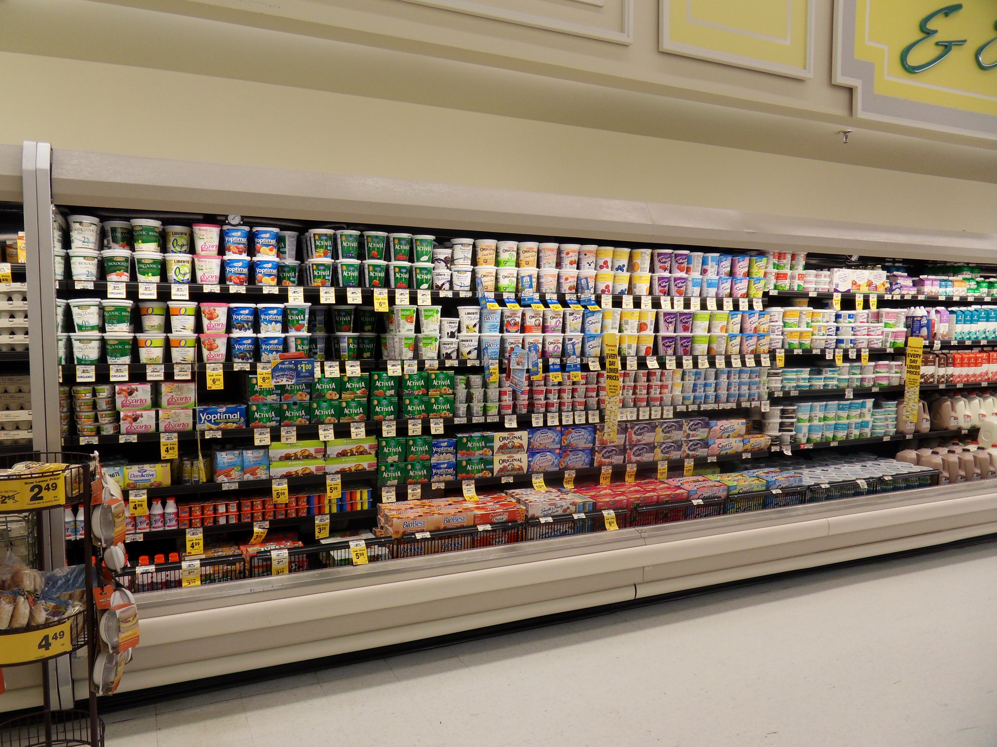
Decisions and Decisional Balance

Slide 33
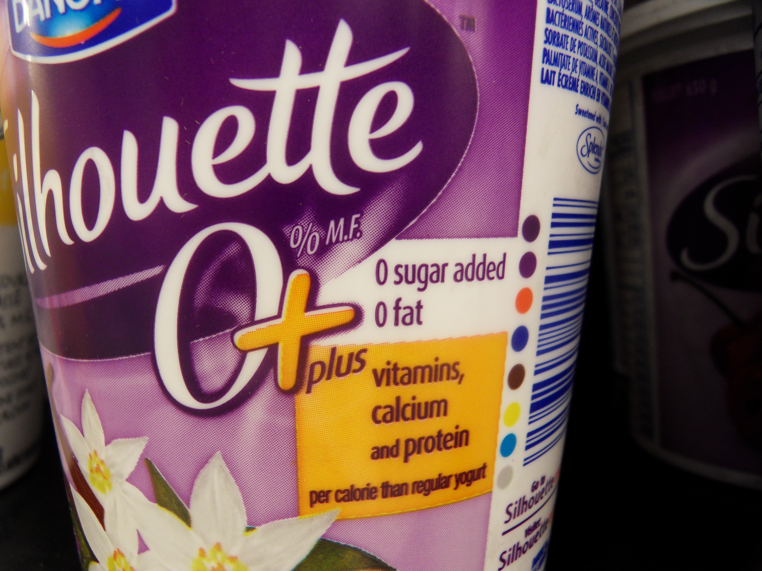
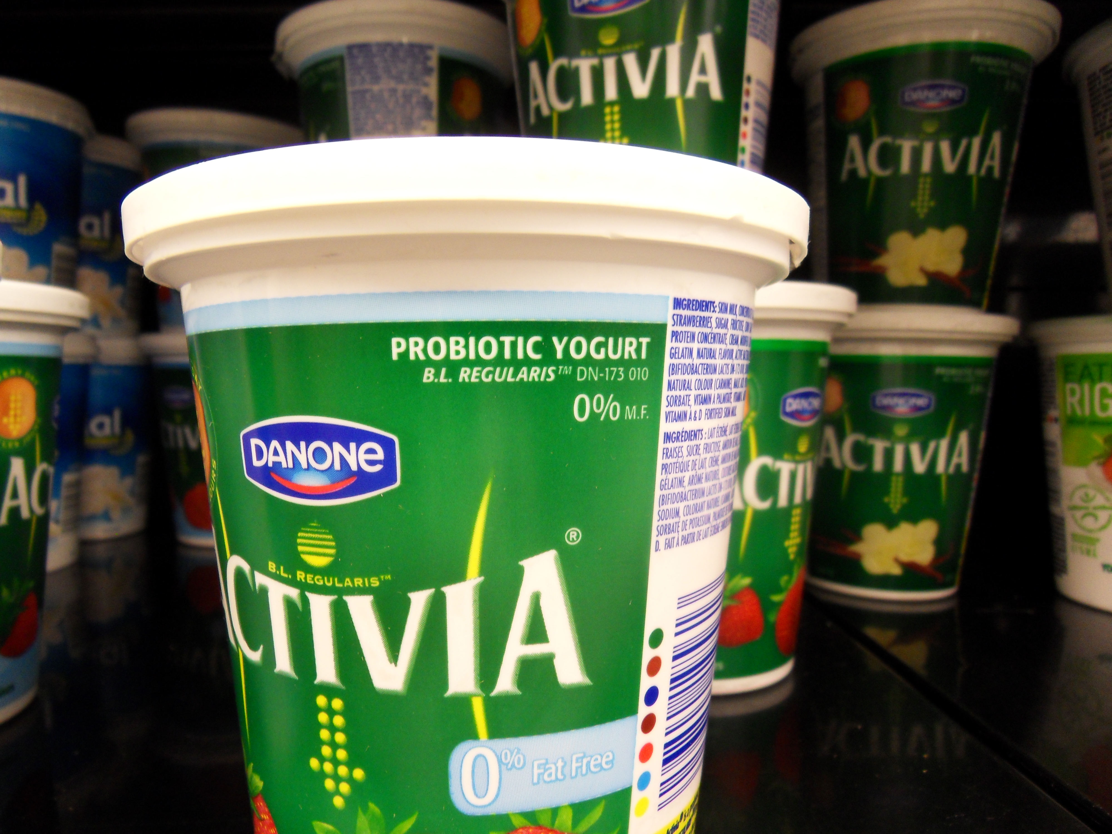
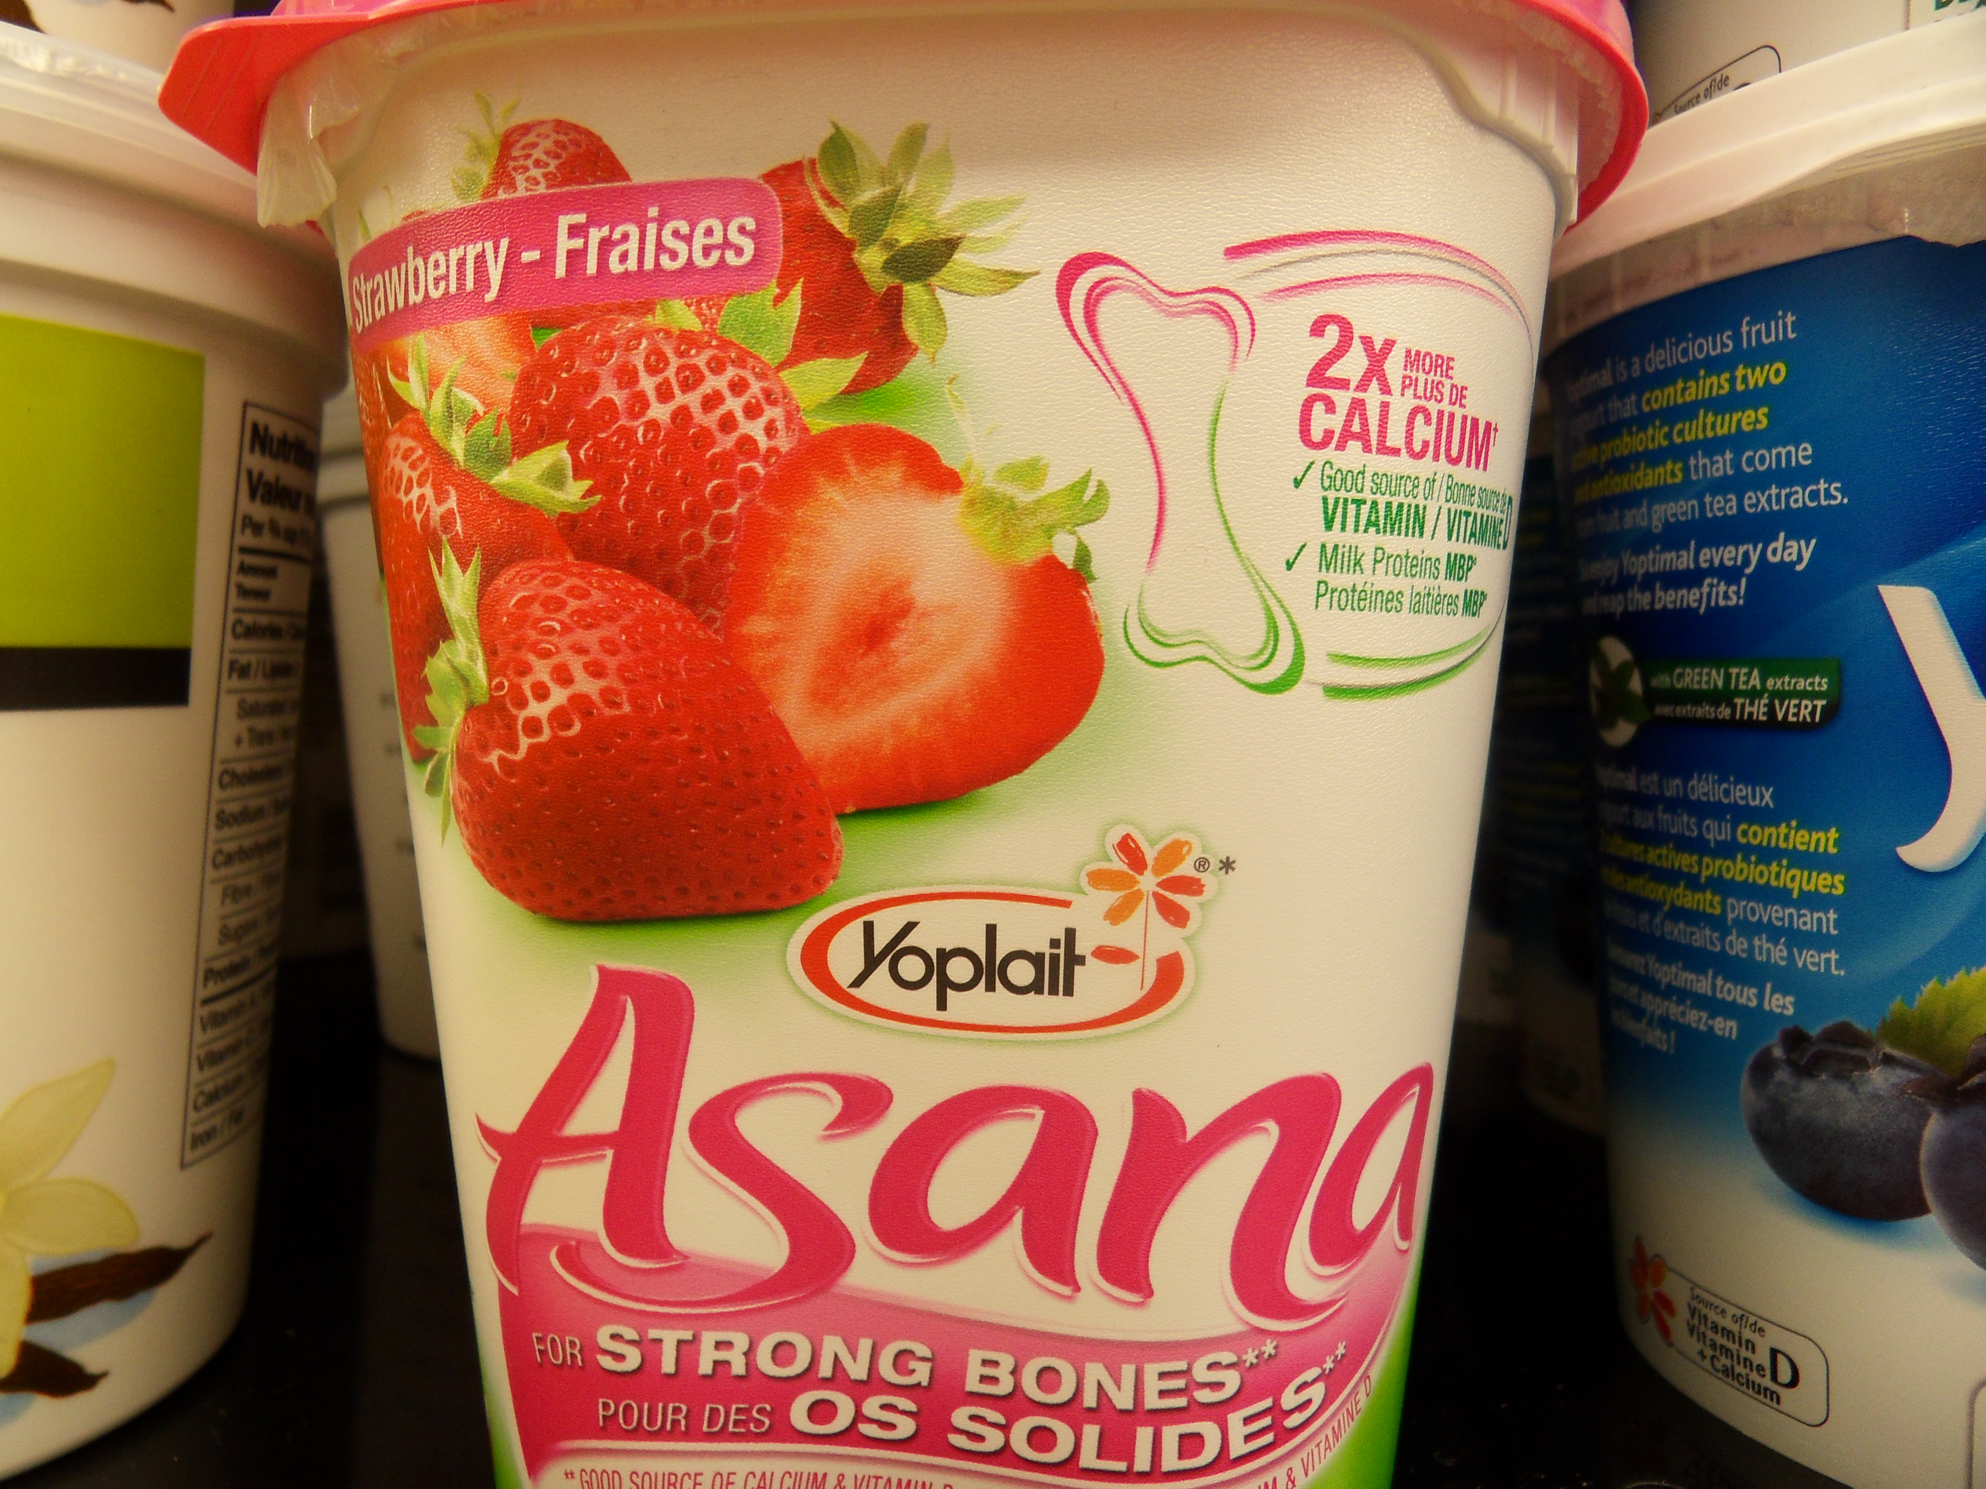

Decisions and Decisional Balance

Slide 34
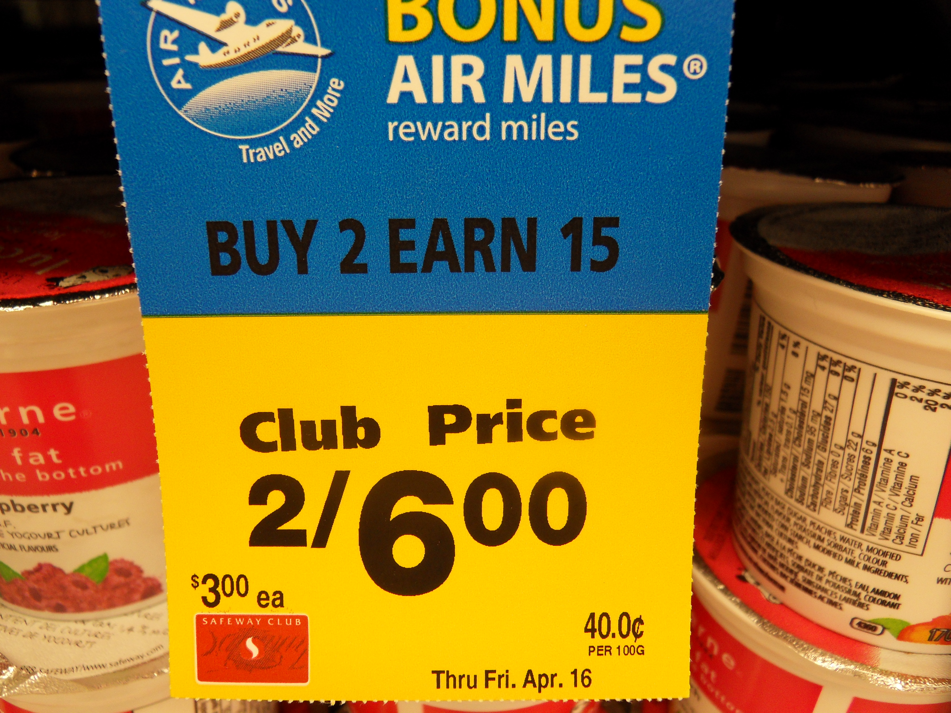
Tipping the Decisional Balance

Slide 35
Who we are and what we do
Thoughts on identity and influence

Slide 36
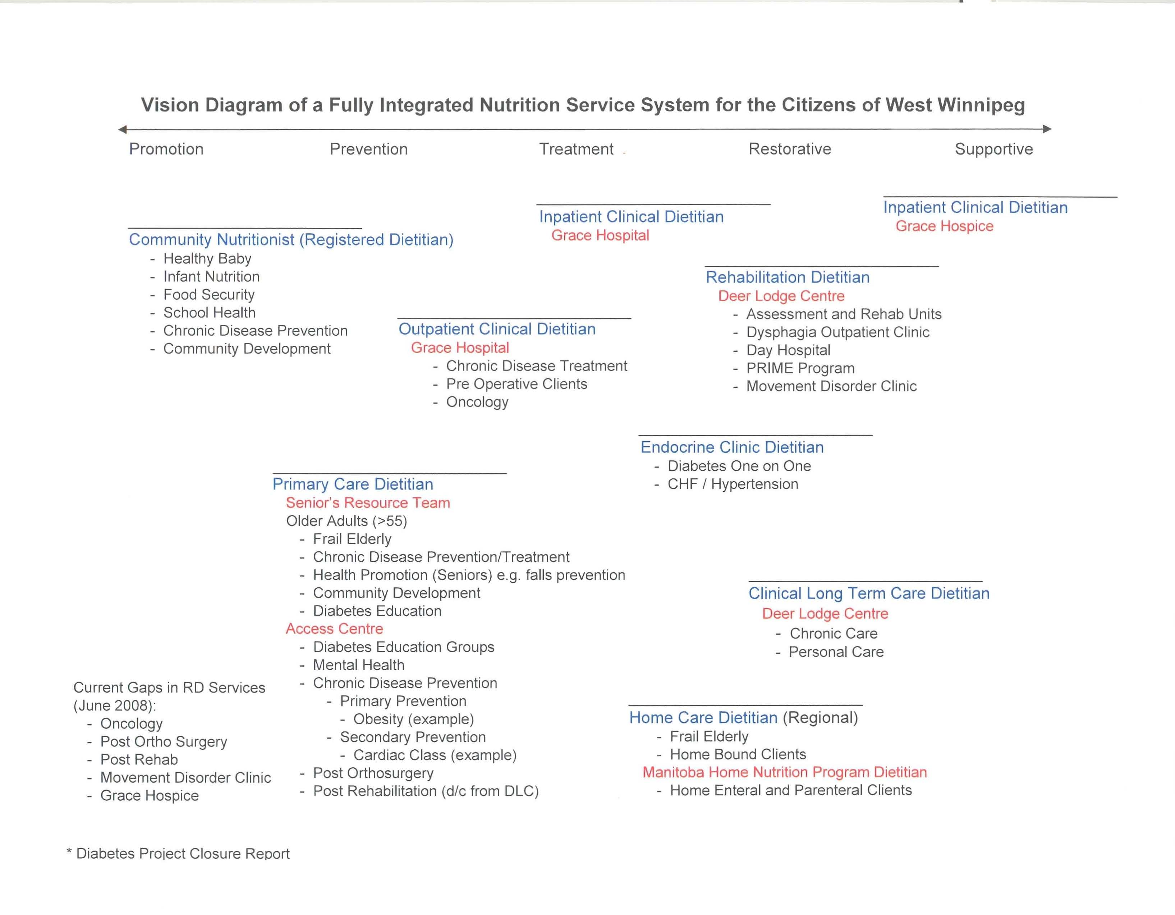

Slide 37
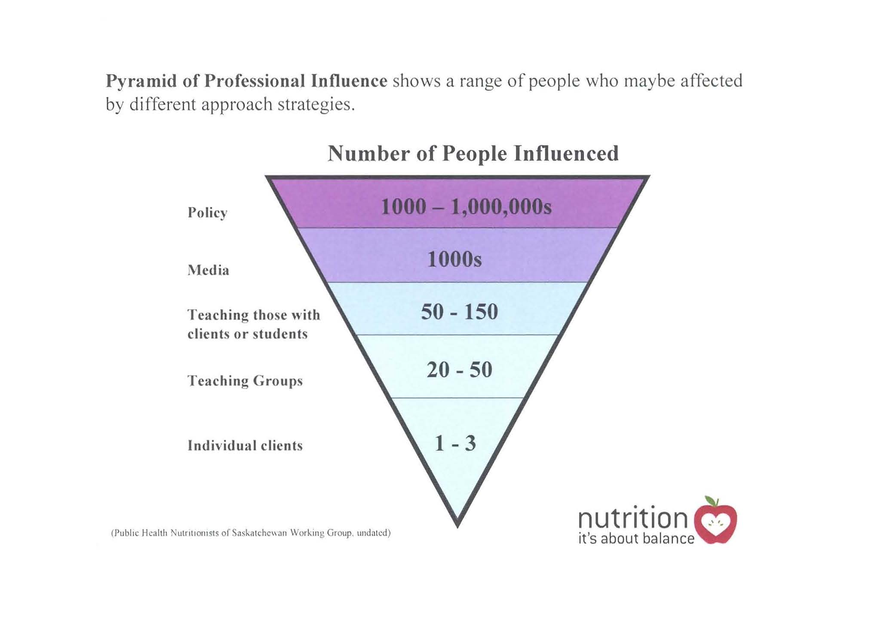

Slide 38
3 Key areas to focus time and resources
Working collaboratively across sectors and jurisdictions
Investment and collective effort focused on the early years
Strengthening community-level efforts
David Butler-Jones 100 years of Public Health in Canada: Invited Commentary CJPH

Slide 39
Dare to Dream it
The Public Health Nutrition Professional is the ‘go to resource’ and knowledge broker who works within strong networks across sectors
We have current and accessible resources to share with our partners
The public knows who we are, what we offer and how to find the information they need through us
We collectively focus our effort for the greatest return

Slide 40
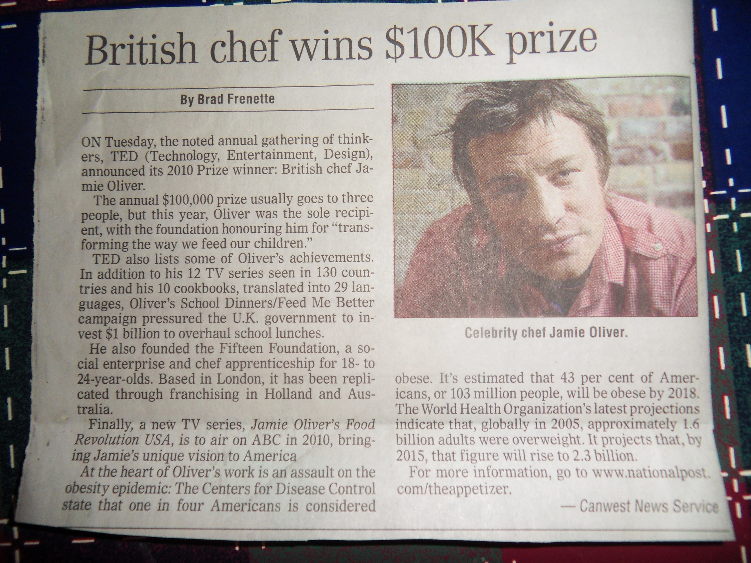

Slide 41
Thank you.
Questions?
Notes:
41

