Slide 1

Meningococcal and MMrv catch up clinic immunization orientation
March 2023

Slide 2
Overview
Public Health Meningococcal and MMRV catch up clinics
Immunizing in the WRHA
  Casual Nurse Competency Requirements
  PHIA and Hand Hygiene Requirements
  Point of Risk Assessment
Immunization Resources
Personal Protective Equipment (PPE)
Safety and Vaccine Administration
Meningococcal and MMRV recourses
Clinic considerations and set up
Program Contacts

Slide 3
Overview of Meningococcal Catch up clinics

Slide 4
Men-c catch up clinics
There is a decreasing trend in Meningococcal C (Men-C) vaccine coverage in children born in 2019, 2020 and 2021 across all regions in Manitoba.
These birth cohorts experienced COVID-19 related disruptions to childhood immunizations.
Since the first dose of the Men-C vaccine is typically administered with the first dose of the measles, mumps, rubella-varicella (MMRV) vaccine during the 12-month well child visit, it is likely that the vaccine coverage for MMRV vaccine in the 2019, 2020 and 2021 birth cohorts are also low.
Men-C vaccine coverage has historically been 85% in Manitoba with regional variability.

Slide 5
Provincial and regional Meningococcal C vaccine coverage by birth cohort
Percentage of children with valid first doses of meningococcal C vaccine by birth cohort in Public Health Information Management System (PHIMS)
**PHIMS data as of January 17, 2023
 | 2018 | 2019 | 2020 | 2021
Interlake-Eastern Health Region | 83.3 | 81.4 | 73.0 | 66.6
Northern Health Region | 89.5 | 81.0 | 72.9 | 53.5
Prairie Mountain Health Region | 83.2 | 80.2 | 75.4 | 66.5
Southern Health-Santé Sud Region | 69.6 | 67.1 | 60.0 | 54.5
Winnipeg-Urban | 83.65 | 83.6 | 82.0 | 77.2
Manitoba | 83.09 | 81.4 | 77.1 | 69.9

Slide 6
Meningococcal Coverage rates in Winnipeg Manitoba Data extracted by Epidemiology and Surveillance on January 24, 2023
Meningococcal vaccine coverage by birth cohort.
 | 2018 | 2019 | 2020 | 2021
Winnipeg- Urban | 83.65 | 83.6 | 82.0 | 77.2
Manitoba | 83.09 | 81.4 | 77.1 | 69.9

Slide 7
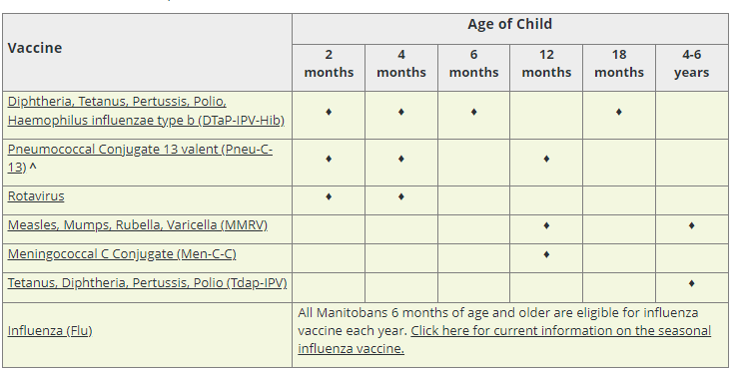
Manitoba Immunization Schedule for Infant and Pre School Children

Slide 8
Meningococcal burden of disease
Bacterial infection can result in meningitis or septicemia
High incidence in the very young population
Severe illness and sometimes fatal. One in 10 infected will die, and one in five survivors will suffer severe permanent complications.
Meningococcal vaccination programs have led to a decrease in disease incidence

Slide 9
WRHA Public health Strategy to increase immunization rates for men-C
April 3-14 2023 Focused immunization clinics to capture the birth cohorts that are found to be under immunized for Men-C /MMRV ages 2-4 year old’s
Educate and encourage the public on immunization

Slide 10
I. Immunizing as a Casual in the WRHA

Slide 11
Immunizing in the WRHA competency requirements for casual Nurse
Completion of online Nurse Orientation
Completion of required reading list
Immunization observation by CD Coordinator at first assigned clinic. Sign off form completed and kept by CD team manager

Slide 12
Immunizing in the WRHA- other Requirements…
The following requirements are on-line learning modules. You will need to create an account in LMS (Learning Management System) in order to access them.
PHIA- Personal Health Information Act
  All staff to complete WRHA PHIA training every three years
  Link to the on-line learning Modules: http://home.wrha.mb.ca/privacy/phia_training.php
Hand Hygiene
  Training must be updated every 2 years
        Audits randomly occur at immunization clinics
  Link to the on-line learning Modules- https://sharedhealthmb.learnflex.net/users/index.aspx
  You have to create an account; search for “Hand Hygiene Module”; click on “Register”

Slide 13
Immunizing in the WRHA- other Requirements (continued)
Personal Protective Equipment (PPE)
  All staff to complete WRHA PPE training on hire and every two years
  Audits randomly occur at immunization clinics
  Link to the on-line learning Modules: http://home.wrha.mb.ca/privacy/phia_training.php
Other Training Requirements requiring completion upon hire include:
  Point of Care Risk Assessment; Workplace Hazardous Materials Information System (WHMIS); Accessibility: Active Offer; Active Shooter; Code Red; Respectful Workplace; Violence Prevention Unit 1 and Unit 2.
  Link to the on-line learning Modules- https://sharedhealthmb.learnflex.net/users/index.aspx
  You have to create an account; search for above courses; click on “Register”

Slide 14
II. Immunization Required reading and Resources

Slide 15
immunization required reading list for Casual Nurses
  Regional Immunization Manual
  Required reading and Resource for all Immunization providers in the WRHA.
    See Link : Regional Immunization Manual
  Based on the National Immunization Competencies for Health Professionals
  Includes:
    Clinical Practice Guidelines
    Program Specific Information
    Covid- 19 ,Influenza and Pneumococcal
    School Based program
    Targeted immunization Campaings
  Important to review the Program Specific information each year prior to the beginning of the School-based and Influenza clinics as well as targeted immunization campaigns for updated/current information.

Slide 16
Immunization Resources
  Additional Important Immunization Resources:
Manitoba Health Immunization Schedule
http://www.gov.mb.ca/health/publichealth/cdc/div/schedules.html
School Immunization Program
https://www.gov.mb.ca/health/publichealth/cdc/div/sip.html
Manitoba Health Vaccine Eligibility Criteria
http://www.gov.mb.ca/health/publichealth/cdc/vaccineeligibility.html

Slide 17
PHIMs- (formerly known as Panorama)
The Public Health Information Management System (PHIMS) is a secure, integrated electronic public health record designed to assist public health practitioners in Manitoba to manage:
        Immunizations
        Vaccine inventory
        Communicable disease investigations
PHIMs also serves as the provincial database/registry for immunization records.
PHNs use it to manage large school and flu based clinics, record immunizations and review client’s immunization records. They also use the “forecaster” function which helps to determine what immunizations an individual is due for based on the client’s immunization history. It is a decision-making tool to assist the immunizer, but the immunizer’s clinical judgement will overrule the forecaster if there are any contraindications . (ie; live vaccines and pregnant individuals)
Note :Casual Nurses are to document on the paper consent form. The Public Health clerk will then enter the immunizations given by the Casual nurse into PHIMS.

Slide 18
III. Vaccine Administration

Slide 19
Informed Consent
There are four basic requirements of a valid consent:
It must be voluntary
It must be given by a person with the capacity to consent
It must refer to both the treatment and the provider of the treatment
It must be informed
What is informed consent for immunization?
Informed consent means the client must be provided with the information necessary to make a decision to have or to refuse treatment.

Slide 20
Informed Consent continued….
This information must include:
the nature and purpose of the immunization
what the immunization is and how it will be done
the expected benefits of the immunization
the risks and possible side effects of the immunization
alternative courses of action - other things that the client can do to prevent the disease
the risks of not having the immunization
    See the following Clinical Practice Guideline: Informed Consent for Immunization

Slide 21
The 10 Rights during immunizing
  Right patient/client
  Right medication/vaccine
  Right dose
  Right route
  Right time/schedule
  Right patient/client education
  Right documentation
  Right to refuse
  Right Assessment
  Right evaluation
  Note -Important to check expiry date on the vaccine

Slide 22
Vaccine Administration Basics
Preparation for vaccine administration:
  Check product
  Expiry date
  Appearance
  Multi-dose vial check date of when it was first punctured
  Gently shake or roll product just prior to drawing up
  Aseptic technique
    Swab all vial stoppers
    Handwashing / hand sanitizer / Gloves (only required if open sores on immunizers hands)
  Disposal
    Approved sharps container at each immunizers station
Review link in the Regional Immunization Manual re: Vaccine Administration
    Administration of Immunizing Agents

Slide 23
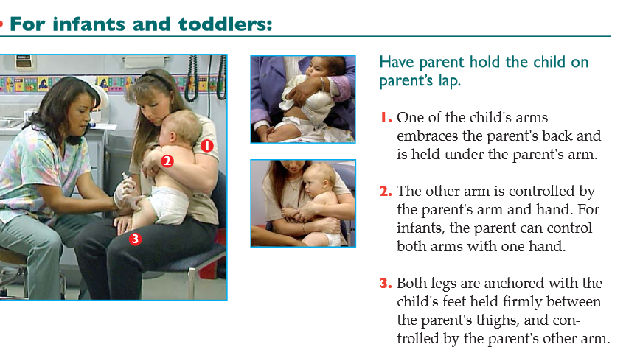
Comforting Restraint

Slide 24
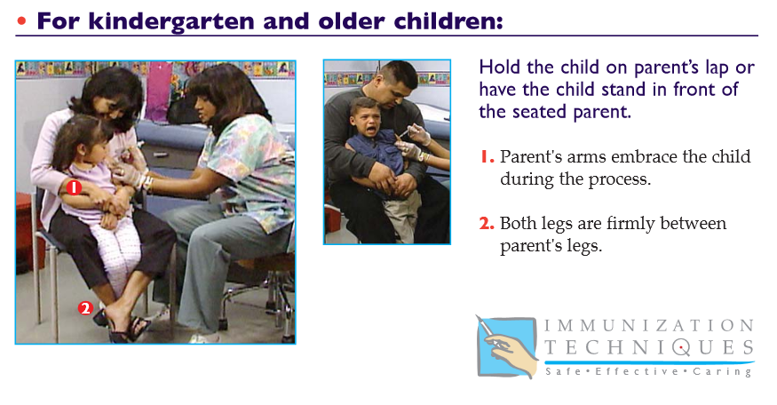
Comforting Restraint

Slide 25
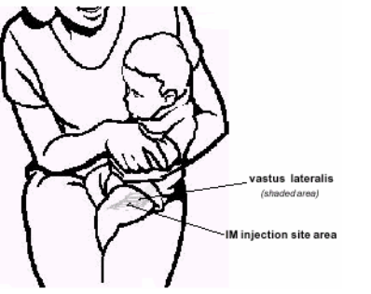
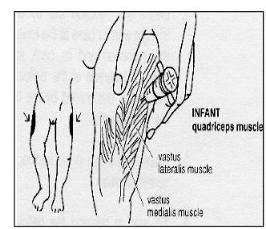
Infant I.M.’s
Landmarking: vastus lateralis muscle
Needle gauge: 25 G
Needle length: 1”

Slide 26
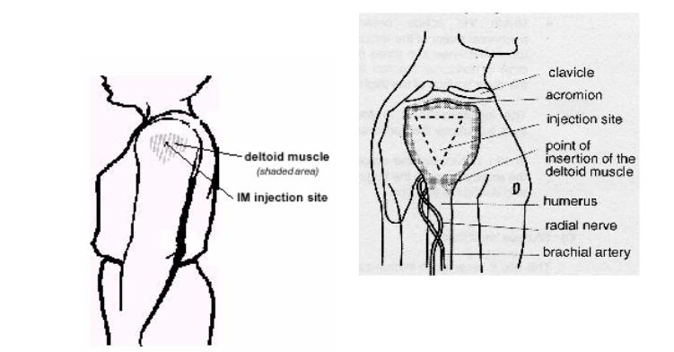
Children & Adults I.M.’s
Landmarking: deltoid muscle
Needle gauge: 22-25 G
Needle length: Children 1” Adults 1- ½”

Slide 27
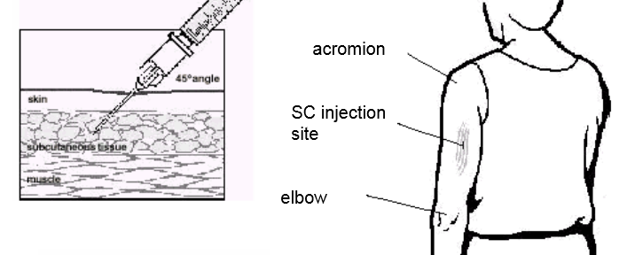
Subcutaneous Injections
Adults ( SQ is an option for pneumo vaccine) NOTE: I.M. preferred for administration
Upper outer triceps area for 12 months & up
Needle gauge 25 and length 5/8”

Slide 28
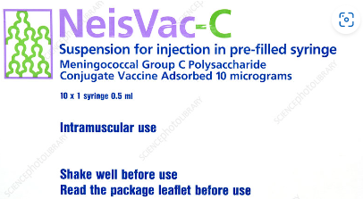
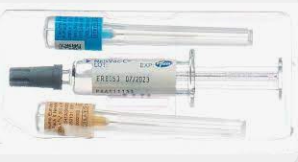
Men-C neisvac-C vaccine (meningococcal group C-TT conjugate vaccine, adsorbed)

Slide 29
Men-C neisvac-C vaccine (meningococcal group C-TT conjugate vaccine, adsorbed)
No dilution required , product is supplied in pre filled syringes
Dose : 0.5 ml
Route: NeisVac-C® vaccine is for intramuscular injection, preferably in the anterolateral thigh region in infants and the deltoid region in older children, adolescents and adults.
Product monograph : Product Monograph (download PDF, 287KB)

Slide 30
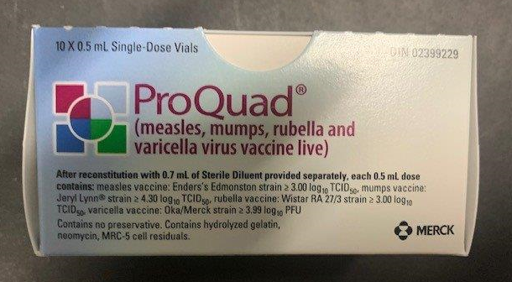
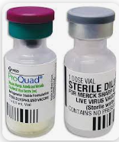
MMRV - ProQuad®

Slide 31
MMRV ProQuad® (Measles, Mumps, Rubella and Varicella Virus Vaccine Live)
Dilution ProQuad® is reconstituted by withdrawing the entire volume of solvent (0.7ml) into a syringe. Inject the entire content of the syringe into the vial containing the powder. Gently agitate to dissolve completely. Withdraw the entire content of the reconstituted vaccine from the vial into the same syringe and inject the entire volume.
Dose : 0.5 ml
Route: Injected subcutaneously (SC),
Product monograph : [Product Monograph Template - Standard] (merck.ca)

Slide 32
The importance of landmarking and vaccine administration

Slide 33
SIRVA - Shoulder injury related to vaccine administration and other injection site events
Shoulder injury related to vaccine administration (SIRVA) is a preventable occurrence caused by the injection of a vaccine into the shoulder capsule rather than the deltoid muscle. As a result, inflammation of the shoulder structures causes patients to experience pain, a decreased range of motion, and a decreased quality of life. Shoulder injury related to vaccine administration and other injection site events (cfp.ca)

Slide 34
Adverse Events Following Immunizations- (AEFI)
An AEFI is any untoward medical occurrence in a vaccinee which follows immunization and which does not necessarily have a causal relationship with the administration of the vaccine
Review the following Clinical Practice Guidelines re: AEFI’s
Adverse Events Following Immunization

Slide 35
Anaphylaxis
See the following link re: Anaphylaxis vs Vasovagal Reaction
The Lead PHN will determine the roles re: anaphylactic response prior to the clinic
Anaphylaxis kits in strategic areas (immunizing area and/or post-immunization area)
Epinephrine is LIFESAVING
DO NOT hesitate to give epinephrine
Diphenhydramine (i.e. Benadryl®) is NOT indicated in anaphylaxis and is no longer included in anaphylaxis management kits
*Review the following:
https://professionals.wrha.mb.ca/old/professionals/immunization/03-04.php
Note: Anaphylaxis is managed by the lead PHN as well as casual Nurses at the immunization clinic.

Slide 36
Storage and Handling of vaccines
  Monitor cold gel packs at your station. Change every 3 hrs or more frequently if needed.
  Be mindful of open vials at stations and keep them on gel packs
  Vaccine to be returned at end of clinic to monitored vaccine fridges
See following link for more information
Storing and Handling of Vaccines at Off-site clinics:

Slide 37
Documentation
Documentation of an immunization on the health record will include:
Name of person • Date of birth
• PHIN # • Trade name of the product
• Manufacturer • Vaccine and/or antigen(s)
• Date given • Dose
• Route • Site
• Lot # • Time ( only if immune globulin was given)
• Any untoward occurrences at the time of immunization (e.g. client afraid)
• Signature of the immunization provider
See Clinical Practice Guideline re: Documentation: Competency #10: Documentation
https://professionals.wrha.mb.ca/old/professionals/immunization/03-05.php

Slide 38
Vaccine Administration
Review the following video re: vaccine administration
https://www.youtube.com/watch?v=5axQQpTzxAE&feature=youtu.be

Slide 39
Social Distancing
Physical (or social) distancing is one of the key tools used to prevent the spread of COVID-19 as well as other respiratory infections . Adherence to spatial separation of 6 feet/2 meters wherever possible, reduces your risk and the risk of others coming into contact with respiratory droplets that are generated when an infected person coughs or sneezes.

Slide 40
Personal Protective Equipment (PPE)
Staff must adhere to guidelines for infection control and prevention, including use of Personal Protective Equipment (PPE).
Immunization clinics are considered a “green zone” and therefore PPE is used for the entire shift.
PPE includes mask and eye protection.
Masks: Extended use of same procedure mask for repeated interactions with multiple patients. Store and reuse same procedure mask following coffee break (s) unless caring for patient requiring additional precautions for respiratory viruses; change mask following meal break
Change procedure mask if it becomes wet, damaged, or soiled
Eye protection: to be used throughout the shift with appropriate cleaning and disinfecting protocols. Remove and clean/disinfect at breaks and at end of shift. Wherever possible, retain face shields, lenses and/or frames and disinfect eye protection at the end of the shift.
Gloves and gowns: are not required for every patient interaction however meticulous attention to hand hygiene is required; should only be applied as per Routine Practices and Additional Precautions (e.g. MRSA, Scabies, blood or body fluid contact or excessive soiling)

Slide 41
Personal Protective Equipment (PPE)
Key Resources
All areas
Outpatient settings PPE in Outpatient/Community Settings
Guidance on the Removal, Storage and Extended Wear of Medical Face Masks in Green Zones
Disinfecting Eye Protection

Slide 42
Steps during the clinic
Each immunizer sets up their immunizing station at the beginning of the clinic with all the supplies that are required. A cold pack is required at each station to keep pre-drawn vaccines on.
The immunizer will draw up the vaccines required for the individual child and then administer the vaccine (s). Pre-drawing is not recommended for clinics where multiple types of vaccines are required.
The paper consent forms are used for each immunizer to review with the child to be immunized. Ensure the correct student by matching 2 client identifiers ( Name and D.O.B.).
Ensure the form has been signed by parent/legal guardian and which vaccines the consent has been given to. Some children may require up to 2 vaccines at one clinic/visit.
Immunize child and document on consent form.
Provide the client with record of immunization
When clinic is complete, clean and pack up immunizing station.

Slide 43
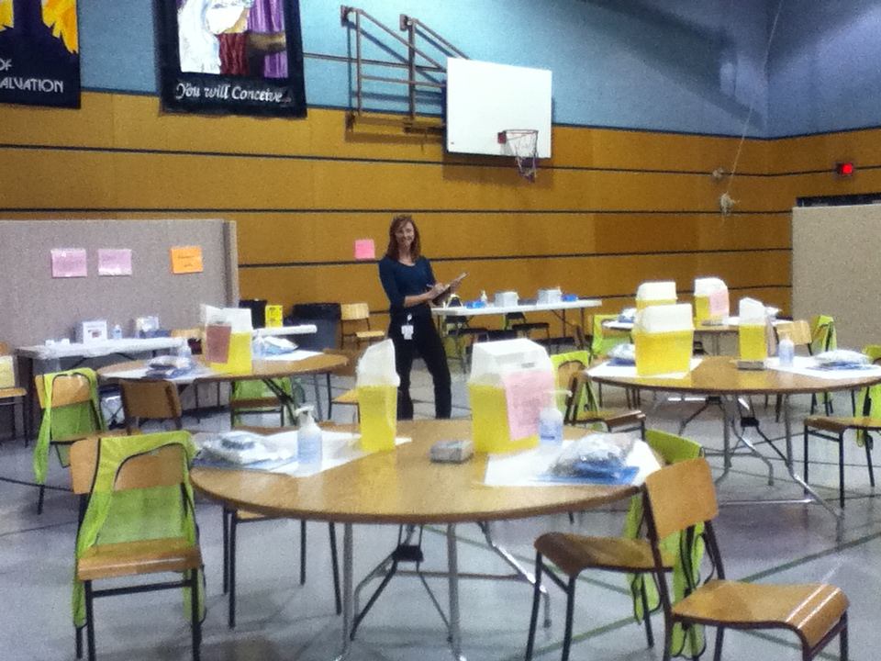
Clinic set up- example ( influenza clinic)

Slide 44
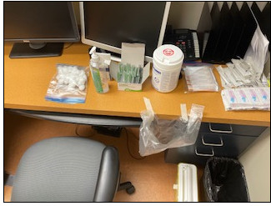
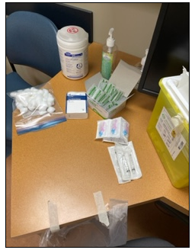
Immunization Station set up example

Slide 45
Immunization Program Contacts
Immunization Manager
Sylvia Camara Taveras 204-430-5740
WRHA CD Coordinators wrhacdcoordinators@wrha.mb.ca

