Slide 1
Packing it in:
Creating a Plan to Quit smoking
https://www.iconfinder.com/icons/3408423/box_inside_item_man_open_product_taking_icon
Notes:
Welcome to Packing It In. My name is Olsen and I will be your speaker for today. My background is I am a Respiratory Therapist working as a Chronic Disease, Management Clinician with My Health Team. My role is to work with patients whose providers have signed on to My Health team to improve their lives by addressing their respiratory issues. Smoking is one such issue and one of the most difficult to deal with. According to the WHO, smoking is the number one cause of preventable death in the world and one of the top 5 causes of premature death. Most people who quit use just stop or go cold turkey, this is the least successful way of quitting. Others use medications which help initially but doesn’t always last. The research shows that combing medications and counselling to be the best way to quit.

Slide 2
Objectives
Benefits of Quitting
Why people smoke
Using the 3 Aspects of quitting to quit and stay quit
Developing a Quit Plan
Resources
Notes:
This presentation will cover the following topics. The goal is to better understand why people smoke and expand your familiarity with non medical strategies to augment your quit attempt

Slide 3
Benefits of Quitting: Toxins and Chemicals
http://www.medicaldaily.com/what-cigarette-chemicals-and-ingredient-list-confirm-how-dangerous-smoking-really-279718
Notes:
As I said earlier, Smoking is the number one cause of preventable death and among the top causes of premature death according to the WHO.
The average cigarette contains upward of 600 different ingredients
When the cigarette is lit it burn creating over 7,000 chemicals.
Of the 7000 chemicals produced from burning, 69 have been found to carcinogenic, that is cancer causing.

Slide 4
Benefit of quiting (Cigars and Pipes)
Large cigars can have as much tobacco as a pack of cigarettes
Contain the most of the 7000 poisonous chemicals as cigarettes
The risk of health problems are the same as those who smoke cigarettes
Notes:
Using tobacco in other forms does not make you sophisticated or reduce your risk of getting diseases associated with tobacco use.

Slide 5
It’s never too late to stop
If you smoke, stopping smoking and avoiding second hand smoke is the best way to reduce the rate of decline in lung function.
Smoking cessation is the only way to stop the damage
Anthonisen NR, et al. JAMA 1994;272(19):1497-505.
Notes:
As we look at this graph the key message is it is never too late to quit. This graph comes from a study by Fletcher. He did a breathing test on all the subjects in this study and created this graph. The red line are those who smoked all their life and the green is those subjects who never smoked. The most interesting line is the dashed line that indicates what happens when someone quits. The follow the same decline as those who never smoked, just at a lower level.
Key Message:
Smoking cessation is the only way to stop the damage
Quitting at any age is helpful

Slide 6
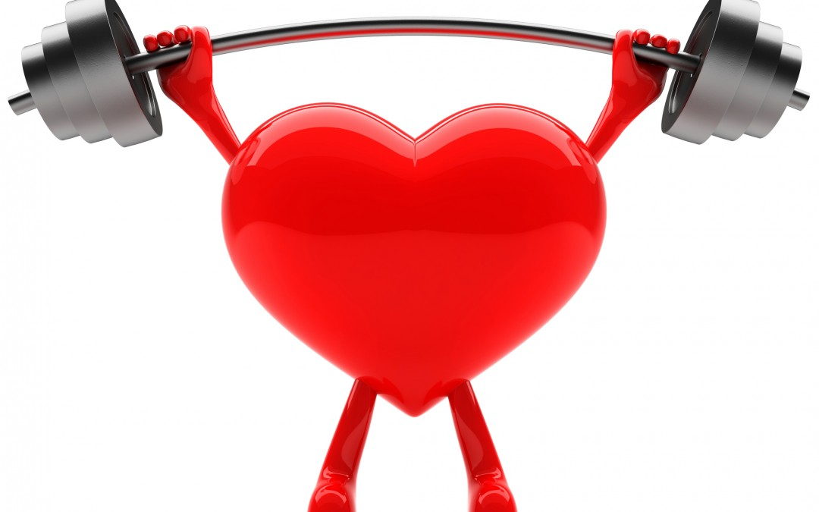
Benefits of Quitting: Health
20 mins:
BP returns to pre-cigarette value
24 hours:
Carbon monoxide levels return to normal
2-3 weeks:
Lung function increases by 30%, Blood flow improves
1st year:
Reduced cough, colds, fatigue, shortness of breath
Risk of heart disease reduced by 50%

Slide 7
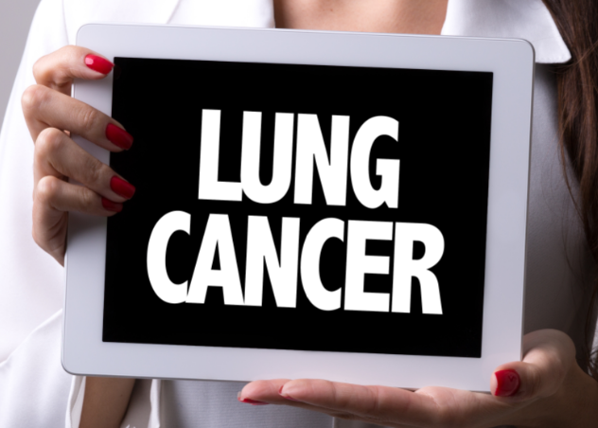
Benefits of Quitting: Health
5 years:
Risk of stroke becomes the same as a non-smoker
10-15 years:
Risk of lung cancer is 50% reduced
Lower risk of other cancers
Heart attack risk is same as non-smoker
The body is an amazing self-healer​

Slide 8
Benefits of Quitting: Social
Better Skin integrity
Less wrinkles
Less sagging
Whiter teeth
Less yellow
Everything smells better
Clothes, hair, breath, car, house,
Longer life
More money
Improves exercise performance
12 hours
Less Carbon Monoxide
Sense of smell improves in 2 days
Food tastes better
Hair
More luminous
Less shedding
Fingers
Finger nails are whiter
Fingers are less cold (due to better circulation)
Notes:
Social Benefits Talk about the different parts of the body and the problems.

Slide 9
Benefits of Quitting: Cost
Cost of a pack X number of packs per day= X
X x 365= Y
Y x years smoked=
Example
Cost 17.55 (526.50/month based on 30 days)
17.55 x 365= $6405.75
$6405,17 x 10 years = 64,057.50
Notes:
Smoking costs 10’s of thousands per year. All for something that will eventually cause premature death.

Slide 10
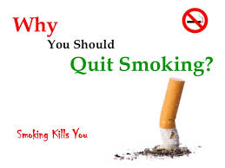
Why people Smoke: Start with Why
What is your purpose, cause or belief?
I want to ____________ ( Goal)
because_______________ (negative effects)
What is the impact?
So that_____________. (the result I want)
Notes:
The first step to quitting is to start with why. This means deciding on a what you want to accomplish, which is usually due to some negative experience you are having or will have in your life. Then ask yourself about the impact on your life when the goal is achieved. It may be necessary to ask yourself about the impact 3 times. The purpose of doing this is to get at the deeper why, some thing you value. Values are important as you tend to prioritize them.

Slide 11
Smoking : What People Say
Smokers Enjoy Smoking
Smokers Choose to smoke
Smoking relieves Boredom
Smoking relieves stress
Smoking Helps with concentration
Smoking is relaxing
Smoking is a habit
It takes will power to quit
Notes:
Now that we have our why, it is important to get rid of some myths we have about smoking. Many of you have most likely heard some of these myths from smokers and non smokers. (Read Myths)

Slide 12
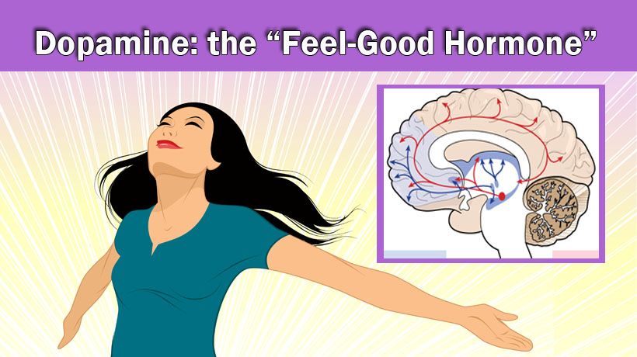
Nicotine and Dopamine
Nicotine gets absorbed in the Mouth and goes to the brain stimulates neurons to release dopamine.
Dopamine makes people feel good.
But you don't need nicotine to get a Dopamine release.
Notes:
Let’s understand what is happening when someone has a cigarette. When the cigarette is inhaled the nicotine is absorbed in the mouth and goes to the brain causing euphoria, pleasant feeling. Some people voiew this feeling as relaxing but studies on blood pressure and heart rate show they both rise when taken after a cigarette. So having a cigarette is not relaxing. There is a good feeling but it is not relaxing.

Slide 13
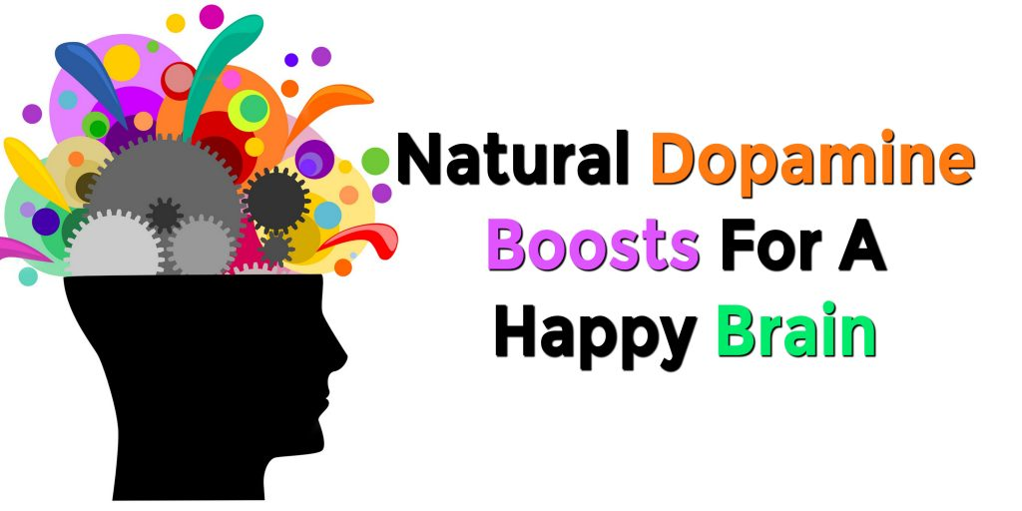
Increasing Dopamine Naturally
Eating well
Getting some sunlight
Doing something you enjoy, Watching Sports or Participate in any physical activity
Deep breathing or meditation
Helping people
Learning something new
Notes:
The good news is there are natural ways of raising your dopamine. The rise is not as high as a cigarette, but it will raise them when they are low.
Diet
Will give you the building blocks for dopamine (phenylalanine and tyrosine)
Playing and watching Sports
Listening or playing music
Making Crafts
Doing Hobbies
Helping people
Learning something new.
Foods
Almonds, avocado, banana, beets, green leafy veges, green tea lime beans, oregano, peanuts, rosemary, sesame and pumpkin seeds, turmeric and watermelon
Healthy intestinal flora
(86 billion neurons. They communicate using neurotransmitters In charge of pleasure reward symptoms)
Healthy
Exercise, walks, yoga, taichi, sunlight, meditation, hobbies, music playing or listening, touch massage, touching pets, cold shower or cold blast at the end of a shower

Slide 14
Is it A Habit or Addiction?
It is both. Addition because a person always feels they need it and when they don’t have it they experience with drawal.
A habit can be good or bad but they are also repetitive and automatic
Notes:
Is smoking a habit or an Addiction?
An addiction is a
compulsive need for and use of a habit-forming substance (such as heroin, nicotine, or alcohol) characterized by tolerance and by well-defined physiological symptoms upon withdrawal
Habit is a settled or regular tendency or practice. It is learned
an acquired mode of behavior that has become nearly or completely involuntary mariam-Webster
Give brushing teeth example.
Most people say it is both
Compulsive need for and use of a habit-forming substance (such as heroin, nicotine, or alcohol) characterized by tolerance and by well-defined physiological symptoms upon withdrawal
A habit is a behavior pattern acquired by frequent repetition or physiologic exposure that shows itself in regularity or increased facility of performance.
https://designtaxi.com/news/388604/infographic-addiction-vs-habit-recognizing-the-dangers/

Slide 15
Smoking Truths
Smokers don’t choose to smoke, they smoke to satisfy a nicotine addiction
It is not just a habit but also an addiction
When someone stops smoking there are a lot of physical sensations
Willpower method which makes them feel like are giving up something
Has not proven to be successful because you did not change your mind
Bored could be due to lack of energy
Increased carbon monoxide levels reduces the ability of the blood to carry oxygen
Notes:
From Allan Carr

Slide 16
Smoking Truths
Doesn’t relieve stress
Heart rate and Blood pressure go up when a cigarette is consumed
Concentration is only improved because the distracting thoughts of having a cigarette are gone when you having a cigarette
Does not cause relaxation
Nicotine is a stimulant and smokers connect the feeling of pleasure from the release of dopamine as relation

Slide 17
The 3 Aspects of Quitting Smoking
Physical
Environmental
Social-Emotional
Notes:
In order to quit 3 aspects must be addressed. The physical or biological, Environmental and Behavioral. Let’s look at each one separately them show how they can be part of your quit plan.

Slide 18
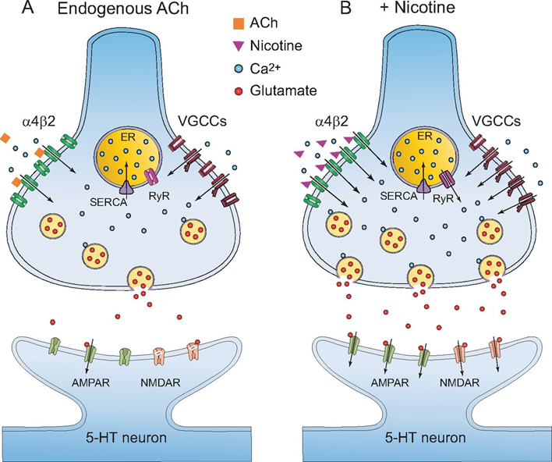
Physical
Related to:
The rate the body metabolizes nicotine
The number of dopamine receptors
Sensitivity of those receptors
Ongoing use
creates a tolerance only satisfied through increased use
Notes:
We are all genetically different. Some people can just put down a cigarette and quit for good. Others need to try up to 10 times. This is because the receptors in our brain may be higher in number or more sensitive. Also some people metabolize nicotine faster. The end result is more nicotine is needed to keep the receptors happy and prevent cravings. The problem then becomes increased use causes tolerance. To address these physical inequities, genetic differences, medications are suggested as part of a quit plan.

Slide 19
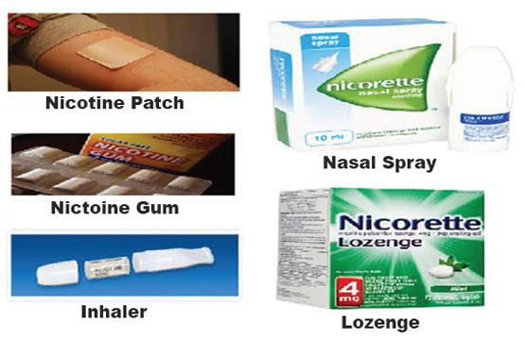
Treating the Physical: Tobacco Reduction Aids
Pharmacological based
Nicotine Replacement Therapy (NRT):
Gum, Lozenge, Patch, Spray, Inhaler
Varencline (Champix)
Bupropion (brands: Zyban, Wellbutrin)
E-cigarettes: NOT RECOMMENDED BY FDA!!!!
Non-Pharmacological & alternative based
Hypnosis
Meditation
Acupuncture
Notes:
** E-Cigarettes will be on their own slide
Cessation aids are meant to be supportive – reduce cravings and withdrawal symptoms (or their severity), increase your chances of success through altered delivery speed of nicotine, & wean you from the physical addiction to nicotine.
Those who use aids increase their chances of success 2-3x depending on aid, combination of aids, compared to cold turkey. Success is increased if readiness is high, and medication use is combined with behavior/lifestyle and environment changes.

Slide 20
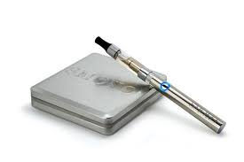
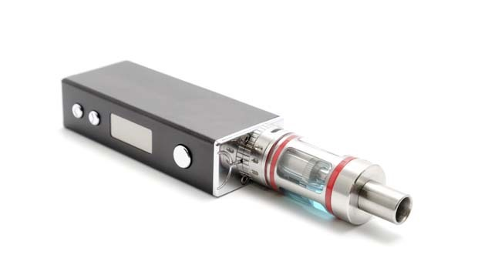
E-Cigarettes
Vaping and quitting
Vape only
Vape and smoke
Go back to smoking
A minority quit
Use it with the intention to quit
Not Recommended
Safety of Vaping:
Heating liquid produces more carcinogens
Safety not established
Seems safer than smoking
Not Recommended
Notes:
People who use vaping to quit fall into one of 4 categories. (describe the 4 categories) So most don’t quit. Also the quit rates are not any better than using NRT, which we know are safe. Some issues associated with Vaping are listed.

Slide 21
Nicotine Side effects
Digestive
excess saliva in the mouth
feeling nauseous
stomach ache
vomiting
loss of appetite
dehydration
Breathing
cough
rapid breathing
Nervous System
eye irritation
headache
dizziness
tremors
anxiety and restlessness
confusion
sweating
Heart
increased heart rate
elevated blood pressure
From: https://www.medicalnewstoday.com/articles/319627.php
Notes:
Sometimes when you are using Nicotine Replacement Therapy. You can get some side effects of nicotine. This could mean you are using too high of a dose of the patch, gum or lozenge or using the spray too often.

Slide 22
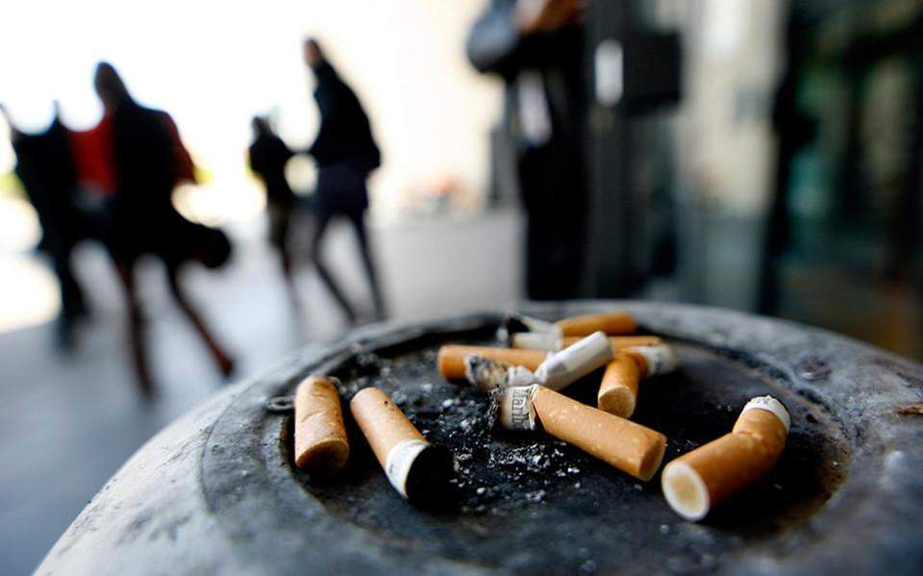
Environmental
What is it:
Exposure from shows, movies, media, tobacco sponsorship, etc
Exposure from parents/family, friends
Location where you currently smoke
Other substance use
Stresses in life( Job, income, relationships)
Chronic Health Issues
Notes:
Review statements

Slide 23
Treating the Environmental
How to Quit Smoking in Different Environments:
Spend more time in places where smoking is not allowed
Decide on personal spaces where you will not smoke (car, home, cabin)
Decide on a plan for encountering people who are smoking
Decide who to spend more time with or less time
Decide on what to do with other substance use
Make the environment difficult to smoke
Take care of Health Issues
Notes:
Review Statements

Slide 24
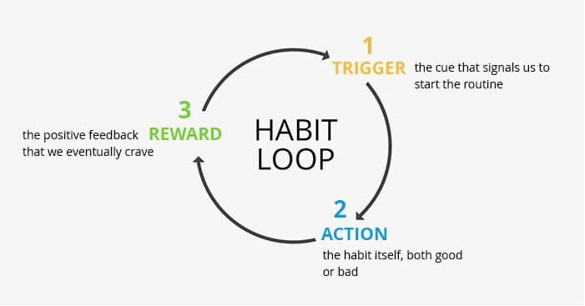
The Habit Loop
Notes:
Environment change allows you to break the habit loop. (From Charles Duhigg author of the Habit loop.) The Habit loop has 3 parts, a trigger, an action and a reward. This process is usually mindless, that is involves no thinking. It is hard to get rid of the trigger because they usually appear without our influence. The part of the Habit Loop that we have control of is our reaction to the trigger, that is the action part of the Habit Loop. If we change our environment by removing items that don’t support habits we want to continue and include items that support habits we want to continue, a new habit can be broken, and a new one developed.
Give brushing your teeth example. With the empty toothpaste
Habits are difficult to get rid of but can be replaced. The key is to leave the cue and change the action or the response to the cue. The new or replacement action needs to have a reward. Keep in mind the reward should be as a result of the new activity, not external. For example if your substitute activity is going for a walk, celebrate that you have done this new activity, not that you have missed a smoke as smoking will soon not be part of your life.

Slide 25
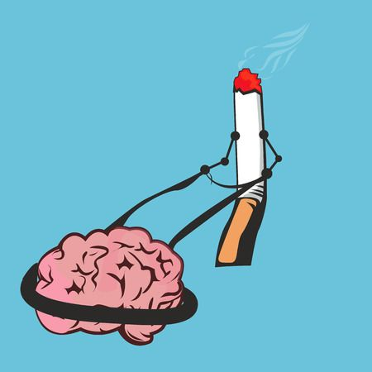
Social-Emotional
Related to:
Emotions
Happy
Sad
Mad
Bored
Reaching a goal
New
Behavior
Notes:
These are the cigarettes associated with emotions and reaching a goal. In order to get rid of these cigarettes it is necessary to change the routines with new behaviors To change routines we must recognize the trigger, break the habit loop and engage with the new behavior. If breaking the habit loop is difficult then we will need to engage in Mindfulness. The reward of any new habit should be inherent in the activity. It requires a celebration of doing the new activity not missing a cigarette.

Slide 26
Treating the Social Emotional With Behavior Change
Craving Tracking
8 Ways to
Manage Your Cravings
https://www.mondaycampaigns.org/quit-stay-quit/8-ways-conquer-mindless-smoking-triggers-monday
Notes:
If you are not sure of your triggers, Pack or Craving tracking can help you discover them. After a few days of pack tracking, you can probably identify trends in times of day, activities or feeling that prompt your cigarette use. This information can help with behavior changes, that may work best in a specific situation. For example if you choose to do coloring as a new behavior, it may not work as well when you are driving.

Slide 27
Craving Tracking
Track cravings
Where were you?
Who are you with?
When did it happen?
What was happening?
Describe mood.
Rate it: good or bad
Did you beat the craving or give in?
What did you do to avoid the cigarette?
https://www.mondaycampaigns.org/quit-stay-quit/quit-smoking-great-american-smokeout-stay-quit-mondays
Notes:
The basis of pack tracking is based on CBT behavior change. Answering these questions will help show a pattern of behavior and allow discussion on the best behaviors to insert to replace smoking. Suggest starting with changing the morning routine to avoid the first cigarette of the day. If the first cigarette of the day is not a problem then ask the patient which cigarette he/she would like to replace. Goal replace at least one cigarette per day until next appointment. Also they should do pack tracking for next appointment

Slide 28
Creating a Habit Loop
Steps for Creating a Habit Loop
Environment Change
Decide where to store cigarette and lighter separately?
Biological
Decide if you will use medications. Which ones. Learn how to use.
Behavior Change
Decide on new behaviors to do that will replace smoking.
Decide on how you will celebrate
Create new routine
Notes:
Now it is time to create your Habit Loop. Your EBB Plan.
First, Decide on environment changes you will make, places where you will quit, separating cigarettes and lighter, people you will spend more time with
Second decide will I use medications, which ones and how much you will need to talk with you smoking cessation advisor,
Third decide on new behaviors you will start doing instead of smoking
Forth decide on how you will celebrate

Slide 29
Increasing Your Success
Mindfulness – Mindful Smoking
Reducing other substance use; Alcohol, Cannabis, Caffeine
Drinking more water
Exercising more
Eat more Vegetables
Notes:
These are some ways to increase your success when trying to quit smoking. In fact, people who reduce, other substance use (Alcohol, Cannabis, Caffeine), exercising more, eat more Vegetables have been shown to have more success quitting.

Slide 30
Creating a Habit Loop
Steps for Dealing with a Craving
Acknowledge The Craving
Remember your why statement
Go perform your new action instead of having a cigarette?
Celebrate you did the new action
Allow your body to experience the craving
Notes:
Now that you know 2 ways to break the Habit Loop, Changing your Environment and performing a new behavior, it is time for you to create one. When a craving happens, first acknowledge it, allow you body to feel it, name the thoughts and feelings, comfort your self. Then go perform you new action. Then reward your self. Rewards should not be another behavior, especially an addictive one. It should be inherent in the activity. Develop a way to celebrate when something good happens. This should involve your 5 senses. Look at art, give yourself a cheer, smell a favorite fragrance, do a dance or raise your hands clinch your fists. Combine them.

Slide 31
Nicotine Withdrawal Symptoms
What to do:
Thirst – change in saliva stimulation ; drinking water will help flush toxins
Hunger – cigarettes are an appetite suppressant – be prepared with healthy options
Cough – normal & positive – your lungs are getting rid of “gunk”
Mood swings - from the changes in Dopamine stimulation
Coffee/Caffeine! Reminder!!!! – as you cut back cigarettes, you become more sensitive to caffeine, which can feel similar to nicotine withdrawal
Notes:
You may experience these symptoms so here are some strategies to overcome them. These are happening because your dopamine levels are low. If you allow them and comfort yourself they will go away and come bac less often and less frequently.

Slide 32
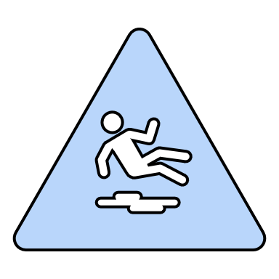
Dealing with a Slip/Relapse
What to do:
Put out the cigarette as soon as possible
Remove yourself from the situation
Consult your “Quit Plan”
Call/Text your support person
Review your behavior change options
Practice Acknowledge, Allow, Comfort
Remember: YOU ARE HUMAN! Don’t let one day, one cigarette define you – a slip does NOT make you a smoker again
Notes:
A slip does NOT have to bee seen as a negative. Actually this is the situation where many patients have told me they realize they don’t like the smell of burning feeling of smoking. So what should you do?

Slide 33
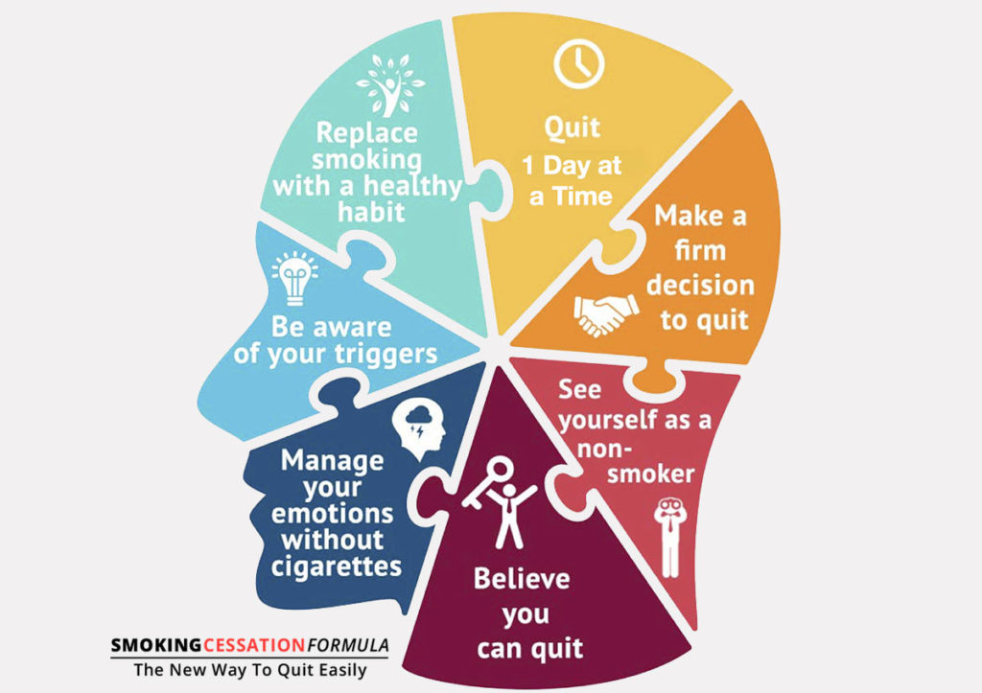
Developing Your Quit Plan:
Decide on why quitting smoking is important
Create a Habit Loop to deal with your cravings
Set a date when you will start to quit
Notes:
Now you are ready to create your plan of action.
First complete the pack tracking sheet, if you need to find out what your triggers or cues for smoking.
Create your Habit Loop.
Then choose a date to start replacing the activity with smoking.

Slide 34
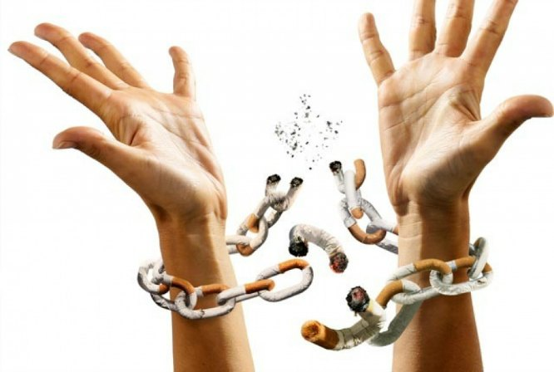
Resources
Smoking Cessation Apps
Websites
Smokers Helpline
Commit to Quit
One to one follow up

Slide 35
Smoking Cessation Apps
Best apps for quitting https://phandroid.com/best-apps-to-quit-smoking/
Easy Quit https://play.google.com/store/apps/details?id=com.herzberg.easyquitsmoking
Monitor your progress https://goo.gl/images/9QvHbq
CBT Diary
https://play.google.com/store/apps/details?id=pl.com.continuum.cbtbasicemotionsdiary&hl=en_CA
CBT Journal https://play.google.com/store/apps/details?id=com.zakaria_houssam.journalcbt&hl=en_CA
Calculator https://goo.gl/images/kMZTwz
Tracker https://goo.gl/images/nsVqgN
Apps should
Track cravings
Track cigarettes smoked
Track intervention used
Calculate some benefit money saved, health risks reduced, cigarettes not smoked or avoided
Have motivation option (nice to have)

Slide 36
Websites
WRHA Tobacco Reduction Webpage http://www.wrha.mb.ca/community/publichealth/services-tobacco-reduction.php
Smokers Helpline https://www.smokershelpline.ca
Eat more move more Quit Now https://www.eatsmartmovemorenc.com/NCHealthSmartTlkt/QuitNowWrkBk.html
Quit smoking calculator online https://www.calculators.org/health/quit-smoking.php
Smoking and the body https://www.nhs.uk/smokefree/why-quit/smoking-health-problems
Manitoba Quits Facebook Group
Break it Off: A website and app aimed towards young adults. www.breakitoff.ca
Walk or Run to Quit: An innovative program where participants of all ages and fitness levels learn to walk or run 5 KM while receiving practical support on quitting smoking. Successfully quitting for 5 weeks could make the participant eligible to win $1000. Register at www.runtoquit.com

Slide 37
Group Programs and Counseling
Packing it In: January, February and March
Smokers helpline 1-877-513-5333
Smoking Cessation counseling
One to one for My Health Team patients

Slide 38
Thank You for Listening
Doc Mike Evans
https://youtu.be/z16vhtjWKL0

Slide 39
Feedback Survey and Questions
We are interested in your feedback on this recorded presentation. Please click on the link below this video to complete a short survey.
For information on other programs you can take, please see the Health Management Group Programs Guide at wrha.mb.ca/groups.
If you have questions about anything discussed, please see the Guide for a live session to attend, or contact the health professional that referred you to this program. You can also ask questions of your doctor or other regular healthcare provider.

